Slide 1
The American Diabetes Association’s Standards of Care in Diabetes—2026
This slide deck contains content created, reviewed, and approved by the American Diabetes Association® (ADA). You are free to use the slides in presentations without further permission as long as the slide content is not altered in any way and appropriate attribution is made to the ADA (the ADA's name and logo on the slides constitutes appropriate attribution). Permission is required from the ADA for any commercial use or for reproduction in any print materials (contact permissions@diabetes.org).

Slide 2

Standards of Care in Diabetes—2026 (Standards of Care)

Slide 3
Standards of Care in Diabetes—2026
Intended to provide clinicians, patients, researchers, payers, and other interested individuals with the components of diabetes care, general treatment goals, and tools to evaluate the quality of care.

Slide 4



Search of scientific diabetes literature over past year
Recommendations revised per new evidence
EVIDENCE
Professional Practice Committee
External peer review
Reviewed by the ADA’s Board of Directors
Living Standards
PROCESS
Funded out of the ADA’s general revenues
Does not use industry support
FUNDING

Slide 5
The ADA’s Standards of Care—a Living Document
Beginning with the ADA’s 2018 Standards of Care in Diabetes, the Standards document became a “living” document where notable updates are incorporated
A description of the Living Standards updates is available at professional.diabetes.org/standards-of-care/living-standards-update

Slide 6
The ADA’s Standards of Care—a Living Document
Updates will be made in response to important events inclusive of, but not limited to:
Approval of new treatments (medications or devices) with the potential to impact care;
Publication of new findings that support a change to a recommendation and/or evidence level of a recommendation; or
Publication of a consensus document endorsed by the ADA that necessitates an update of the Standards to align content of the documents

Slide 7
Evidence-Grading System

Slide 8
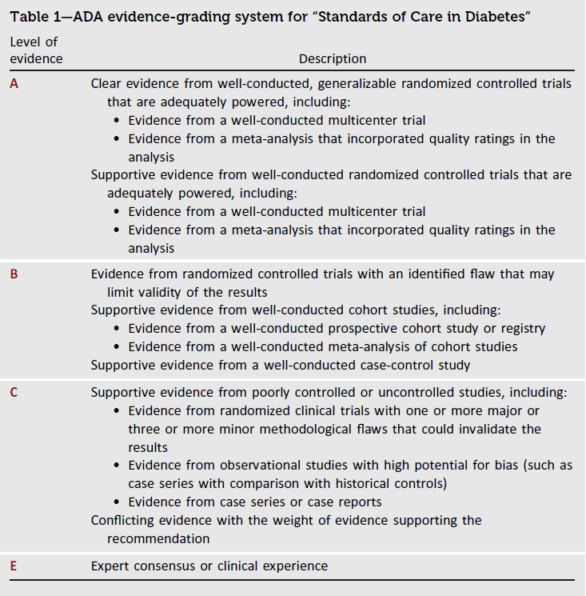
Evidence-Grading System
Introduction: Standards of Care in Diabetes - 2026. Diabetes Care 2026;49(Suppl. 1):S1-S5

Slide 9
Table of Contents

Slide 10
Table of Contents
Improving Care and Promoting Health in Populations
Diagnosis and Classification of Diabetes
Prevention or Delay of Diabetes and Associated Comorbidities
Comprehensive Medical Evaluation and Assessment of Comorbidities
Facilitating Positive Health Behaviors and Well-being to Improve Health Outcomes
Glycemic Goals, Hypoglycemia, and Hyperglycemic Crises
Diabetes Technology
Obesity and Weight Management for the Prevention and Treatment of Diabetes
Pharmacologic Approaches to Glycemic Treatment
Cardiovascular Disease and Risk Management
Chronic Kidney Disease and Risk Management
Retinopathy, Neuropathy, and Foot Care
Older Adults
Children and Adolescents
Management of Diabetes in Pregnancy
Diabetes Care in the Hospital
Diabetes and Advocacy

Slide 11
Section 1. Improving Care and Promoting Health in Populations
(https://doi.org/10.2337/dc26-S001)

Slide 12
Diabetes and Population Health
1. Improving Care and Promoting Health in Populations
1.1 Ensure treatment decisions are timely, rely on evidence-based guidelines, address social determinants ofhealth, and incorporate shared decision-making based on individual values, preferences, prognoses,comorbidities, and informed financial considerations. B
1.2 Align approaches to diabetes management with evidence-based care models. These models emphasize person-centered team care, integrated long-term treatment approaches to diabetes and comorbidities, and ongoing collaborative communication and goal setting among all team members and with people with diabetes. A
1.3 Care systems should facilitate in-person and virtual team-based care, include those knowledgeable and experienced in diabetes management as part of the team, and utilize patient registries, decision support tools, proactive care planning, and community involvement to meet needs of individuals with diabetes. B
1.4 Assess diabetes management, risk factors, and complications using reliable and relevant data metrics to improve processes of care and health outcomes, with attention to individual values, preferences, goals for care, and treatment burden including costs of care. B
1.5 Health systems should adopt a culture of continuous quality improvement, implement benchmarking programs, and engage interprofessional teams to support sustainable and scalable process changes to improve quality of care and health outcomes. A

Slide 13
Tailoring Treatment for Social Context
1. Improving Care and Promoting Health in Populations
1.6 Health systems should assess and address gaps in diabetes care and health outcomes (e.g., by stratifying clinical quality data by factors such as insurance status, race, ethnicity, preferred language for health care discussions, disability, and social determinants of health). B
1.7 During clinical encounters, assess for social determinants of health, including food insecurity, A housing insecurity, financial barriers, health insurance and health care access, environmental and neighborhood factors, and social capital/social community support, B to inform treatment decisions, with referral to appropriate local community resources.
1.8 Provide people with diabetes additional self-management support from lay health coaches, navigators, or community health workers when available. A Digital self-management tools or coaches may be considered as appropriate. B
1.9 Consider the involvement of community health workers to support management of diabetes and cardiovascular and kidney risk factors, especially in underserved communities and health care systems. B

Slide 14
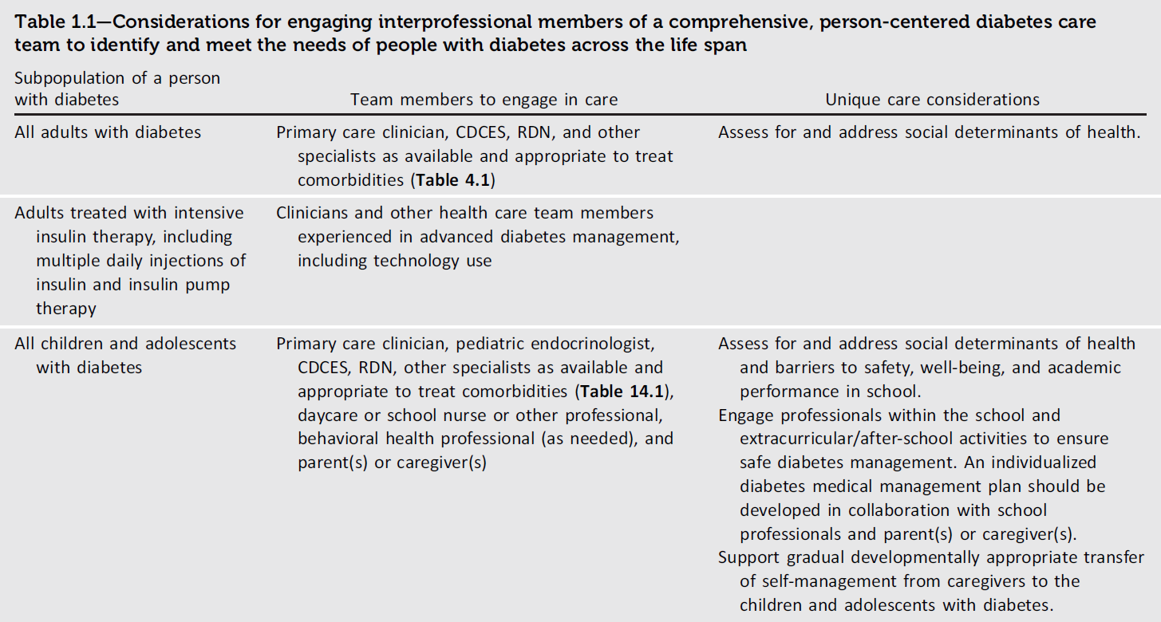
1. Improving Care and Promoting Health in Populations
Table 1.1
Improving Care and Promoting Health in Populations: Standards of Care in Diabetes - 2026. Diabetes Care 2026;49(Suppl. 1):S13-S26

Slide 15
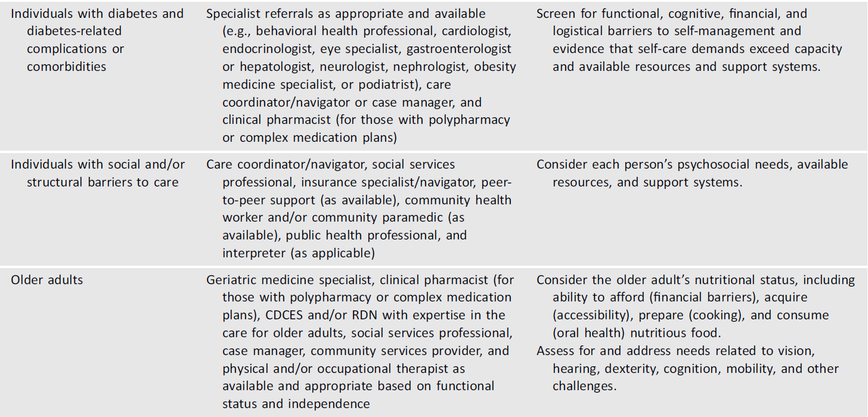
1. Improving Care and Promoting Health in Populations
Table 1.1 (continued)
Improving Care and Promoting Health in Populations: Standards of Care in Diabetes - 2026. Diabetes Care 2026;49(Suppl. 1):S13-S26

Slide 16
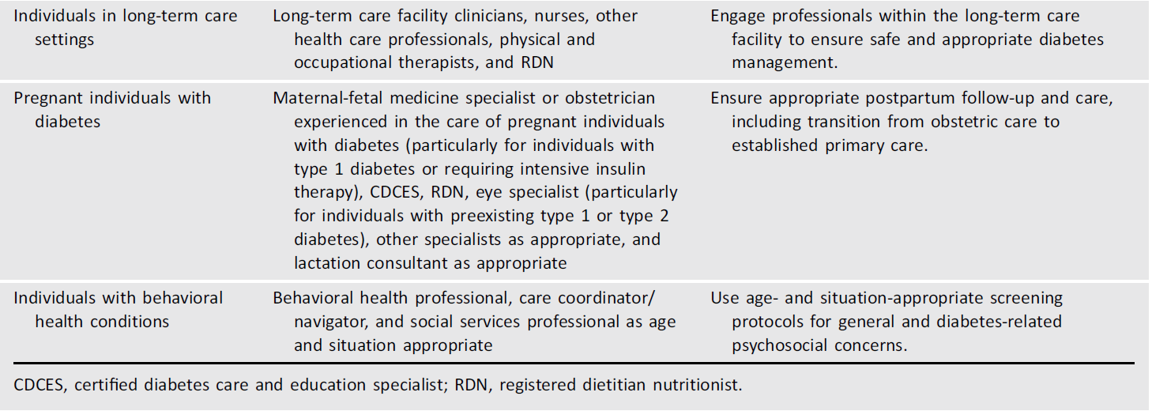
Table 1.1 (continued)
1. Improving Care and Promoting Health in Populations
Table 1.1
Improving Care and Promoting Health in Populations: Standards of Care in Diabetes - 2026. Diabetes Care 2026;49(Suppl. 1):S13-S26

Slide 17
Section 2. Diagnosis and Classification of Diabetes
(https://doi.org/10.2337/dc26-S002)

Slide 18
Diagnostic Tests for Diabetes
2. Diagnosis and Classification of Diabetes
2.1a Diagnose diabetes based on A1C or plasma glucose criteria. Plasma glucose criteria include either fasting plasma glucose (FPG), 2-h plasma glucose (2-h PG) during a 75-g oral glucose tolerance test (OGTT), or random glucose accompanied by classic hyperglycemic symptoms or crises (Table 2.1). B
2.1b In the absence of unequivocal hyperglycemia (e.g., hyperglycemic crises), diagnosis requires confirmatory testing (Table 2.1). B

Slide 19
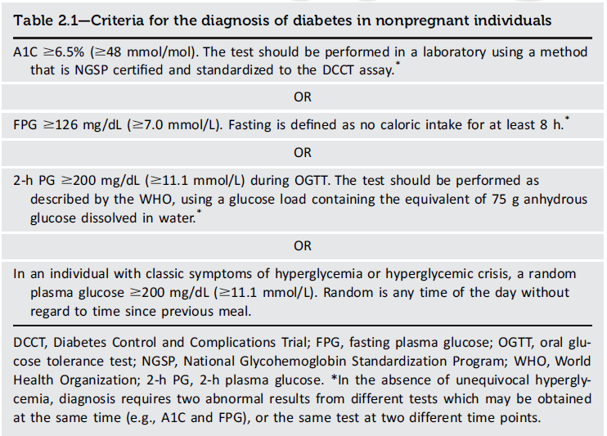
2. Diagnosis and Classification of Diabetes
Table 2.1
Diagnosis and Classification of Diabetes: Standards of Care in Diabetes - 2026. Diabetes Care 2026;49(Suppl. 1):S27-S49

Slide 20
Use of A1C for Screening and Diagnosis of Diabetes
2. Diagnosis and Classification of Diabetes
2.2a The A1C test should be performed using a method that is certified by the National Glycohemoglobin Standardization Program (NGSP) as traceable to the Diabetes Control and Complications Trial (DCCT) reference assay. B
2.2b Point-of-care A1C testing for diabetes screening and diagnosis should be restricted to devices approved for diagnosis by the U.S. Food and Drug Administration at Clinical Laboratory Improvement Amendments–certified laboratories that perform testing of moderate complexity or higher by trained personnel. B
2.3 Evaluate for the possibility of a problem or interference with either test when there is consistent and substantial discordance between blood glucose values and A1C test results. B
2.4 In conditions associated with an altered relationship between A1C and glycemia, such as some hemoglobin variants, pregnancy, glucose-6-phosphate dehydrogenase deficiency, HIV, and conditions that may alter red blood cell turnover, plasma glucose criteria should be used to diagnose diabetes. B

Slide 21
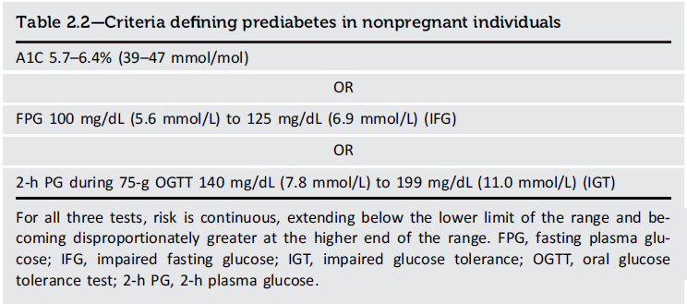
2. Diagnosis and Classification of Diabetes
Table 2.2
Diagnosis and Classification of Diabetes: Standards of Care in Diabetes - 2026. Diabetes Care 2026;49(Suppl. 1):S27-S49

Slide 22
Classification
2. Diagnosis and Classification of Diabetes
2.5 Classify people with hyperglycemia into appropriate diagnostic categories to aid in personalized management. E

Slide 23
Classification (continued)
2. Diagnosis and Classification of Diabetes
Type 1 diabetes (due to autoimmune β-cell destruction, usually leading to absolute insulin deficiency, including latent autoimmune diabetes in adults)
Type 2 diabetes (due to a nonautoimmune progressive loss of adequate β-cell insulin secretion, frequently on the background of insulin resistance)
Specific types of diabetes due to other causes, e.g., monogenic diabetes syndromes, diseases of the exocrine pancreas, and drug- or chemical-induced diabetes
Gestational diabetes mellitus (diabetes diagnosed in the second or third trimester of pregnancy that was not clearly overt diabetes prior to gestation or other types of diabetes occurring throughout pregnancy, such as type 1 diabetes)

Slide 24
Type 1 Diabetes
2. Diagnosis and Classification of Diabetes
2.6 Screen for presymptomatic type 1 diabetes by testing autoantibodies: insulin (IA), glutamic acid decarboxylase (GAD), islet antigen 2 (IA-2), or zinc transporter 8 (ZnT8). B
2.7 Autoantibody-based screening for presymptomatic type 1 diabetes should be offered to those with a family history of type 1 diabetes or otherwise known elevated genetic risk. B
2.8a Individuals with screening results positive for one or more islet autoantibodies should be evaluated for stage 3 (overt) type 1 diabetes (using A1C, urinalysis, and/or plasma glucose), which would require prompt clinical management and education. B
2.8b Individuals with multiple confirmed islet autoantibodies and without overt type 1 diabetes have a high risk for progression to stage 3 type 1 diabetes and should be referred to a specialized center for metabolic staging (Table 2.4), education, and consideration of prevention trials or approved treatments (e.g., teplizumab). E

Slide 25
Type 1 Diabetes (continued)
2. Diagnosis and Classification of Diabetes
2.9 Individuals with a single confirmed IA-2 autoantibody should be monitored similarly to individuals with multiple islet autoantibodies, as IA-2 autoantibody positivity is an independent risk factor for progression. B Individuals with a single confirmed islet autoantibody should undergo repeat antibody testing every 6 months to 3 years (depending on age) to assess for persistence or seroconversion. E
2.10 Standardized islet autoantibody tests are recommended for classification of diabetes in adults who have phenotypic risk factors that overlap with those for type 1 diabetes (e.g., younger age at diagnosis, unintentional weight loss, ketoacidosis, or short time to insulin treatment). E

Slide 26
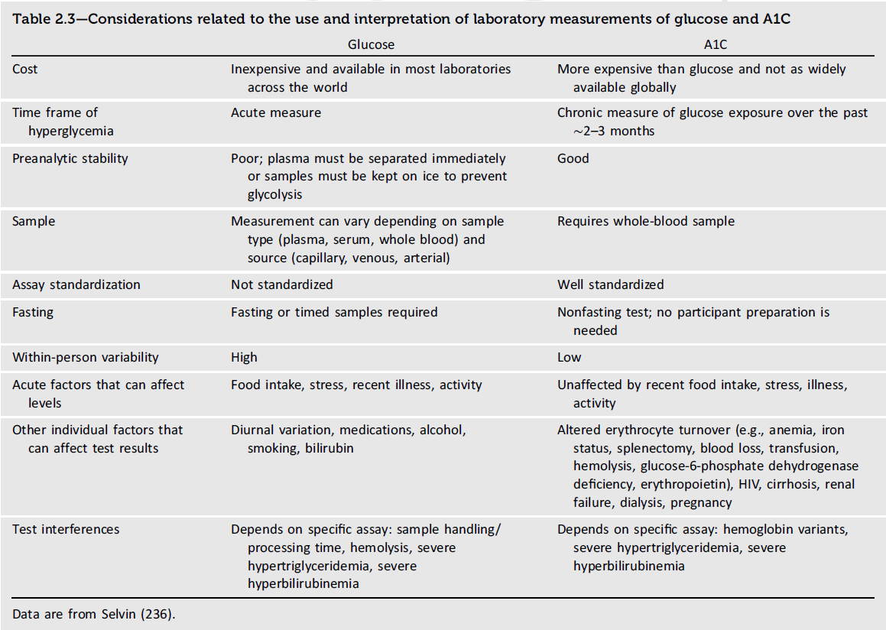
2. Diagnosis and Classification of Diabetes
Table 2.32
Diagnosis and Classification of Diabetes: Standards of Care in Diabetes - 2026. Diabetes Care 2026;49(Suppl. 1):S27-S49

Slide 27
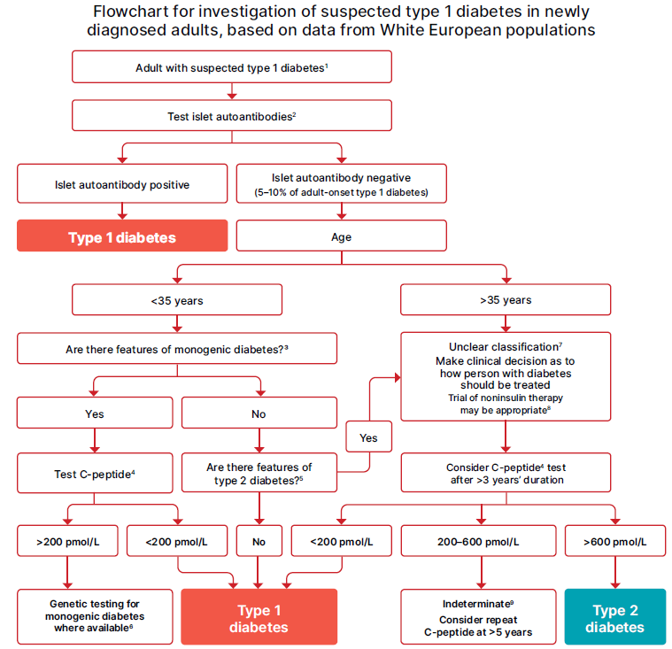
2. Diagnosis and Classification of Diabetes
Figure 2.1
Diagnosis and Classification of Diabetes: Standards of Care in Diabetes - 2026. Diabetes Care 2026;49(Suppl. 1):S27-S49
Notes:
Figure 2.1—Flowchart for investigation of suspected type 1 diabetes in newly diagnosed adults, based on data from White European populations.^1 No single clinical feature confirms type 1 diabetes in isolation.^2 Glutamic acid decarboxylase (GAD) should be the primary antibody measured and, if negative, should be followed by islet tyrosine phosphatase 2 (IA-2) and/or zinc transporter 8 (ZnT8) where these tests are available. In individuals who have not been treated with insulin, antibodies against insulin may also be useful. In those diagnosed at <35 years of age who have no
clinical features of type 2 diabetes or monogenic diabetes, a negative result does not change the diagnosis of type 1 diabetes, since 5–10% of people with type 1 diabetes do not have antibodies.^3 Monogenic diabetes is suggested by the presence of one or more of the following features: A1C <58 mmol/mol (<7.5%) at diagnosis, one parent with diabetes, features of a specific monogenic cause (e.g., renal cysts, partial lipodystrophy, maternally inherited deafness, and severe insulin resistance in the absence of obesity), and monogenic diabetes prediction model probability >5%
(diabetesgenes.org/exeter-diabetes-app/ModyCalculator).^4 A C-peptide test is only indicated in people receiving insulin treatment. A random sample (with concurrent glucose) within 5 h of eating can replace a formal C-peptide stimulation test in the context of classification. If the result is ≥600 pmol/L (≥1.8 ng/mL), the circumstances of testing do not matter. If the result is <600 pmol/L (<1.8 ng/mL) and the concurrent glucose is <4 mmol/L (<70 mg/dL) or the person may have been fasting, consider repeating the test. Results showing very low levels (e.g., <80 pmol/L
[<0.24 ng/mL]) do not need to be repeated. Where a person is insulin treated, C-peptide must be measured prior to insulin discontinuation to exclude severe insulin deficiency. Do not test C-peptide within 2 weeks of a hyperglycemic emergency.^5 Features of type 2 diabetes include increased BMI (≥25 kg/m^2), absence of weight loss, absence of ketoacidosis, and less marked hyperglycemia. Less discriminatory features include non-White ethnicity, family history, longer duration and milder severity of symptoms prior to presentation, features of metabolic syndrome, and absence of a family history of autoimmunity.^6 If genetic testing does not confirm monogenic diabetes, the classification is unclear and a clinical decision should be made about treatment.^7 Type 2 diabetes should be strongly considered in older individuals. In some cases, investigation for pancreatic or other types of diabetes may be appropriate.^8 A person with possible type 1 diabetes who is not treated with insulin will require careful monitoring and education so that insulin can be rapidly initiated in the event of glycemic deterioration.^9 C-peptide values 200–600 pmol/L (0.6–1.8 ng/mL) are usually consistent with type 1 diabetes or maturity-onset diabetes of the young but may occur in insulin-treated type 2 diabetes, particularly in people with normal or low BMI or after long duration. Reprinted and adapted from Holt et al. (32).

Slide 28
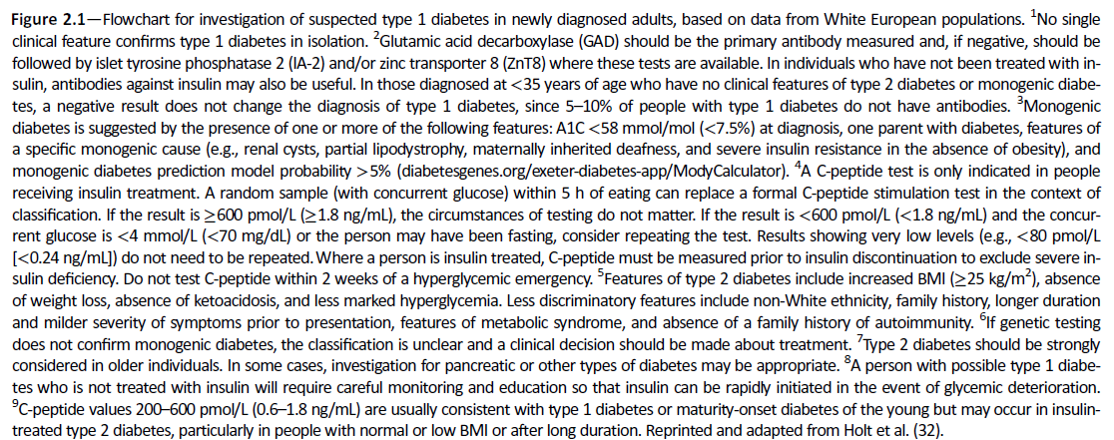
2. Diagnosis and Classification of Diabetes
Figure 2.1 (continued)
Diagnosis and Classification of Diabetes: Standards of Care in Diabetes - 2026. Diabetes Care 2026;49(Suppl. 1):S27-S49
Notes:
Figure 2.1—Flowchart for investigation of suspected type 1 diabetes in newly diagnosed adults, based on data from White European populations.^1 No single clinical feature confirms type 1 diabetes in isolation.^2 Glutamic acid decarboxylase (GAD) should be the primary antibody measured and, if negative, should be followed by islet tyrosine phosphatase 2 (IA-2) and/or zinc transporter 8 (ZnT8) where these tests are available. In individuals who have not been treated with insulin, antibodies against insulin may also be useful. In those diagnosed at <35 years of age who have no
clinical features of type 2 diabetes or monogenic diabetes, a negative result does not change the diagnosis of type 1 diabetes, since 5–10% of people with type 1 diabetes do not have antibodies.^3 Monogenic diabetes is suggested by the presence of one or more of the following features: A1C <58 mmol/mol (<7.5%) at diagnosis, one parent with diabetes, features of a specific monogenic cause (e.g., renal cysts, partial lipodystrophy, maternally inherited deafness, and severe insulin resistance in the absence of obesity), and monogenic diabetes prediction model probability >5%
(diabetesgenes.org/exeter-diabetes-app/ModyCalculator).^4 A C-peptide test is only indicated in people receiving insulin treatment. A random sample (with concurrent glucose) within 5 h of eating can replace a formal C-peptide stimulation test in the context of classification. If the result is ≥600 pmol/L (≥1.8 ng/mL), the circumstances of testing do not matter. If the result is <600 pmol/L (<1.8 ng/mL) and the concurrent glucose is <4 mmol/L (<70 mg/dL) or the person may have been fasting, consider repeating the test. Results showing very low levels (e.g., <80 pmol/L
[<0.24 ng/mL]) do not need to be repeated. Where a person is insulin treated, C-peptide must be measured prior to insulin discontinuation to exclude severe insulin deficiency. Do not test C-peptide within 2 weeks of a hyperglycemic emergency.^5 Features of type 2 diabetes include increased BMI (≥25 kg/m^2), absence of weight loss, absence of ketoacidosis, and less marked hyperglycemia. Less discriminatory features include non-White ethnicity, family history, longer duration and milder severity of symptoms prior to presentation, features of metabolic syndrome, and absence of a family history of autoimmunity.^6 If genetic testing does not confirm monogenic diabetes, the classification is unclear and a clinical decision should be made about treatment.^7 Type 2 diabetes should be strongly considered in older individuals. In some cases, investigation for pancreatic or other types of diabetes may be appropriate.^8 A person with possible type 1 diabetes who is not treated with insulin will require careful monitoring and education so that insulin can be rapidly initiated in the event of glycemic deterioration.^9 C-peptide values 200–600 pmol/L (0.6–1.8 ng/mL) are usually consistent with type 1 diabetes or maturity-onset diabetes of the young but may occur in insulin-treated type 2 diabetes, particularly in people with normal or low BMI or after long duration. Reprinted and adapted from Holt et al. (32).

Slide 29
Prediabetes and Type 2 Diabetes
2. Diagnosis and Classification of Diabetes
2.11 Screening for risk of prediabetes and type 2 diabetes with an assessment of risk factors or validated risk calculator should be done in asymptomatic adults. B
2.12a Testing for prediabetes or type 2 diabetes in asymptomatic people should be considered in adults of any age with overweight or obesity who have one or more risk factors (Table 2.5). B
2.12b For all other people, screening should begin at age 35 years. B
2.12c In people without prediabetes or diabetes after screening, repeat screening recommended at a minimum of 3-year intervals is reasonable, sooner with symptoms or change in risk (e.g., weight gain). C
2.13 To screen for prediabetes and type 2 diabetes, FPG, 2-h PG during 75-g OGTT, and A1C are each appropriate (Table 2.1 and Table 2.2). B

Slide 30
Prediabetes and Type 2 Diabetes (continued)
2. Diagnosis and Classification of Diabetes
2.14 When using OGTT as a screening tool for prediabetes or diabetes, adequate carbohydrate intake (at least 150 g/day) should be assured for 3 days prior to testing. C
2.15 Risk-based screening for prediabetes or type 2 diabetes should be considered after the onset of puberty or after 10 years of age, whichever occurs earlier, in children and adolescents with overweight (BMI ≥ 85th percentile) or obesity (BMI ≥ 95th percentile) and who have one or more risk factors for diabetes. (See Table 2.6 for evidence grading of risk factors.) B
2.16a Consider screening people for prediabetes or diabetes if they are on certain medications, such as statins, thiazide diuretics, and some HIV medications, as these agents are known to increase the risk of these conditions. C
2.16b In people who are prescribed second-generation antipsychotic medications, screen for prediabetes and diabetes at baseline and repeat 12–16 weeks after medication initiation or sooner, if clinically indicated, and annually thereafter. B

Slide 31
Prediabetes and Type 2 Diabetes (continued)
2. Diagnosis and Classification of Diabetes
2.17 People with HIV should be screened for diabetes and prediabetes with an FPG test before starting antiretroviral therapy, at the time of switching antiretroviral therapy, and 3–6 months after starting or switching antiretroviral therapy. If initial screening results are normal, FPG should be checked annually. E
2.18 Monitor postprandial or random glucose levels with recurrent or long-term use of glucocorticoids. B

Slide 32
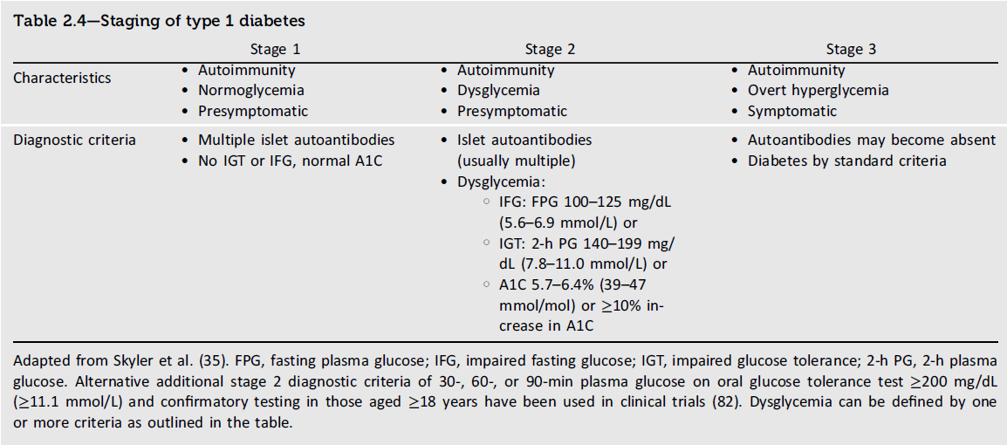
2. Diagnosis and Classification of Diabetes
Table 2.4
Diagnosis and Classification of Diabetes: Standards of Care in Diabetes - 2026. Diabetes Care 2026;49(Suppl. 1):S27-S49

Slide 33
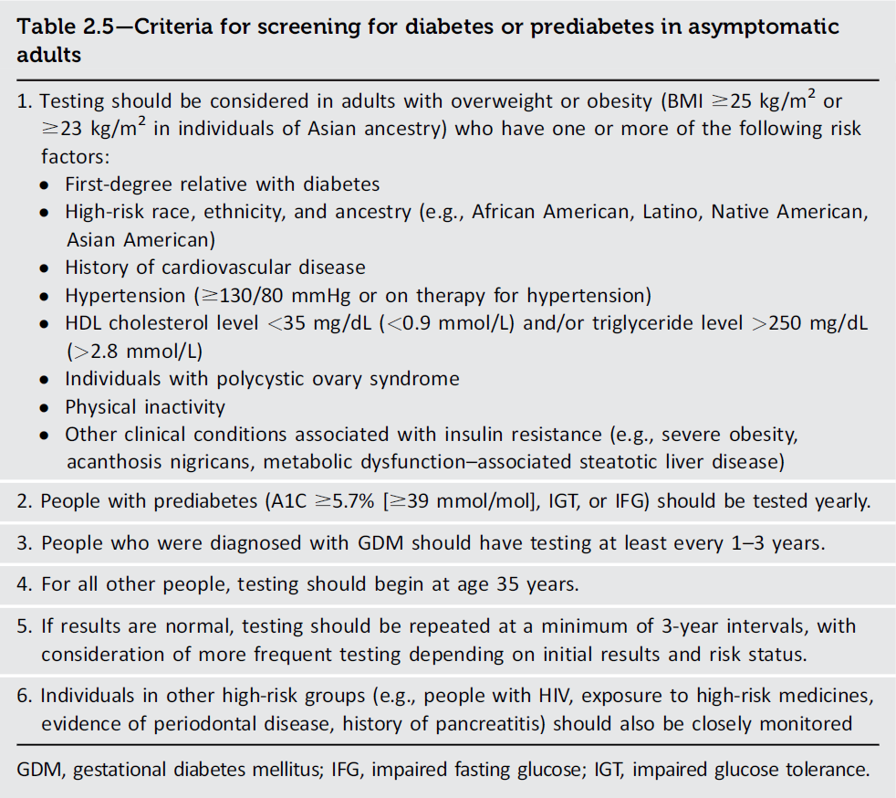
2. Diagnosis and Classification of Diabetes
Table 2.5
Diagnosis and Classification of Diabetes: Standards of Care in Diabetes - 2026. Diabetes Care 2026;49(Suppl. 1):S27-S49

Slide 34
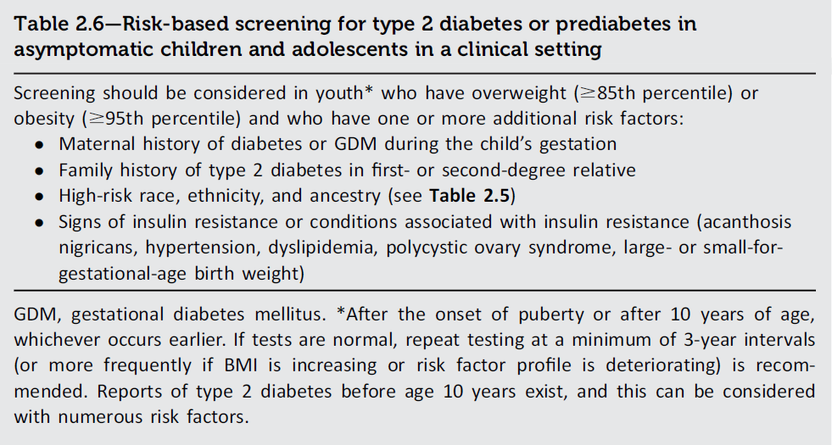
2. Diagnosis and Classification of Diabetes
Table 2.6
Diagnosis and Classification of Diabetes: Standards of Care in Diabetes - 2026. Diabetes Care 2026;49(Suppl. 1):S27-S49

Slide 35
Diabetes Induced by Systemic Anti-Cancer Therapy
2. Diagnosis and Classification of Diabetes
2.19 People starting cancer treatment with immune checkpoint inhibitors (ICI), including anti-PD-1 or anti-PDL-1 therapy (e.g., nivolumab, pembrolizumab, avelumab), phosphoinositidylinositol 3-kinase α (PI3Kα) inhibitors (e.g., alpelisib, inavolisib), or mammalian target of rapamycin (mTOR) inhibitors (e.g., everolimus), should be educated regarding risks, symptoms, and signs of hyperglycemia and hyperglycemic crises. E
2.20 In people treated with ICIs, fasting or random plasma glucose should be tested before initiating treatment, during each visit, or if symptoms and signs of hyperglycemia develop during or after treatment cessation. E
2.21 In people treated with PI3Kα inhibitors, fasting or random plasma glucose and A1C should be tested before initiating treatment, and random plasma glucose should be tested weekly for the first 2 weeks of treatment and then every 4 weeks during treatment. C Consider testing A1C every 3 months during treatment. E
2.22 In people treated with mTOR inhibitors, fasting or random plasma glucose should be tested before starting and at each visit throughout the duration of treatment. Consider testing A1C every 3 months during treatment. C

Slide 36
Pancreatic Diabetes or Diabetes in the Context of the Exocrine Pancreas
2. Diagnosis and Classification of Diabetes
2.23 Screen people for diabetes within 3–6 months following an episode of acute pancreatitis and annually thereafter. Screening for diabetes is recommended annually for people with chronic pancreatitis. E

Slide 37
Cystic Fibrosis-Related Diabetes
2. Diagnosis and Classification of Diabetes
2.24a Annual screening for cystic fibrosis–related diabetes (CFRD) should begin by age 10 years in all people with cystic fibrosis, preferably using OGTT. B
2.24b If an OGTT is not feasible, A1C can be used as an alternative method as part of a two-step screening strategy. Individuals with A1C values between 5.5% and 6.4% (37 and 47 mmol/mol, respectively) should undergo an OGTT within 3 months. C An A1C value of ≥6.5% (≥48 mmol/mol) is consistent with a diagnosis of CFRD. B
2.25 Beginning 5 years after the diagnosis of CFRD, annual monitoring for complications of diabetes is recommended. E

Slide 38
Posttranslplantation Diabetes Mellitus
2.26 After organ transplantation, screening for hyperglycemia should be done. A formal diagnosis of posttransplantation diabetes mellitus (PTDM) is best made once the individual is stable on an immunosuppressive plan and in the absence of an acute infection. B
2.27 The OGTT is the preferred test to make a diagnosis of PTDM. B
2.28 Immunosuppressive plans shown to provide the best outcomes for individuals and graft survival should be used, irrespective of PTDM risk. E

Slide 39
Monogenic Diabetes Syndromes
2. Diagnosis and Classification of Diabetes
2.29a Regardless of current age, all people diagnosed with diabetes in the first 6 months of life should have genetic testing for neonatal diabetes. A
2.29b Children and young adults who do not have typical characteristics of type 1 or type 2 diabetes and have a family history of diabetes in successive generations (suggestive of an autosomal-dominant pattern of inheritance) should have genetic testing for maturity-onset diabetes of the young (MODY). A
2.29c In both instances, consultation with a center specializing in diabetes genetics is recommended to understand the significance of genetic mutations and how best to approach further evaluation, treatment, and genetic counseling. E

Slide 40
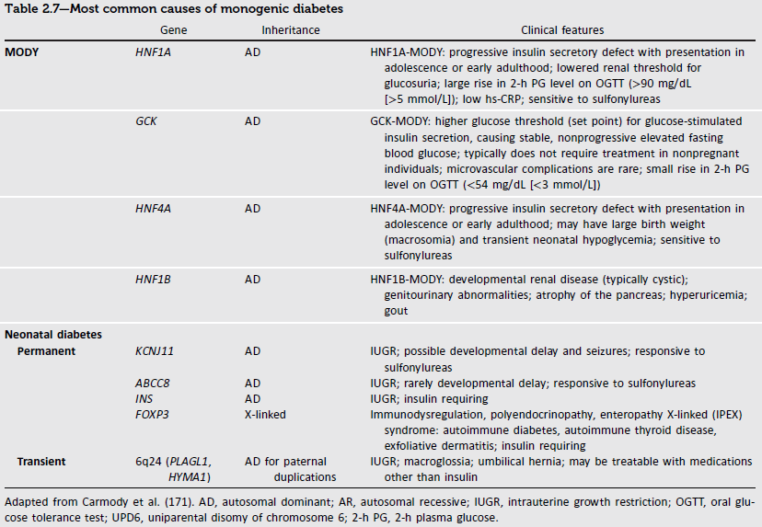
2. Diagnosis and Classification of Diabetes
Table 2.7
Diagnosis and Classification of Diabetes: Standards of Care in Diabetes - 2026. Diabetes Care 2026;49(Suppl. 1):S27-S49

Slide 41
The Diagnosis of Monogenic Diabetes
2. Diagnosis and Classification of Diabetes
The diagnosis of monogenic diabetes should be considered in children and adults diagnosed with diabetes in early adulthood with the following findings:
Diabetes diagnosed within the first 6 months of life
Diabetes without typical features of type 1 or type 2 diabetes (negative diabetes-associated autoantibodies, no obesity, and lacking other metabolic features, especially strong family history of diabetes)
Stable, mild fasting hyperglycemia (100–150 mg/dL [5.6–8.5 mmol/L]), stable A1C between 5.6% and 7.6% (between 38 and 60 mmol/mol), especially if no obesity

Slide 42
Gestational Diabetes Mellitus
2. Diagnosis and Classification of Diabetes
2.30 In individuals who are planning pregnancy, screen those with risk factors (Table 2.5) B and consider testing all individuals of childbearing potential for undiagnosed prediabetes or diabetes. E
2.31a Before 15 weeks of gestation, test individuals with risk factors (Table 2.5) B and consider testing all individuals E for undiagnosed diabetes at the first prenatal visit using standard diagnostic criteria if not screened preconception.
2.31b Before 15 weeks of gestation, screen for abnormal glucose metabolism (defined as A1C 5.9–6.4% [41–47 mmol/mol] or FPG 110–125 mg/dL [6.1–6.9 mmol/L]) to identify individuals who are at higher risk of adverse pregnancy and neonatal outcomes and are at high risk of a later gestational diabetes mellitus (GDM) diagnosis. B
2.32 Screen for GDM at 24–28 weeks of gestation in pregnant individuals not previously found to have diabetes or high-risk abnormal glucose metabolism detected earlier in the current pregnancy. A

Slide 43
Gestational Diabetes Mellitus (continued)
2. Diagnosis and Classification of Diabetes
2.33 Screen individuals with GDM for prediabetes or diabetes at 4–12 weeks postpartum, using the 75-g OGTT and clinically appropriate nonpregnancy diagnostic criteria. B
2.34 Individuals with a history of GDM should have lifelong screening for the development of prediabetes or diabetes every 1–3 years. B

Slide 44
Gestational Diabetes Mellitus
2. Diagnosis and Classification of Diabetes
GDM diagnosis (Table 2.8) can be accomplished with either of two strategies:
The “one-step” 75-g OGTT derived from the IADPSG criteria, or
The older “two-step” approach with a 50-g (nonfasting) screen followed by a 100-g OGTT for those who screen positive based on the work of Carpenter-Coustan’s interpretation of the older O’Sullivan and Mahan criteria.

Slide 45
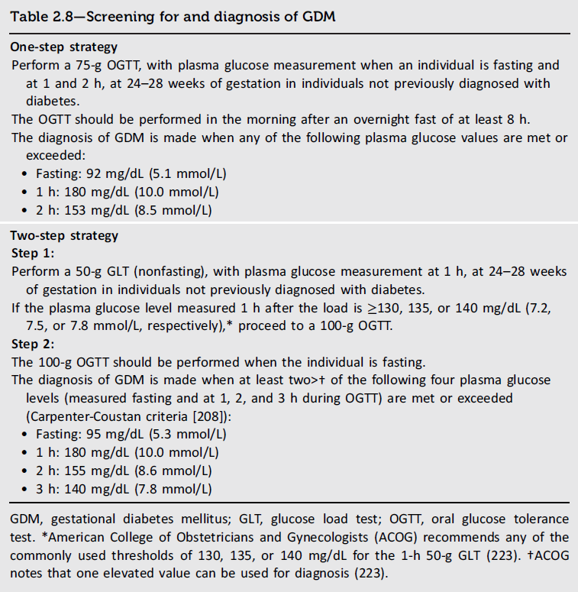
2. Diagnosis and Classification of Diabetes
Table 2.8
Diagnosis and Classification of Diabetes: Standards of Care in Diabetes - 2026. Diabetes Care 2026;49(Suppl. 1):S27-S49

Slide 46
Section 3. Prevention or Delay of Diabetes and Associated Comorbidities
(https://doi.org/10.2337/dc26-S003)

Slide 47
Overall Recommendations
3. Prevention or Delay of Diabetes and Associated Comorbidities
3.1 In people with prediabetes, monitor for the development of diabetes at least annually; modify frequency of testing based on individual risk assessment. E
3.2 In people with presymptomatic type 1 diabetes, monitor for disease progression using A1C approximately every 6 months and 75-g oral glucose tolerance test (i.e., fasting and 2-h plasma glucose) annually; modify frequency of monitoring and consider augmenting with other glycemic assessment tools such as continuous glucose monitoring metrics based on individual risk assessment based on age, number and type of autoantibodies, and glycemic metrics. E

Slide 48
Lifestyle Behavior Change for Type 2 Diabetes Prevention
3. Prevention or Delay of Diabetes and Associated Comorbidities
3.3 Refer adults with overweight or obesity at high risk of type 2 diabetes to a diabetes prevention program to achieve and maintain a weight reduction of at least 5–7% of initial body weight through a healthy reduced-calorie eating pattern and ≥150 min/week of moderate-intensity physical activity. A
3.4 Prescribe an evidence-based eating pattern (e.g., Mediterranean, low carbohydrate) to individuals with prediabetes to prevent type 2 diabetes. B
3.5 Offer diabetes prevention programs to adults at high risk for type 2 diabetes. A Diabetes prevention programs should be covered by third-party payors, and inconsistencies in access should be addressed. E
3.6 Based on individual preference, certified technology-assisted diabetes prevention programs through smartphones, web-based applications, and telehealth can be effective in preventing type 2 diabetes and should be considered. B

Slide 49
Pharmacologic Interventions to Delay Type 2 Diabetes
3. Prevention or Delay of Diabetes and Associated Comorbidities
3.7 Metformin for the prevention of type 2 diabetes should be considered in adults at high risk of type 2 diabetes, as typified by the Diabetes Prevention Program, especially those aged 25–59 years with BMI ≥35 kg/m², higher fasting plasma glucose (e.g., ≥110 mg/dL [≥6 mmol/L]), and higher A1C (e.g., ≥6.0% [≥42 mmol/mol]), and in individuals with prior gestational diabetes mellitus. A
3.8 Consider using metformin to prevent hyperglycemia in high-risk individuals treated with a phosphatidylinositol 3-kinase α (PI3Kα) inhibitor (e.g., alpelisib and inavolisib). B
3.9 Consider using metformin to prevent hyperglycemia in high-risk individuals treated with high-dose glucocorticoids. B
3.10 Consider periodic assessment of vitamin B12 levels in individuals receiving long-term metformin therapy, especially in those with anemia or peripheral neuropathy. B

Slide 50
Prevention of Vascular Disease and Mortality
3. Prevention or Delay of Diabetes and Associated Comorbidities
3.11 Prediabetes is associated with heightened cardiovascular risk; therefore, screening for and treatment of modifiable risk factors for cardiovascular disease are suggested. B
3.12 Statin therapy may increase the risk of type 2 diabetes in people at high risk of developing type 2 diabetes. In such individuals, glucose status should be monitored regularly and diabetes prevention approaches reinforced. It is not recommended that statins be avoided or discontinued for this adverse effect. B
3.13 In people with a history of stroke and evidence of insulin resistance and prediabetes, pioglitazone may be considered to lower the risk of stroke or myocardial infarction. However, this benefit needs to be balanced with the increased risk of weight gain, edema, and fractures. A Lower doses may mitigate the risk of adverse effects but may be less effective. C

Slide 51
Person-Centered Care Goals
3. Prevention or Delay of Diabetes and Associated Comorbidities
3.14 In adults with overweight or obesity at high risk of type 2 diabetes, care goals should include weight loss and maintenance, minimizing the progression of hyperglycemia, and attention to cardiovascular risk. B
3.15 Pharmacotherapy (e.g., for weight management, minimizing the progression of hyperglycemia, and cardiovascular risk reduction) should be considered to support person-centered care goals. A
3.16 More intensive preventive approaches should be considered in individuals who are at particularly high risk of progression to diabetes, including individuals with BMI ≥35 kg/m², those with higher glucose levels (e.g., fasting plasma glucose 110–125 mg/dL [6.1–6.9 mmol/L], 2-h post-challenge glucose 173–199 mg/dL [9.6–11.0 mmol/L], and A1C ≥6.0% [≥42 mmol/mol]), and individuals with a history of gestational diabetes mellitus. A

Slide 52
Pharmacologic Interventions to Delay Symptomatic Type 1 Diabetes
3. Prevention or Delay of Diabetes and Associated Comorbidities
3.17 Teplizumab-mzwv infusion to delay the onset of symptomatic type 1 diabetes (stage 3) should be discussed with selected individuals aged ≥8 years with stage 2 type 1 diabetes. Treatment should be in a setting with appropriately trained personnel. B

Slide 53
Section 4. Comprehensive Medical Evaluation and Assessment of Comorbidities
(https://doi.org/10.2337/dc26-S004)

Slide 54
Person-Centered Collaborative Care
4. Comprehensive Medical Evaluation and Assessment of Comorbidities
4.1 A communication style that uses person-centered, culturally sensitive, and strength-based language and active listening; elicits individual preferences and beliefs; and assesses literacy, numeracy, and potential barriers to care should be used to optimize health outcomes and health-related quality of life. B
4.2 People with diabetes can benefit from a coordinated interprofessional team that may include but is not limited to diabetes care and education specialists, primary care and subspecialty clinicians, nurses, registered dietitian nutritionists, exercise specialists, pharmacists, dentists, podiatrists, and behavioral health professionals. C

Slide 55
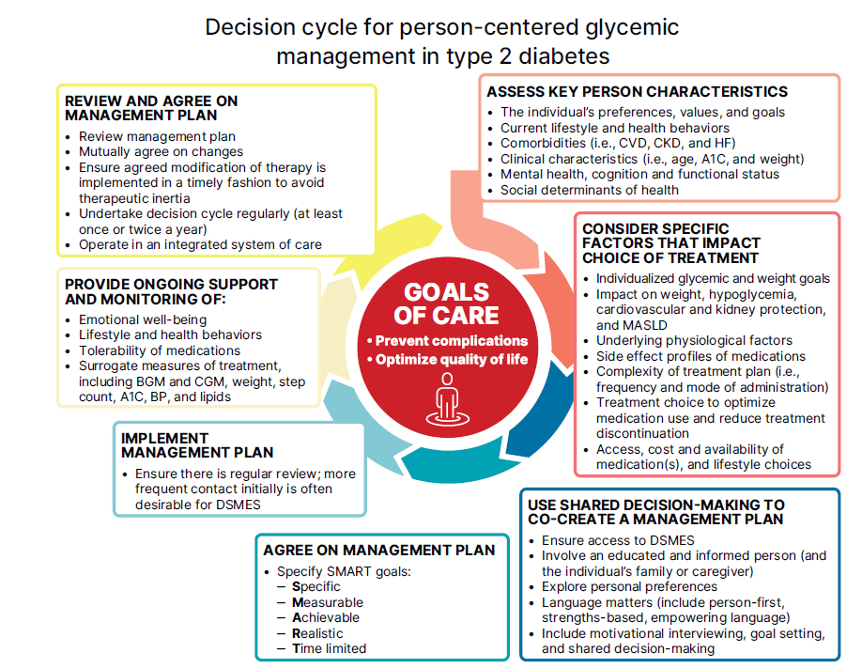
4. Comprehensive Medical Evaluation and Assessment of Comorbidities
Figure 4.1
Comprehensive Medical Evaluation and Assessment of Comorbidities: Standards of Care in Diabetes - 2026. Diabetes Care 2026;49(Suppl. 1):S61-S88

Slide 56
4. Comprehensive Medical Evaluation and Assessment of Comorbidities
Figure 4.1 (continued)
Comprehensive Medical Evaluation and Assessment of Comorbidities: Standards of Care in Diabetes - 2026. Diabetes Care 2026;49(Suppl. 1):S61-S88
Notes:
Figure 4.1—Decision cycle for person-centered glycemic management in type 2 diabetes. BGM, blood glucose monitoring; BP, blood pressure;
CGM, continuous glucose monitoring; CKD, chronic kidney disease; CVD, cardiovascular disease; DSMES, diabetes self-management education and
support; HF, heart failure. Adapted from Davies et al. (324).

Slide 57
Comprehensive Medical Evaluation
4. Comprehensive Medical Evaluation and Assessment of Comorbidities
4.3 A complete medical evaluation should be performed at the initial visit and follow-up, as appropriate, to:
• Confirm the diagnosis and classify diabetes. A
• Assess glycemic status and previous and current treatment. A
• Evaluate for diabetes complications, potential comorbid conditions, and overall health status. A
• Identify care partners, support systems, and available resources. E
• Assess social determinants of health and structural barriers to optimal health and health care. A
• Review risk factor management in the person with diabetes. A
• Begin engagement with the person with diabetes in the formulation of a care management plan including goals of care. A
• Develop a plan for continuing care. A

Slide 58
Comprehensive Medical Evaluation (continued)
4. Comprehensive Medical Evaluation and Assessment of Comorbidities
4.4 Ongoing management should be guided by the assessment of overall health and functional status, diabetes complications, cardiovascular risk, hypoglycemia risk, and shared decision making to set therapeutic goals. B

Slide 59
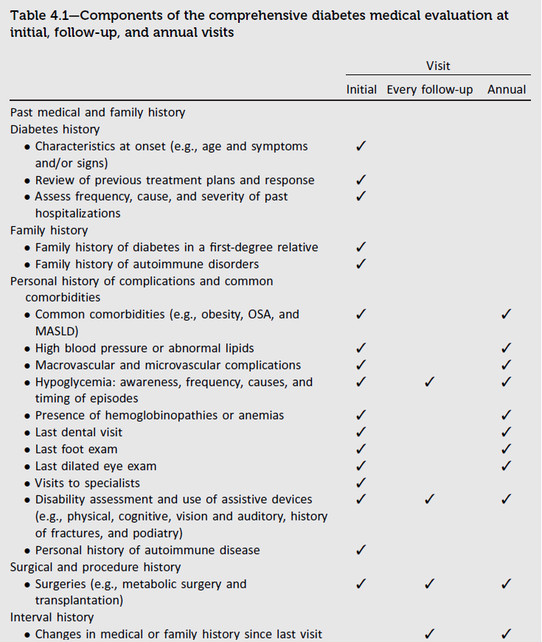
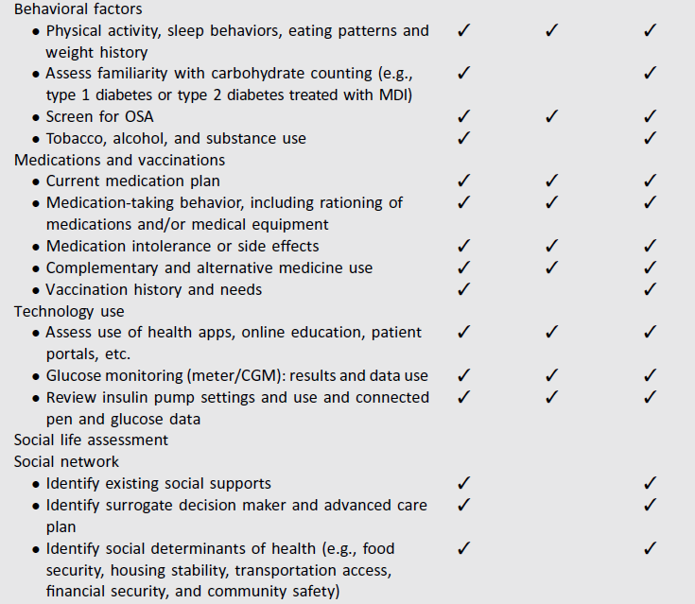
4. Comprehensive Medical Evaluation and Assessment of Comorbidities
Table 4.1
Comprehensive Medical Evaluation and Assessment of Comorbidities: Standards of Care in Diabetes - 2026. Diabetes Care 2026;49(Suppl. 1):S61-S88

Slide 60
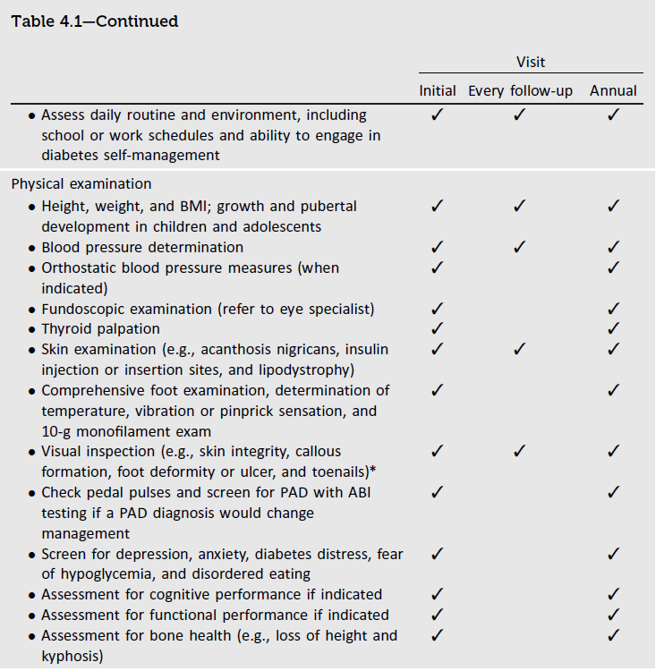
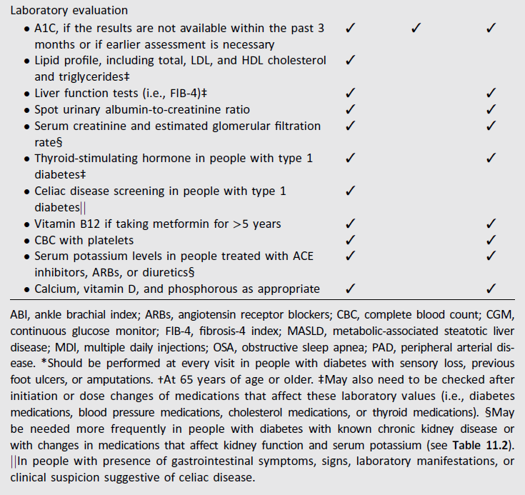
4. Comprehensive Medical Evaluation and Assessment of Comorbidities
Table 4.1 (continued)
Comprehensive Medical Evaluation and Assessment of Comorbidities: Standards of Care in Diabetes - 2026. Diabetes Care 2026;49(Suppl. 1):S61-S88

Slide 61
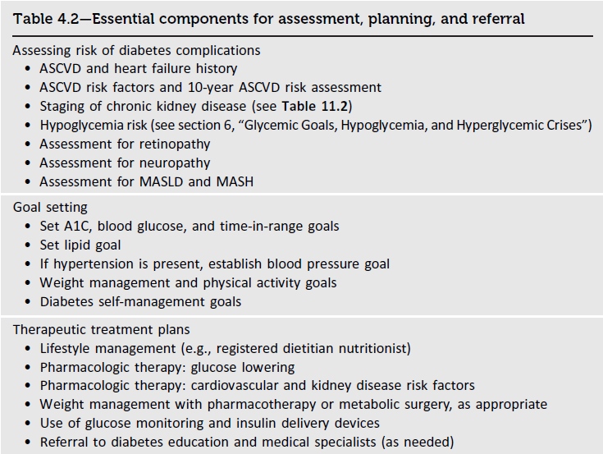
4. Comprehensive Medical Evaluation and Assessment of Comorbidities
Table 4.2
Comprehensive Medical Evaluation and Assessment of Comorbidities: Standards of Care in Diabetes - 2026. Diabetes Care 2026;49(Suppl. 1):S61-S88

Slide 62
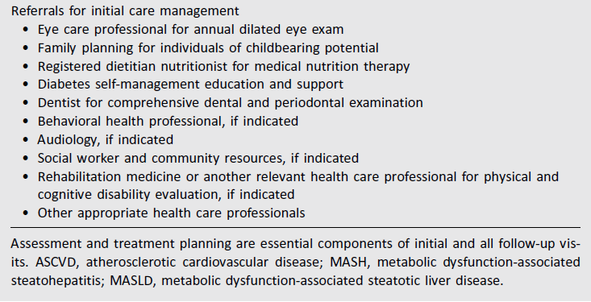
4. Comprehensive Medical Evaluation and Assessment of Comorbidities
Table 4.2 (continued)
Comprehensive Medical Evaluation and Assessment of Comorbidities: Standards of Care in Diabetes - 2026. Diabetes Care 2026;49(Suppl. 1):S61-S88

Slide 63
Immunizations
4. Comprehensive Medical Evaluation and Assessment of Comorbidities
4.5 Provide routinely recommended vaccinations for children and adults with diabetes as indicated by age (see Table 4.3). A

Slide 64
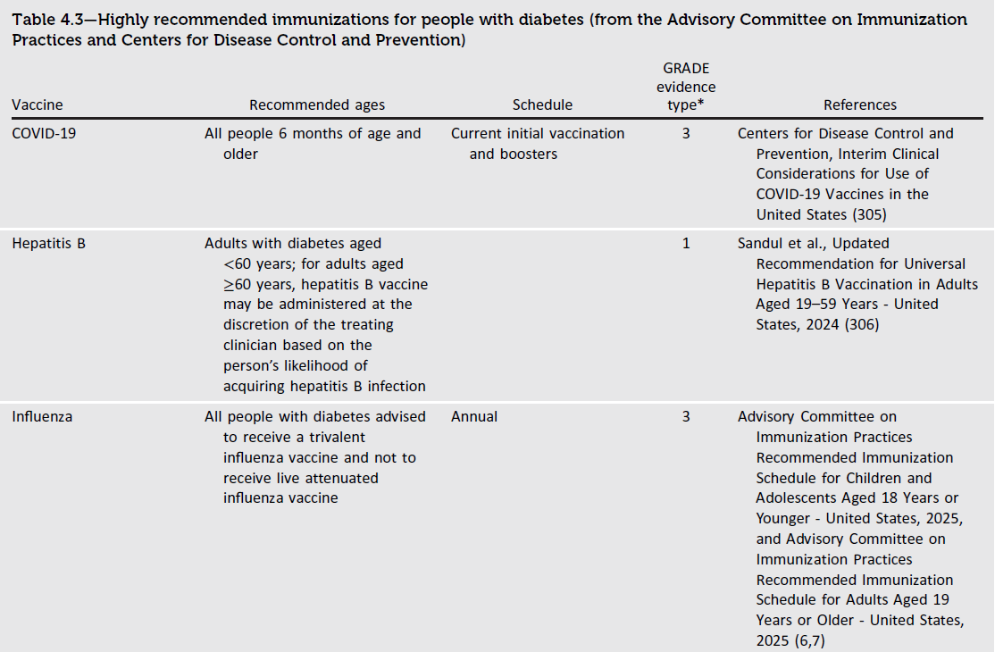
4. Comprehensive Medical Evaluation and Assessment of Comorbidities
Table 4.3
Comprehensive Medical Evaluation and Assessment of Comorbidities: Standards of Care in Diabetes - 2026. Diabetes Care 2026;49(Suppl. 1):S61-S88

Slide 65
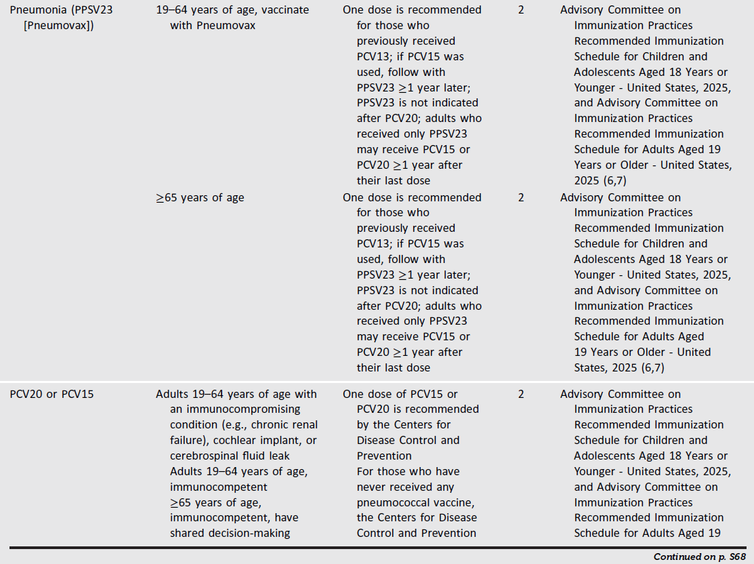
4. Comprehensive Medical Evaluation and Assessment of Comorbidities
Table 4.3 (continued)
Comprehensive Medical Evaluation and Assessment of Comorbidities: Standards of Care in Diabetes - 2026. Diabetes Care 2026;49(Suppl. 1):S61-S88

Slide 66
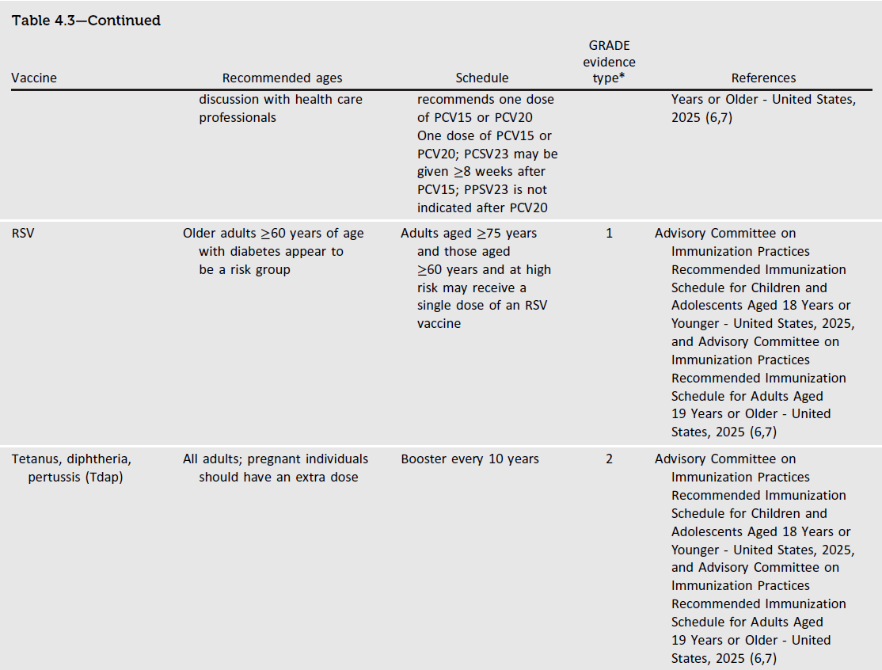
4. Comprehensive Medical Evaluation and Assessment of Comorbidities
Table 4.3 (continued)
Comprehensive Medical Evaluation and Assessment of Comorbidities: Standards of Care in Diabetes - 2026. Diabetes Care 2026;49(Suppl. 1):S61-S88

Slide 67
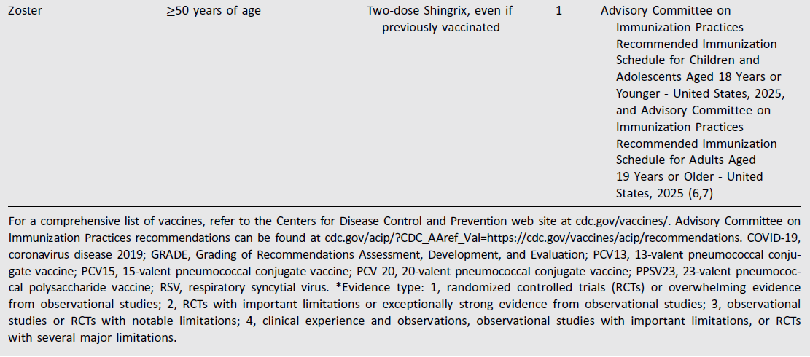
4. Comprehensive Medical Evaluation and Assessment of Comorbidities
Table 4.3 (continued)
Comprehensive Medical Evaluation and Assessment of Comorbidities: Standards of Care in Diabetes - 2026. Diabetes Care 2026;49(Suppl. 1):S61-S88

Slide 68
Autoimmune Diseases
4. Comprehensive Medical Evaluation and Assessment of Comorbidities
4.6 Screen people with type 1 diabetes for autoimmune thyroid disease soon after diagnosis and thereafter at repeated intervals if clinically indicated. B
4.7 Adults with type 1 diabetes should be screened for celiac disease in the presence of gastrointestinal symptoms, signs, laboratory manifestations, or clinical suspicion suggestive of celiac disease. B

Slide 69
Bone Health
4. Comprehensive Medical Evaluation and Assessment of Comorbidities
4.8 Assess fracture risk in older adults with diabetes as a part of routine care in diabetes clinical practice, according to risk factors and comorbidities. A
4.9 Monitor bone mineral density using dual-energy X-ray absorptiometry in older adults with diabetes (aged ≥65 years) and younger individuals with diabetes and multiple risk factors every 2–3 years (Table 4.4). A
4.10 Consider the potential adverse impact on skeletal health when selecting pharmacological options to lower glucose levels in people with diabetes. Avoiding medications with a known association with higher fracture risk (e.g., thiazolidinediones and sulfonylureas) is recommended, particularly for those at elevated risk for fractures. B

Slide 70
Bone Health (continued)
4. Comprehensive Medical Evaluation and Assessment of Comorbidities
4.11 To reduce the risk of falls and fractures, glycemic management goals should be individualized for people with diabetes at a higher risk of fracture. C Prioritize use of glucose-lowering medications that are associated with low risk for hypoglycemia to avoid falls. B
4.12 Advise people with diabetes on their intake of calcium (1,000–1,200 mg/day) and vitamin D to ensure it meets the recommended daily allowance for those at risk for fracture, either through their food choices or supplemental means. B
4.13a Consider osteoporosis drug therapy in older adults with diabetes who are at increased risk of fracture, including those with low bone mineral density (T-score ≤−2.5), history of fragility fracture, or elevated Fracture Risk Assessment Tool score (≥3% for hip fracture or ≥20% for major osteoporotic fracture). B
4.13b Treatment may be considered for adults with diabetes with a T-score between −2.0 and −2.5 in the presence of additional risk factors for fracture. C

Slide 71
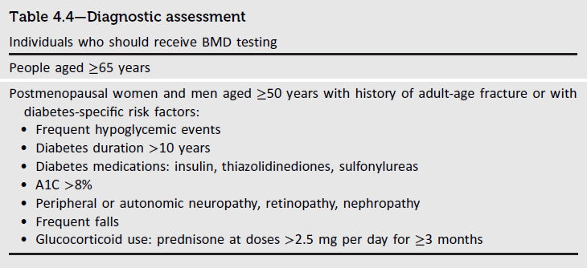
4. Comprehensive Medical Evaluation and Assessment of Comorbidities
Table 4.4
Comprehensive Medical Evaluation and Assessment of Comorbidities: Standards of Care in Diabetes - 2026. Diabetes Care 2026;49(Suppl. 1):S61-S88

Slide 72
Cognitive Impairment/Dementia
4. Comprehensive Medical Evaluation and Assessment of Comorbidities
4.14 In the presence of cognitive impairment, diabetes treatment plans should be simplified as much as possible and tailored to minimize the risk of hypoglycemia. B

Slide 73
Dental Care
4. Comprehensive Medical Evaluation and Assessment of Comorbidities
4.15 People with diabetes should be referred for a dental exam at least once per year. E
4.16 Coordinate efforts between the medical and dental teams to appropriately adjust glucose-lowering medication and treatment plans prior to and in the post-dental procedure period as needed. B

Slide 74
Disability
4. Comprehensive Medical Evaluation and Assessment of Comorbidities
4.17 Assess for disability at the initial visit and for decline in function at each subsequent visit in people with diabetes. If a disability is impacting functional ability or capacity to manage their diabetes, a referral should be made to an appropriate health care professional specializing in disability (e.g., physical medicine and rehabilitation specialist, physical therapist, occupational therapist, or speech-language pathologist). C

Slide 75
Sexual Health in Men
4. Comprehensive Medical Evaluation and Assessment of Comorbidities
4.18 In men with diabetes or prediabetes, screen for erectile dysfunction (ED), particularly in those with high cardiovascular risk, retinopathy, cardiovascular disease, chronic kidney disease, peripheral or autonomic neuropathy, longer duration of diabetes, depression, and hypogonadism and in those who are not meeting glycemic goals. B
4.19 In men with diabetes or prediabetes, inquire about sexual health (e.g., low libido and ED). If symptoms and/or signs of hypogonadism are detected, screen with a morning serum total testosterone level. B

Slide 76
Sexual Health in Women
4. Comprehensive Medical Evaluation and Assessment of Comorbidities
4.20 In women with diabetes or prediabetes, inquire about sexual health by screening for desire (libido), arousal, and orgasm difficulties, particularly in those who experience depression and/or anxiety and those with recurrent urinary tract infections. B
4.21 In postmenopausal women with diabetes or prediabetes, screen for symptoms and/or signs of genitourinary syndrome of menopause, including vaginal dryness and dyspareunia. B

Slide 77
Metabolic-Associated Steatotic Liver Disease and Metabolic-Associated Steatohepatitis - Screening
4. Comprehensive Medical Evaluation and Assessment of Comorbidities
4.22a Screen adults with type 2 diabetes or with prediabetes, particularly those with obesity or other cardiometabolic risk factors or established cardiovascular disease, for their risk of having or developing cirrhosis related to metabolic dysfunction-associated steatohepatitis (MASH) using a calculated fibrosis-4 index (FIB-4) (derived from age, ALT, AST, and platelets [mdcalc.com/calc/2200/fibrosis4-fib-4-index-liver-fibrosis]), even if they have normal liver enzymes. B
4.22b Adults with diabetes or prediabetes with persistently elevated plasma aminotransferase levels for >6 months and low FIB-4 should be evaluated for other causes of liver disease. B
4.23 Adults with type 2 diabetes or prediabetes with a FIB-4 ≥1.3 should have additional risk stratification by liver stiffness measurement with transient elastography, or, if unavailable, the enhanced liver fibrosis (ELF) test. B
4.24 Refer adults with type 2 diabetes or prediabetes at higher risk for significant liver fibrosis (i.e., as indicated by FIB-4, liver stiffness measurement, or ELF) to a gastroenterologist or hepatologist for further evaluation and management. B

Slide 78
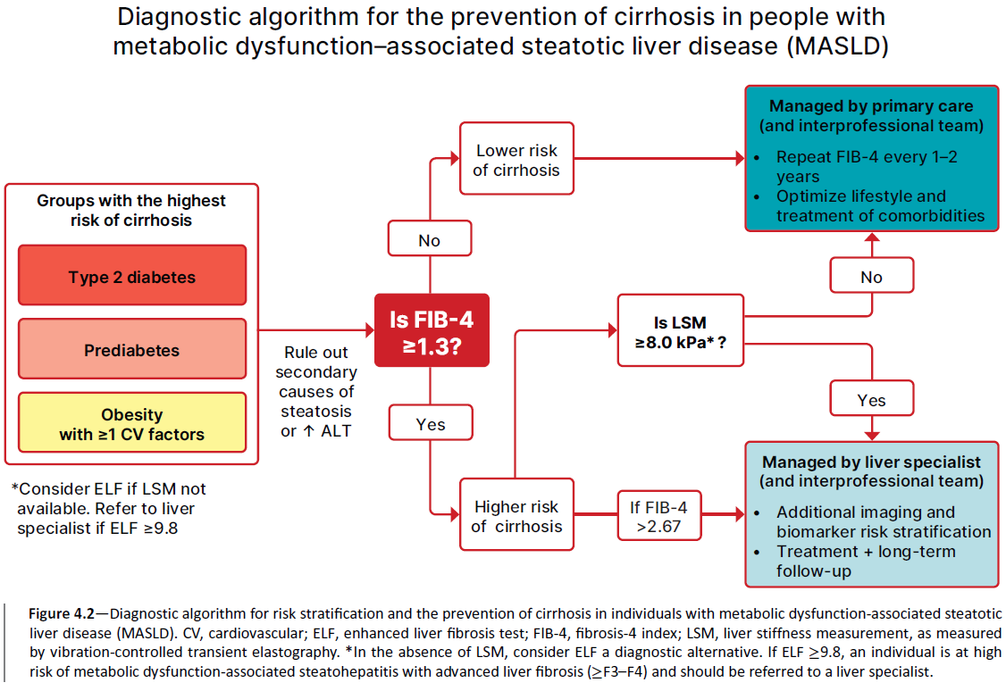
4. Comprehensive Medical Evaluation and Assessment of Comorbidities
Figure 4.2
Comprehensive Medical Evaluation and Assessment of Comorbidities: Standards of Care in Diabetes - 2026. Diabetes Care 2026;49(Suppl. 1):S61-S88

Slide 79
Metabolic-Associated Steatotic Liver Disease and Metabolic-Associated Steatohepatitis - Management
4. Comprehensive Medical Evaluation and Assessment of Comorbidities
4.25 Adults with type 2 diabetes or prediabetes, particularly with overweight or obesity, who have metabolic dysfunction–associated steatotic liver disease (MASLD) should be recommended lifestyle changes using an interprofessional approach that promotes weight loss, ideally within a structured nutrition plan and physical activity program for cardiometabolic benefits B and histological improvement. C
4.26 In adults with type 2 diabetes, MASLD, and overweight or obesity, consider using a glucagon-like peptide 1 receptor agonist (GLP-1 RA) with demonstrated benefits in MASH A or a dual glucose-dependent insulinotropic polypeptide (GIP) and GLP-1 RA with potential benefits in MASH B for the treatment of obesity as an adjunctive therapy to lifestyle interventions for weight loss.
4.27a In adults with type 2 diabetes and biopsy-proven MASH or those at high risk for liver fibrosis (based on noninvasive tests), a GLP-1 RA is preferred for glycemic management due to beneficial effects on MASH. A Pioglitazone B or a dual GIP and GLP-1 RA B can be considered for glycemic management due to potential beneficial effects on MASH.
4.27b Combination therapy with pioglitazone plus GLP-1 RA can be considered for the treatment of hyperglycemia in adults with type 2 diabetes with biopsy-proven MASH or those at high risk of liver fibrosis (identified with noninvasive tests) because of potential beneficial effects on MASH. B

Slide 80
Metabolic-Associated Steatotic Liver Disease and Metabolic-Associated Steatohepatitis – Management (continued)
4. Comprehensive Medical Evaluation and Assessment of Comorbidities
4.28 For consideration of treatment with a thyroid hormone receptor-β agonist in adults with type 2 diabetes or prediabetes with MASLD with moderate (F2) or advanced (F3) liver fibrosis on liver histology, or by a validated imaging-based or blood-based test, refer to a gastroenterologist or hepatologist with expertise in MASLD management. A
4.29 Treatment initiation and monitoring should be individualized and within the context of an interprofessional team that includes a gastroenterologist or hepatologist, consideration of individual preferences, and a careful shared-decision cost-benefit discussion. B
4.30a In adults with type 2 diabetes and MASLD, use of glucose-lowering therapies other than pioglitazone or GLP-1 RAs may be continued as clinically indicated, but these therapies lack evidence of benefit in MASH. B
4.30b Insulin therapy is the preferred agent for the treatment of hyperglycemia in adults with type 2 diabetes with decompensated cirrhosis. C

Slide 81
Metabolic-Associated Steatotic Liver Disease and Metabolic-Associated Steatohepatitis – Management (continued)
4. Comprehensive Medical Evaluation and Assessment of Comorbidities
4.31a Adults with type 2 diabetes and MASLD are at increased cardiovascular risk; therefore, comprehensive management of cardiovascular risk factors is recommended. B
4.31b Statin therapy is safe in adults with type 2 diabetes and compensated cirrhosis from MASLD and should be initiated or continued for cardiovascular risk reduction as clinically indicated. B In people with decompensated cirrhosis, statin therapy should be used with caution, and close monitoring is needed, given limited safety and efficacy data. B
4.32a Consider metabolic surgery in appropriate candidates as an option to treat MASH in adults with type 2 diabetes B and to improve cardiovascular outcomes. B
4.32b Metabolic surgery should be used with caution in adults with type 2 diabetes with compensated cirrhosis from MASLD B and is not recommended in decompensated cirrhosis. B

Slide 82
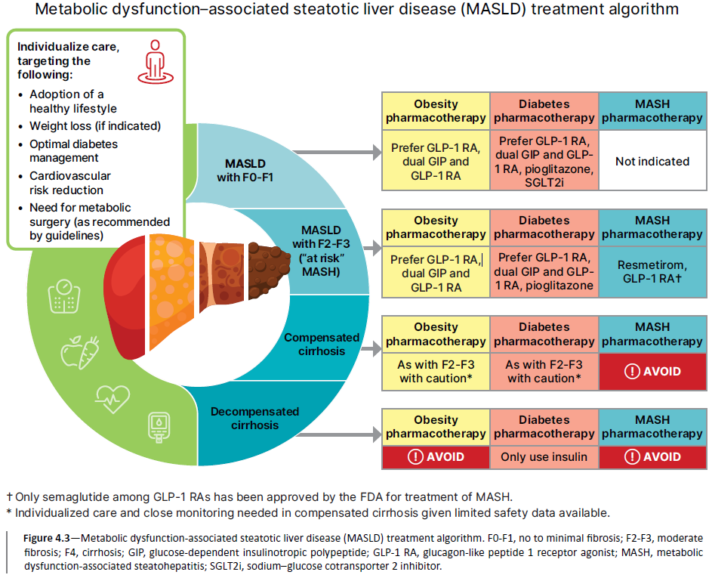
4. Comprehensive Medical Evaluation and Assessment of Comorbidities
Figure 4.3
Comprehensive Medical Evaluation and Assessment of Comorbidities: Standards of Care in Diabetes - 2026. Diabetes Care 2026;49(Suppl. 1):S61-S88

Slide 83
Section 5. Facilitating Positive Behaviors and Well-being to Improve Health Outcomes
(https://doi.org/10.2337/dc26-S005)

Slide 84
Diabetes Self-Management Education and Support
5. Facilitating Positive Behaviors and Well-being to Improve Health Outcomes
5.1 Advise all people with diabetes to participate in developmentally and culturally appropriate diabetes self-management education and support (DSMES) to facilitate informed decision-making, self-care behaviors, problem-solving, and active collaboration with the health care team. A
5.2 Provide DSMES at diagnosis, annually and/or when not meeting treatment goals, when complicating factors develop (e.g., medical, functional, and psychosocial), and when transitions in life and care occur. E
5.3 Assess clinical outcomes, health status, and well-being as key goals of DSMES on an individualized timeframe. C
5.4 Use behavioral strategies (e.g., motivational interviewing, goal setting, problem-solving) to support DSMES and engagement in behaviors known to optimize health-related quality of life and outcomes. A

Slide 85
Diabetes Self-Management Education and Support (continued)
5. Facilitating Positive Behaviors and Well-being to Improve Health Outcomes
5.5 Provide culturally and socially appropriate DSMES responsive to personal preferences and needs in group or individual settings. A Communicate DSMES participation with the diabetes care team. E
5.6 Offer DSMES via telehealth and/or digital interventions to meet individual preferences, reduce access barriers, and improve satisfaction. B
5.7 DSMES can improve outcomes and reduce costs, so reimbursement by third-party payors is recommended. B
5.8 Identify and address barriers to DSMES that exist at the payor, health system, clinic, health care professional, and individual levels. E
5.9 Assess the social determinants of health to guide and design delivery of DSMES to maximize health equity across populations. C

Slide 86
Diabetes Self-Management Education and Support (continued)
5. Facilitating Positive Behaviors and Well-being to Improve Health Outcomes
In addition to providing DSMES upon diagnosis, there are additional critical time points when the need for DSMES should be evaluated by the health care professional and/or interprofessional team, with referrals made as needed:
Annually and/or when not meeting treatment goals, whichever is more frequent
When complicating factors (e.g., health conditions, physical or functional limitations, emotional factors, and basic living needs) that influence self-management develop
When transitions in life and care occur

Slide 87
Medical Nutrition Therapy
5. Facilitating Positive Behaviors and Well-being to Improve Health Outcomes
5.10 Provide individualized medical nutrition therapy by referring people with prediabetes or diabetes to a registered dietitian nutritionist, preferably one who has comprehensive experience in diabetes care. A
5.11 Diabetes medical nutrition therapy can result in cost savings B and improved cardiometabolic outcomes A and should be reimbursed by insurance. E
5.12 Provide an overweight/obesity treatment plan based on their nutrition, physical activity, and behavioral health status for all people with overweight or obesity, aiming for at least 5–7% weight loss. A
5.13 For diabetes prevention and management of people with prediabetes or diabetes, recommend individualized meal plans that keep nutrient quality, total calories, and metabolic goals in mind. B

Slide 88
Medical Nutrition Therapy (continued)
5. Facilitating Positive Behaviors and Well-being to Improve Health Outcomes
5.14 Eating patterns should emphasize key nutrition principles (inclusion of nonstarchy vegetables, whole fruits, legumes, lean proteins, whole grains, nuts and seeds, and low-fat dairy or nondairy alternatives) and minimize consumption of red meat, sugar-sweetened beverages, sweets, refined grains, processed and ultraprocessed foods in people with prediabetes and diabetes. B
5.15 Consider reducing carbohydrate intake for some adults with diabetes to improve glycemia. An effective way to achieve this is by limiting consumption of processed foods. B
5.16 Assess intake of supplements, as supplementation with micronutrients (e.g., vitamins and minerals, such as magnesium or chromium) or herbs or spices (e.g., cinnamon and aloe vera) is not recommended for glycemic benefits. C
5.17 Counsel against β-carotene supplementation, as there is evidence of harm for certain individuals and it confers no benefit. B

Slide 89
Medical Nutrition Therapy (continued)
5. Facilitating Positive Behaviors and Well-being to Improve Health Outcomes
5.18 Advise adults with diabetes and those at risk for diabetes who consume alcohol to not exceed the recommended daily limits. B Advise abstainers to not start drinking alcohol, even in moderation. B
5.19. Counsel people with diabetes about the signs, symptoms, and self-management of delayed hypoglycemia and the importance of monitoring glucose after drinking alcohol to reduce hypoglycemia risk, especially when using insulin or insulin secretagogues. B
5.20 Counsel people with diabetes to limit sodium consumption to <2,300 mg/day, as clinically appropriate, and the best way to achieve this is through limiting consumption of processed foods. B
5.21 Encourage people with diabetes and those at risk for diabetes to consume water over other beverages. A

Slide 90
Medical Nutrition Therapy (continued)
5. Facilitating Positive Behaviors and Well-being to Improve Health Outcomes
5.22 Counsel people with diabetes and those at risk for diabetes that nonnutritive sweeteners can be used in place of sugar-sweetened products if consumed in moderation and for the short term to reduce overall calorie and carbohydrate intake. B
5.23. Counsel and regularly monitor individuals pursuing intentional weight loss to ensure adequate nutritional intake, with particular attention to preventing protein insufficiency and micronutrient deficiencies. E
5.24 Emphasize minimally processed, nutrient-dense, high-fiber sources of carbohydrate (at least 14 g fiber per 1,000 kcal). B
5.25 Advise people with diabetes and those at risk for diabetes to replace sugar-sweetened beverages (including any juices) with water or low-calorie or no-calorie beverages and minimize foods with added sugar to manage glycemia and reduce risk for cardiometabolic disease. B

Slide 91
Medical Nutrition Therapy (continued)
5. Facilitating Positive Behaviors and Well-being to Improve Health Outcomes
5.26 Educate individuals with diabetes who are at risk for developing diabetic ketoacidosis and who are treated with sodium–glucose cotransporter inhibition on the risks and signs of ketoacidosis and methods of risk mitigation management, provide them with appropriate tools for ketone measurement (i.e., serum β-hydroxybutyrate), and discourage a ketogenic eating pattern. E
5.27 Provide education on the glycemic impact of carbohydrate, A fat, and protein B tailored to an individual’s needs, insulin plan, and preferences for care to optimize mealtime insulin dosing.
5.28 Counsel people using fixed insulin doses about consistent patterns of carbohydrate intake with respect to time and amount while considering the insulin action time, as it can result in improved glycemia and reduce the risk for hypoglycemia. B

Slide 92
Medical Nutrition Therapy (continued)
5. Facilitating Positive Behaviors and Well-being to Improve Health Outcomes
5.29 Counsel people with diabetes and those at risk for diabetes to incorporate more plant-based protein sources (e.g., nuts, seeds, and legumes) as part of an overall diverse eating pattern to reduce cardiovascular disease risk. B
5.30 Counsel people with diabetes and those at risk for diabetes to consider an eating plan emphasizing elements of a Mediterranean eating pattern, which is rich in fatty fish, nuts, and seeds, to reduce cardiovascular disease risk A and improve glucose metabolism. B
5.31 Counsel people with diabetes and those at risk for diabetes to limit intake of foods high in saturated fat to help reduce cardiovascular disease risk. B

Slide 93
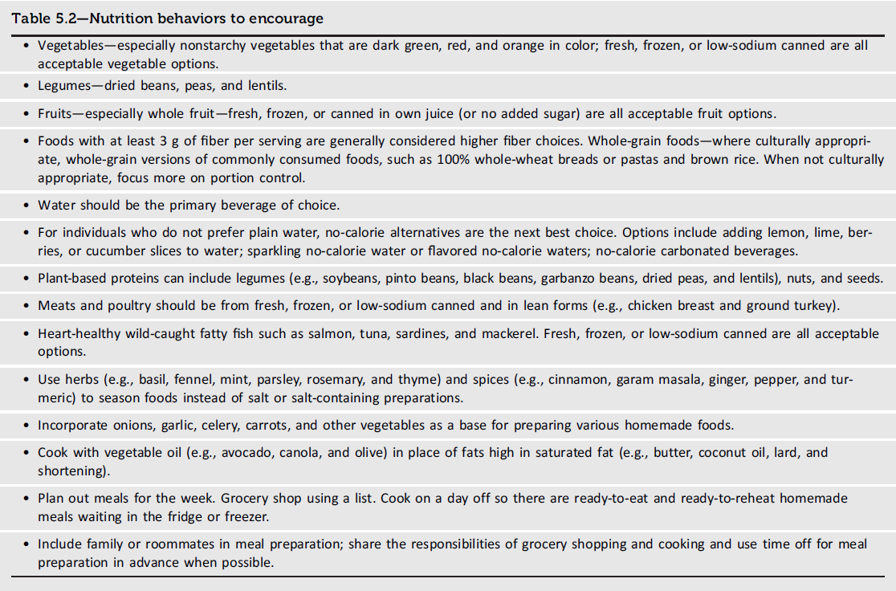
5. Facilitating Positive Behaviors and Well-being to Improve Health Outcomes
Table 5.2
Facilitating Positive Heath Behaviors and Well-being to Improve Health Outcomes: Standards of Care in Diabetes - 2026. Diabetes Care 2026;49(Suppl. 1):S89-S131

Slide 94
Religious Fasting
5. Facilitating Positive Behaviors and Well-being to Improve Health Outcomes
5.32 Use the updated International Diabetes Federation along with Diabetes and Ramadan International Alliance comprehensive prefasting risk assessment to generate a risk score for the safety of religious fasting. Provide fasting-focused education to minimize risks. B
5.33 Assess and optimize treatment plan, dose, and timing for people with diabetes well in advance of religious fasting to reduce risk of hypoglycemia, dehydration, hyperglycemia, and/or ketoacidosis. B

Slide 95
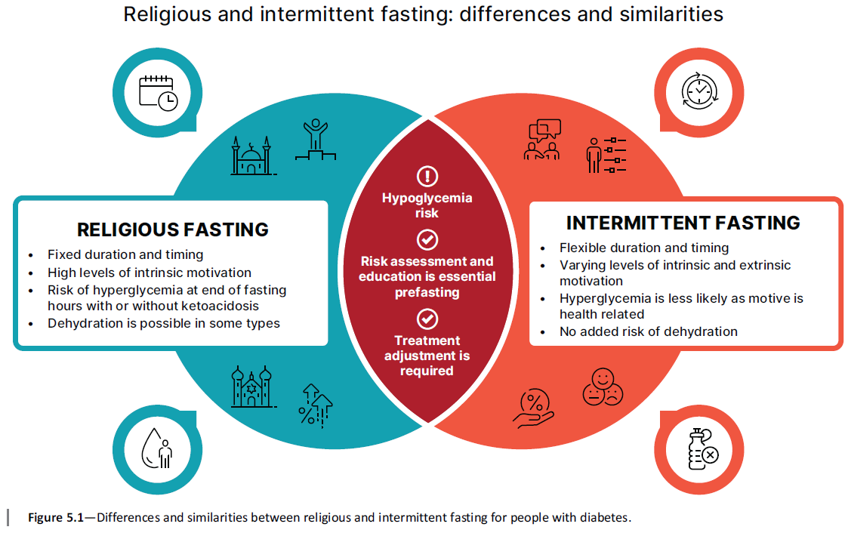
5. Facilitating Positive Behaviors and Well-being to Improve Health Outcomes
Figure 5.1
Facilitating Positive Heath Behaviors and Well-being to Improve Health Outcomes: Standards of Care in Diabetes - 2026. Diabetes Care 2026;49(Suppl. 1):S89-S131

Slide 96
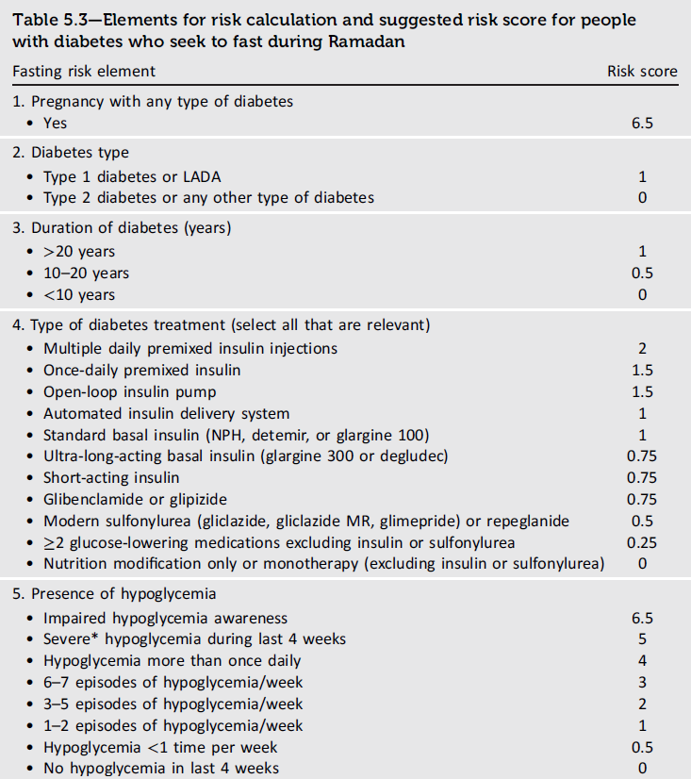
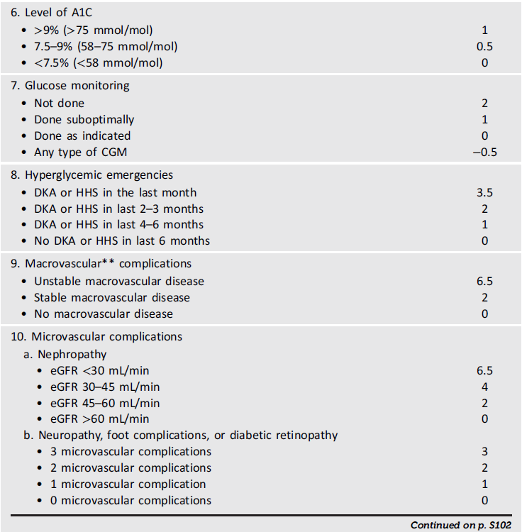
5. Facilitating Positive Behaviors and Well-being to Improve Health Outcomes
Table 5.3
Facilitating Positive Heath Behaviors and Well-being to Improve Health Outcomes: Standards of Care in Diabetes - 2026. Diabetes Care 2026;49(Suppl. 1):S89-S131

Slide 97
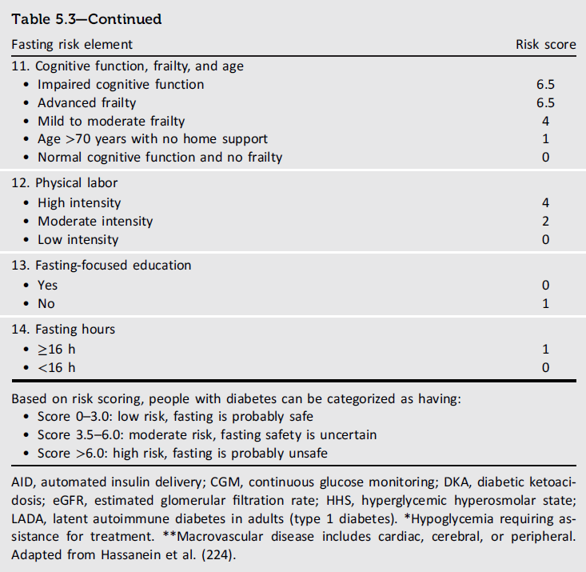
5. Facilitating Positive Behaviors and Well-being to Improve Health Outcomes
Table 5.3
Facilitating Positive Heath Behaviors and Well-being to Improve Health Outcomes: Standards of Care in Diabetes - 2026. Diabetes Care 2026;49(Suppl. 1):S89-S131

Slide 98
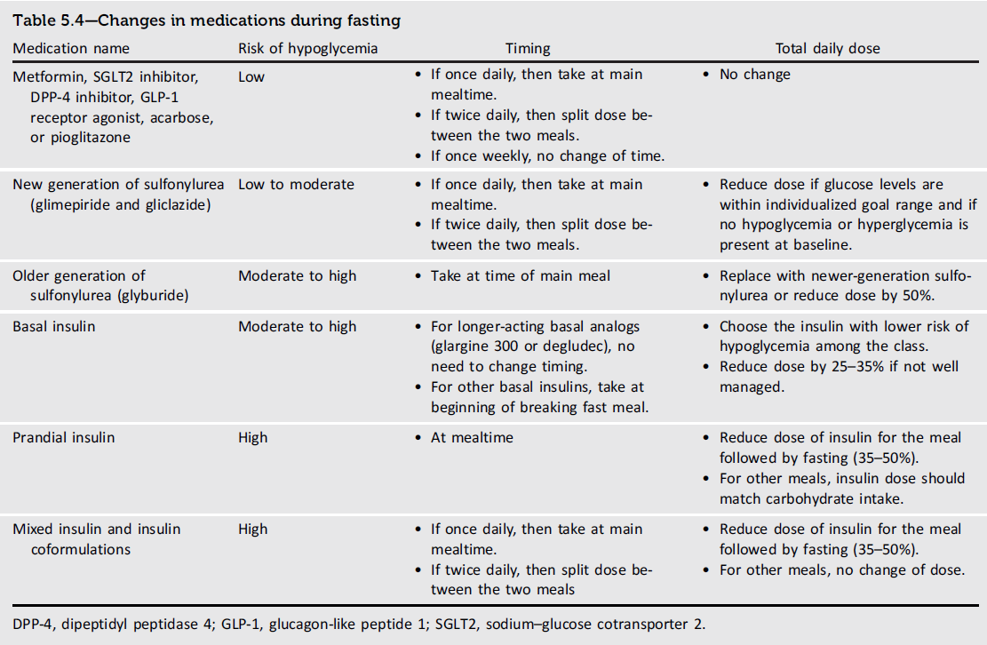
5. Facilitating Positive Behaviors and Well-being to Improve Health Outcomes
Table 5.4
Facilitating Positive Heath Behaviors and Well-being to Improve Health Outcomes: Standards of Care in Diabetes - 2026. Diabetes Care 2026;49(Suppl. 1):S89-S131

Slide 99
Physical Activity
5. Facilitating Positive Behaviors and Well-being to Improve Health Outcomes
5.34 Evaluate baseline physical activity and sedentary time for all people with diabetes and those at risk for diabetes. For people who do not meet activity guidelines, encourage an increase in physical activities above baseline with the goal of meeting activity guidelines. B Counsel that prolonged sitting should be interrupted at least every 30 min for blood glucose and other benefits. C
5.35 Counsel children and adolescents with type 1 diabetes C or type 2 diabetes B to engage in 60 min/day or more of moderate- or vigorous-intensity aerobic activity, with muscle-strengthening and bone-strengthening activities at least 3 days/week, and to limit the amount of time being spent sedentary, including recreational screen time. C
5.36 Counsel most adults with type 1 diabetes C and type 2 diabetes B to engage in 150 min or more of moderate-to vigorous-intensity aerobic activity per week, spread over at least 3 days/week, with no more than 2 consecutive days without activity. Shorter durations (minimum 75 min/week) of vigorous-intensity or interval training may be sufficient for more physically fit individuals.

Slide 100
Physical Activity (continued)
5. Facilitating Positive Behaviors and Well-being to Improve Health Outcomes
5.37 Counsel adults with type 1 diabetes C and type 2 diabetes B to engage in 2–3 sessions/week of resistance exercise on nonconsecutive days.
5.38 Counsel most older adults with diabetes to engage in flexibility training and balance training 2–3 times/week. C
5.39 Counsel all people with diabetes who are treated with obesity pharmacotherapy or metabolic surgery that meeting physical activity recommendations, in particular muscle-strengthening exercises, may be beneficial for maintaining lean body mass. C

Slide 101
Smoking Cessation: Tobacco, e-Cigarettes, and Cannabis
5. Facilitating Positive Behaviors and Well-being to Improve Health Outcomes
5.40. Ask people with diabetes routinely about the use of tobacco or vape products. A Advise complete avoidance of tobacco and vaping. A For individuals who use these products, provide or refer for combination treatment consisting of tobacco and/or vape product(s) cessation counseling and pharmacologic therapy. A
5.41 Advise people with type 1 diabetes C and those with other forms of diabetes at risk for diabetic ketoacidosis not to use recreational cannabis in any form. E

Slide 102
Psychosocial Care
5. Facilitating Positive Behaviors and Well-being to Improve Health Outcomes
5.42 Provide psychosocial care to all people with diabetes as part of routine medical care delivered by trained health care professionals using a collaborative, person-centered, culturally informed approach. A
5.43 Implement screening protocols for psychosocial concerns, preferably using age-appropriate standardized and validated tools. Screen at least annually or when there is a change in health status, treatment, or life circumstances. C
5.44 Refer to behavioral health professionals or other trained health care professionals, ideally those with experience in diabetes, for further assessment and treatment of psychosocial concerns as indicated. B

Slide 103
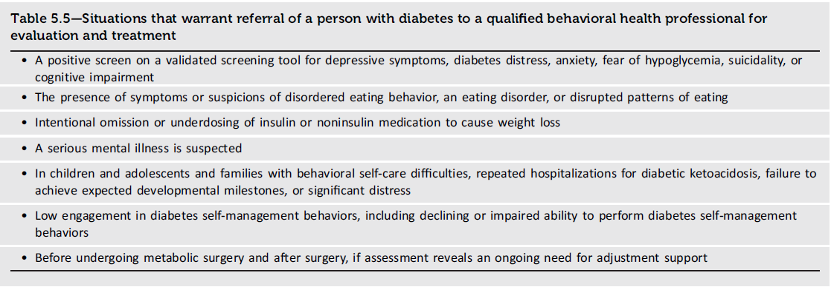
5. Facilitating Positive Behaviors and Well-being to Improve Health Outcomes
Table 5.5
Facilitating Positive Heath Behaviors and Well-being to Improve Health Outcomes: Standards of Care in Diabetes - 2026. Diabetes Care 2026;49(Suppl. 1):S89-S131

Slide 104
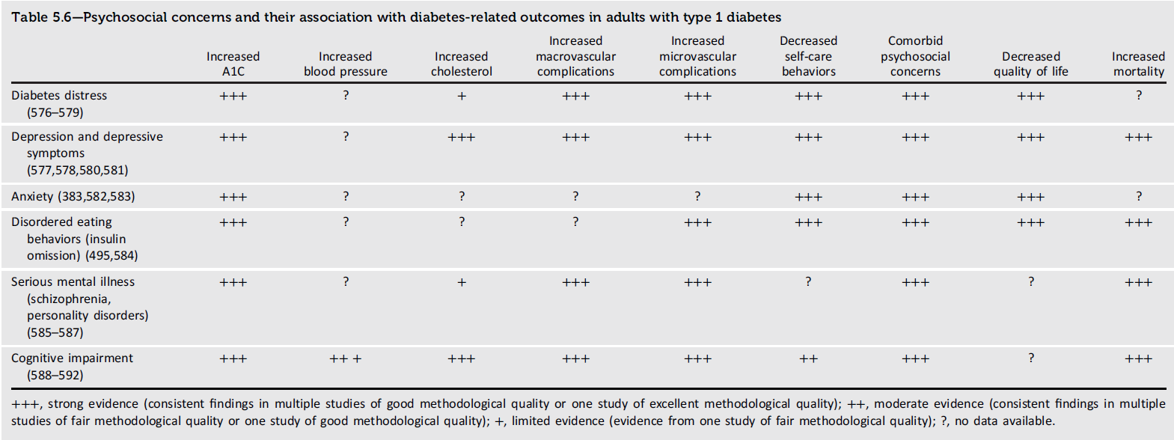
5. Facilitating Positive Behaviors and Well-being to Improve Health Outcomes
Table 5.6
Facilitating Positive Heath Behaviors and Well-being to Improve Health Outcomes: Standards of Care in Diabetes - 2026. Diabetes Care 2026;49(Suppl. 1):S89-S131

Slide 105
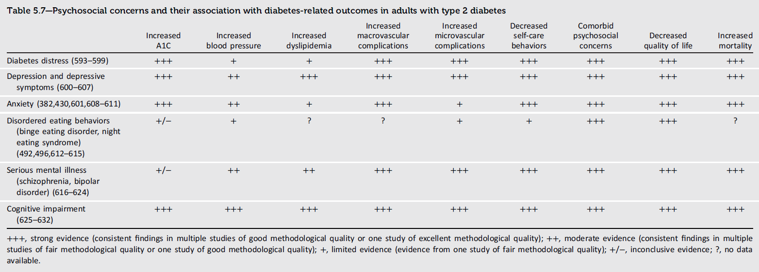
5. Facilitating Positive Behaviors and Well-being to Improve Health Outcomes
Table 5.7
Facilitating Positive Heath Behaviors and Well-being to Improve Health Outcomes: Standards of Care in Diabetes - 2026. Diabetes Care 2026;49(Suppl. 1):S89-S131

Slide 106
Diabetes Distress
5. Facilitating Positive Behaviors and Well-being to Improve Health Outcomes
5.45 Screen for diabetes distress at least annually in people with diabetes, caregivers, and family members, and repeat screening when treatment goals are not met, at transitional times, and/or in the presence of diabetes complications. Health care professionals should consider referral to a qualified behavioral health professional, ideally one with experience in diabetes, for further assessment and treatment if not adequately addressed during medical appointments. B

Slide 107
Anxiety
5. Facilitating Positive Behaviors and Well-being to Improve Health Outcomes
5.46 Screen for anxiety symptoms at least annually in people with diabetes. Health care professionals can address anxiety symptoms within the scope of their practice. Consider referral to a qualified behavioral health professional for further assessment and treatment if anxiety symptoms interfere with diabetes self-management behaviors or quality of life, if not adequately addressed during medical appointments. B
5.47 Screen individuals at high risk for hypoglycemia or with severe and/or frequent hypoglycemia for fear of hypoglycemia at least annually and when clinically appropriate. E Refer to a trained health care professional for evidence-based intervention. A

Slide 108
Depression
5. Facilitating Positive Behaviors and Well-being to Improve Health Outcomes
5.48 Screen for depressive symptoms in all people with diabetes at least annually and more frequently among those with a history of depression. B Refer to qualified behavioral health professionals or other health care professionals with experience using evidence-based treatment approaches for depression in collaboration with the diabetes care team. A
5.49 Rescreen for depression at diagnosis of complications or when there are significant changes in medical status. B

Slide 109
Disordered Eating Behavior
5. Facilitating Positive Behaviors and Well-being to Improve Health Outcomes
5.50 Screen for disordered or disrupted eating using validated screening measures. Review the medical treatment plan to identify potential treatment-related effects on hunger/caloric intake. B
5.51 Reevaluate the treatment plan of people with diabetes who present with symptoms of disordered eating behavior, an eating disorder, or disrupted patterns of eating, ideally in consultation with a qualified professional. B

Slide 110
Serious Mental Illness
5. Facilitating Positive Behaviors and Well-being to Improve Health Outcomes
5.52 Provide an increased level of support for people with diabetes and serious mental illness through enhanced monitoring of and assistance with diabetes self-management behaviors. B
5.53 Monitor changes in body weight, glycemia, and lipids in adolescents and adults with diabetes who are prescribed second-generation antipsychotic medications; adjust the treatment plan accordingly, if needed. C

Slide 111
Cognitive Capacity and Impairment
5. Facilitating Positive Behaviors and Well-being to Improve Health Outcomes
5.54 Monitor cognitive capacity throughout the life span for all individuals with diabetes, particularly in those who have documented cognitive disabilities, those who experience severe hypoglycemia, very young children, and older adults. B
5.55 Consider referral for a formal assessment if cognitive capacity changes or appears to be suboptimal for decision-making and/or behavioral self-management. E

Slide 112
Sleep Health
5. Facilitating Positive Behaviors and Well-being to Improve Health Outcomes
5.56 Screen for sleep health in people with prediabetes, diabetes, and those at risk for diabetes, including sleep disorders and diabetes-related sleep disruptions. Refer to sleep medicine specialists and/or qualified behavioral health professionals or diabetes care team as indicated. B
5.57 Counsel people with diabetes to practice sleep-promoting routines and habits. A

Slide 113
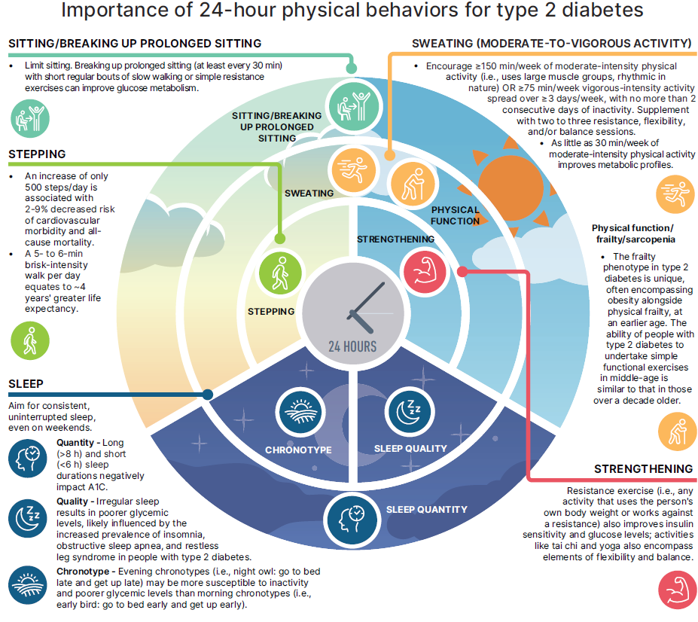
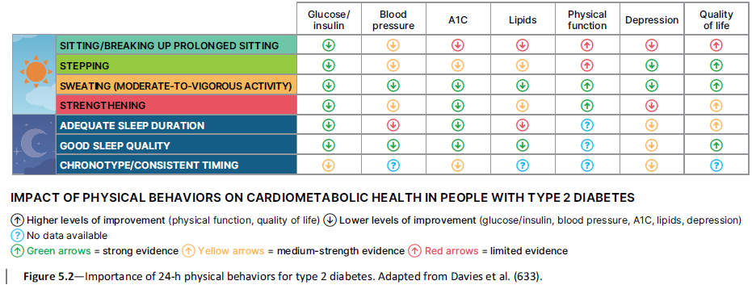
5. Facilitating Positive Behaviors and Well-being to Improve Health Outcomes
Figure 5.2
Facilitating Positive Heath Behaviors and Well-being to Improve Health Outcomes: Standards of Care in Diabetes - 2026. Diabetes Care 2026;49(Suppl. 1):S89-S131

Slide 114
Section 6. Glycemic Goals, Hypoglycemia, and Hyperglycemic Crises
(https://doi.org/10.2337/dc26-S006)

Slide 115
Glycemic Assessment
6. Glycemic Goals, Hypoglycemia, and Hyperglycemic Crises
6.1 Assess glycemic status by A1C A and/or continuous glucose monitoring (CGM) metrics such as time in range, time above range, and time below range. B Fructosamine or CGM can be used for glycemic monitoring when an alternative to A1C is required. B
6.2 Assess glycemic status at least two times a year, and more frequently (e.g., every 3 months) for individuals not meeting glycemic goals or with recent treatment changes, frequent or severe hypoglycemia or hyperglycemia, or changes in health status, or during periods of rapid growth and development in children and adolescents. E

Slide 116
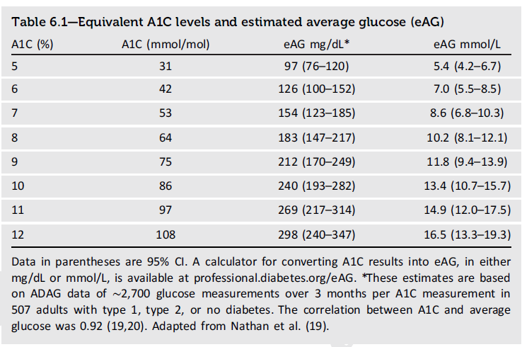
6. Glycemic Goals, Hypoglycemia, and Hyperglycemic Crises
Table 6.1
Glycemic Goals, Hypoglycemia, and Hyperglycemic Crises Standards of Care in Diabetes - 2026. Diabetes Care 2026;49(Suppl. 1):S132-S149

Slide 117
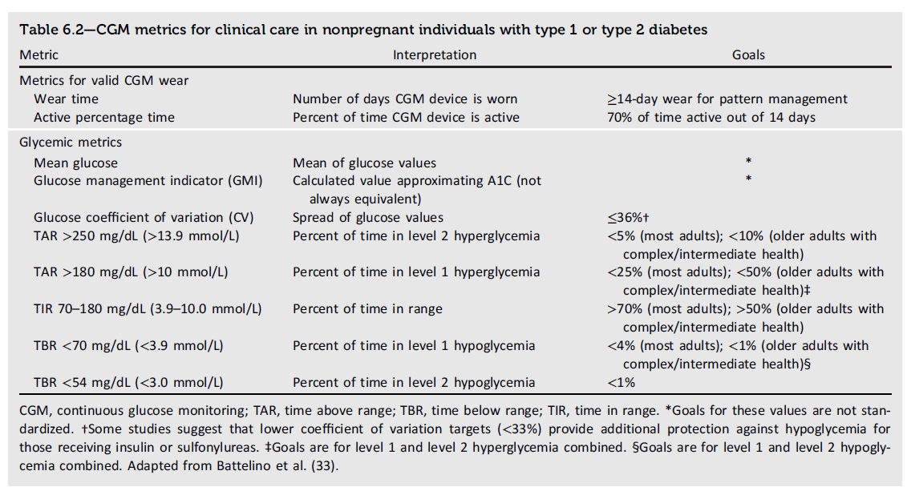
6. Glycemic Goals, Hypoglycemia, and Hyperglycemic Crises
Table 6.2
Glycemic Goals, Hypoglycemia, and Hyperglycemic Crises Standards of Care in Diabetes - 2026. Diabetes Care 2026;49(Suppl. 1):S132-S149

Slide 118
Glycemic Goals
6. Glycemic Goals, Hypoglycemia, and Hyperglycemic Crises
6.3a An A1C goal of <7% (<53 mmol/mol) is appropriate for many nonpregnant adults without severe hypoglycemia or hypoglycemia affecting health or quality of life. A
6.3b A goal time in range of >70% in people using CGM is appropriate for many nonpregnant adults. B
6.3c A goal percent time <70 mg/dL (<3.9 mmol/L) of <4% (or <1% for older adults) and a goal percent time <54 mg/dL (<3.0 mmol/L) of <1% are recommended in people using CGM to prevent hypoglycemia. Deintensify or modify therapy if these goals are not met. B
6.4 Lower A1C goals (e.g., <6.5% [<48 mmol/mol]) may be appropriate for individuals with diabetes with good health and function and low treatment risks (e.g., hypoglycemia) and burdens (see Fig. 6.1). B
6.5 Less stringent glycemic goals may be appropriate for individuals with significant cognitive and/or functional limitations, frailty, or severe comorbidities or where the harms of treatment, including hypoglycemia, are greater than the benefits. B

Slide 119
Glycemic Goals (continued)
6. Glycemic Goals, Hypoglycemia, and Hyperglycemic Crises
6.6 Deintensify hypoglycemia-causing medications (insulin, sulfonylureas, or meglitinides), or switch to a medication class with lower hypoglycemia risk, for individuals who are at high risk for hypoglycemia, within individualized glycemic goals. B
6.7 Deintensify diabetes medications for individuals for whom the harms and/or burdens of treatment may be greater than the benefits, within individualized glycemic goals. B
6.8 Reassess glycemic goals based on the individualized criteria shown in Fig 6.1. E
6.9 Set a glycemic goal during consultations to improve outcomes. A

Slide 120
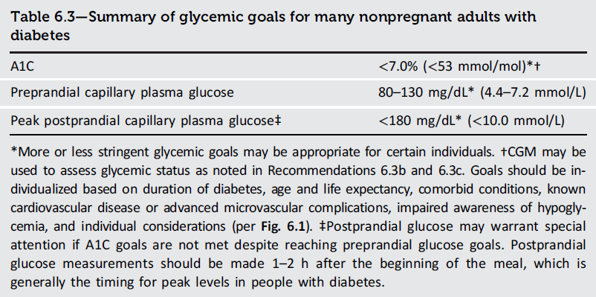
6. Glycemic Goals, Hypoglycemia, and Hyperglycemic Crises
Table 6.3
Glycemic Goals, Hypoglycemia, and Hyperglycemic Crises Standards of Care in Diabetes - 2026. Diabetes Care 2026;49(Suppl. 1):S132-S149

Slide 121
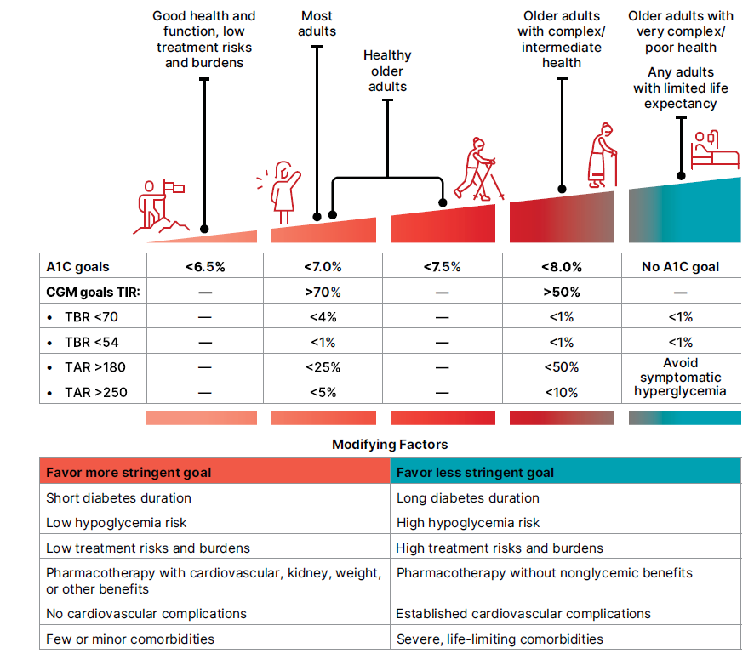
6. Glycemic Goals, Hypoglycemia, and Hyperglycemic Crises
Figure 6.1
Glycemic Goals, Hypoglycemia, and Hyperglycemic Crises Standards of Care in Diabetes - 2026. Diabetes Care 2026;49(Suppl. 1):S132-S149

Slide 122
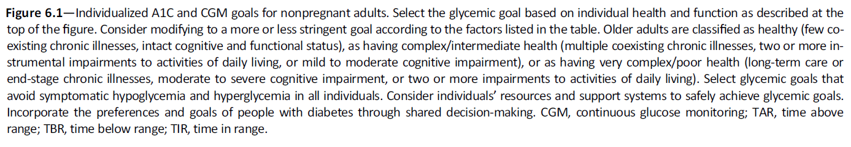
6. Glycemic Goals, Hypoglycemia, and Hyperglycemic Crises
Figure 6.1 (continued)
Glycemic Goals, Hypoglycemia, and Hyperglycemic Crises Standards of Care in Diabetes - 2026. Diabetes Care 2026;49(Suppl. 1):S132-S149

Slide 123
Glucose Lowering and Cardiovascular Disease Outcomes
6. Glycemic Goals, Hypoglycemia, and Hyperglycemic Crises
As outlined in more detail in section 9, “Pharmacologic Approaches to Glycemic Treatment,” and section 10, “Cardiovascular Disease and Risk Management,” the cardiovascular benefits of SGLT2 inhibitors or GLP-1 Ras are not contingent upon A1C lowering; therefore, initiation should be considered in people with type 2 diabetes and CVD, kidney disease, heart failure, and/or obesity independent of the current A1C, A1C goal, or metformin therapy. Based on these considerations, the following two strategies are offered (65):
1. If already on dual therapy or multiple glucose-lowering therapies and not on an SGLT2 inhibitor or a GLP-1 RA or dual GIP and GLP-1 RA, consider switching to one of these agents with proven cardiovascular benefit.
2. Introduce SGLT2 inhibitors or GLP-1 RAs or a dual GIP and GLP-1 RA in people with CVD at A1C goal (independent of metformin) for cardiovascular benefit, independent of baseline A1C or individualized A1C goal.

Slide 124
Hypoglycemia Assessment, Prevention, and Treatment
6. Glycemic Goals, Hypoglycemia, and Hyperglycemic Crises
6.10 Review history of hypoglycemia at every clinical encounter for all individuals at risk for hypoglycemia, and evaluate hypoglycemic events as indicated. C
6.11 Screen individuals at risk for hypoglycemia for impaired hypoglycemia awareness at least annually and when clinically appropriate. E Refer to a trained health care professional for evidence-based intervention to improve hypoglycemia awareness. A
6.12 Screen individuals at high risk for hypoglycemia or with severe and/or frequent hypoglycemia for fear of hypoglycemia at least annually and when clinically appropriate. E Refer to a trained health care professional for evidence-based intervention. A
6.13 Consider an individual’s risk for hypoglycemia (see Table 6.5) when selecting diabetes medications and glycemic goals. B
6.14 Use of CGM is beneficial and recommended for individuals at high risk for hypoglycemia. A
6.15 Glucose is the preferred treatment for the conscious individual with glucose <70 mg/dL (<3.9 mmol/L), although any form of carbohydrate that contains glucose may be used. Avoid using foods or beverages high in fat and/or protein for initial treatment of hypoglycemia. Fifteen minutes after initial treatment, repeat the treatment if hypoglycemia persists. B

Slide 125
Hypoglycemia Assessment, Prevention, and Treatment (continued)
6. Glycemic Goals, Hypoglycemia, and Hyperglycemic Crises
6.16 Glucagon should be prescribed for all individuals taking insulin or at high risk for hypoglycemia. A Family, caregivers, school personnel, and others providing support to these individuals should know its location and be educated on how to administer it. Glucagon preparations that do not have to be reconstituted are preferred. B
6.17 First aid kits should include oral glucose for use in treating hypoglycemia. C
6.18 All individuals taking insulin A or at risk for hypoglycemia C should receive structured education for hypoglycemia prevention and treatment, with ongoing education for those who experience hypoglycemic events.
6.19 One or more episodes of level 2 or 3 hypoglycemia should prompt reevaluation of the treatment plan, including deintensifying or switching diabetes medications if appropriate. B
6.20 Regularly assess cognitive function; if impaired or declining cognition is found, the clinician, person with diabetes, and caregiver should increase vigilance for hypoglycemia. B

Slide 126
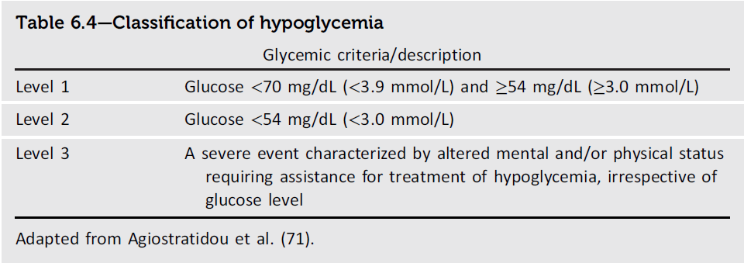
6. Glycemic Goals, Hypoglycemia, and Hyperglycemic Crises
Table 6.4
Glycemic Goals, Hypoglycemia, and Hyperglycemic Crises Standards of Care in Diabetes - 2026. Diabetes Care 2026;49(Suppl. 1):S132-S149

Slide 127
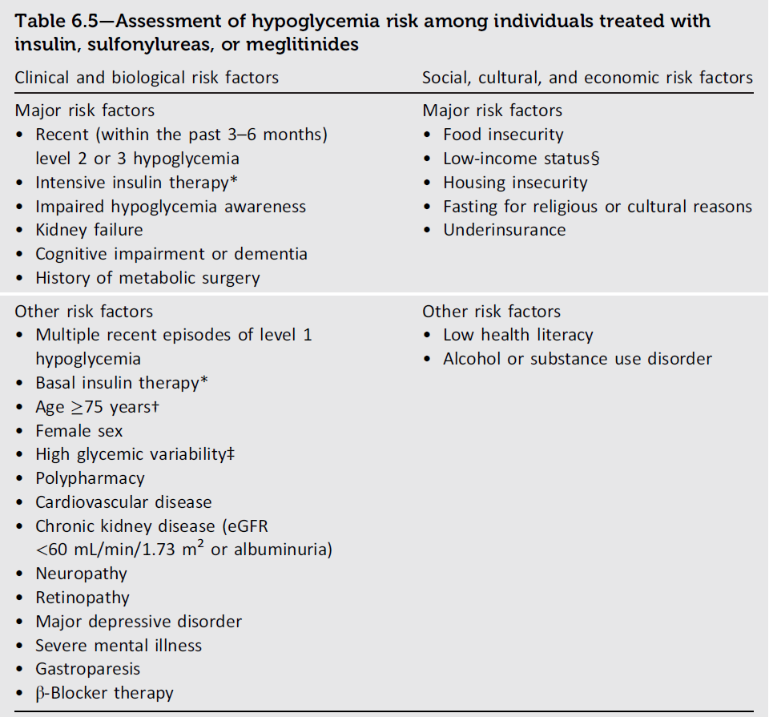
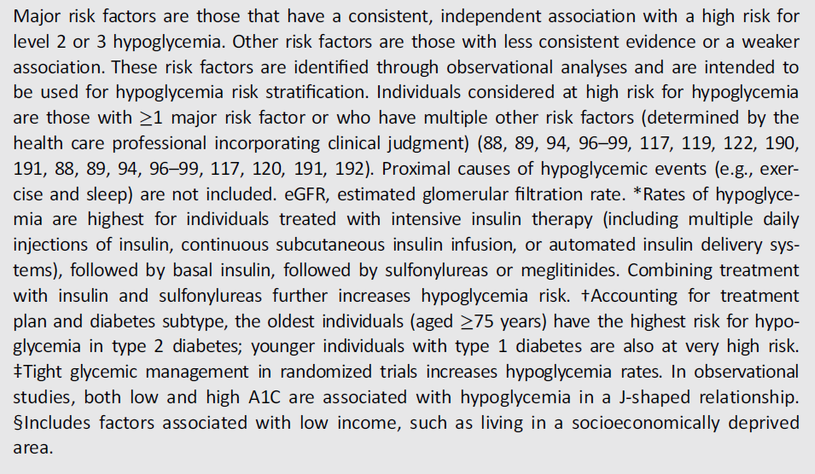
6. Glycemic Goals, Hypoglycemia, and Hyperglycemic Crises
Table 6.5
Glycemic Goals, Hypoglycemia, and Hyperglycemic Crises Standards of Care in Diabetes - 2026. Diabetes Care 2026;49(Suppl. 1):S132-S149

Slide 128
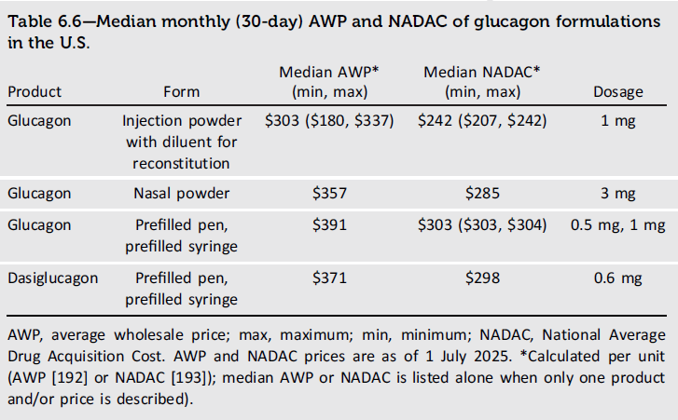
6. Glycemic Goals, Hypoglycemia, and Hyperglycemic Crises
Table 6.6
Glycemic Goals, Hypoglycemia, and Hyperglycemic Crises Standards of Care in Diabetes - 2026. Diabetes Care 2026;49(Suppl. 1):S132-S149

Slide 129
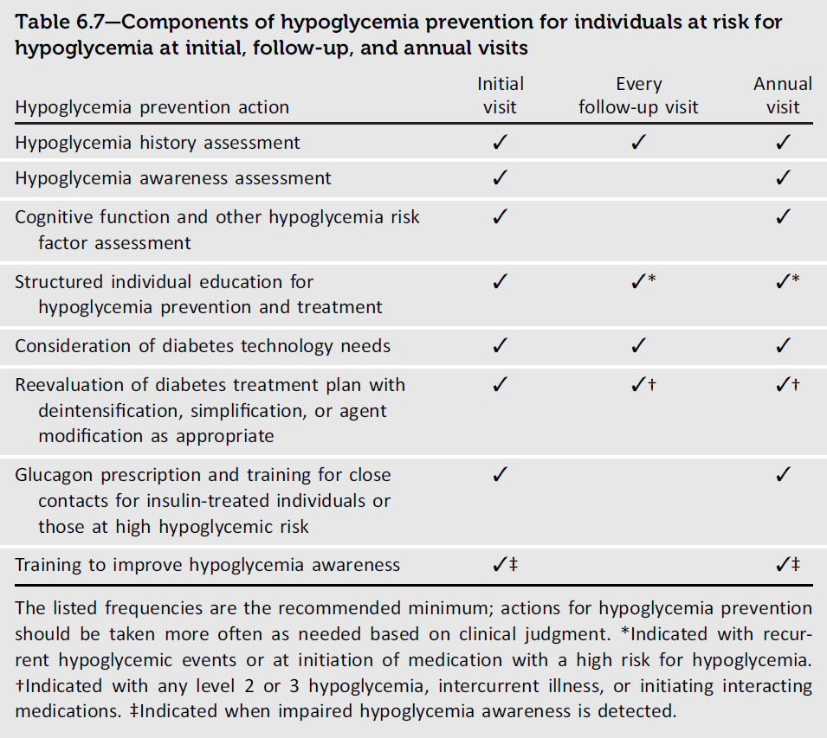
6. Glycemic Goals, Hypoglycemia, and Hyperglycemic Crises
Table 6.7
Glycemic Goals, Hypoglycemia, and Hyperglycemic Crises Standards of Care in Diabetes - 2026. Diabetes Care 2026;49(Suppl. 1):S132-S149

Slide 130
Hyperglycemic Crises: Diagnosis, Management, and Prevention
6. Glycemic Goals, Hypoglycemia, and Hyperglycemic Crises
6.21 Review history of hyperglycemic crises (i.e., diabetic ketoacidosis and hyperglycemic hyperosmolar state) at every clinical encounter for all individuals with diabetes at risk for these events. C
6.22 Provide structured education on the recognition, prevention, and management of hyperglycemic crisis to all individuals with type 1 diabetes, those with type 2 diabetes who have experienced these events, and people at high risk for these events. B

Slide 131
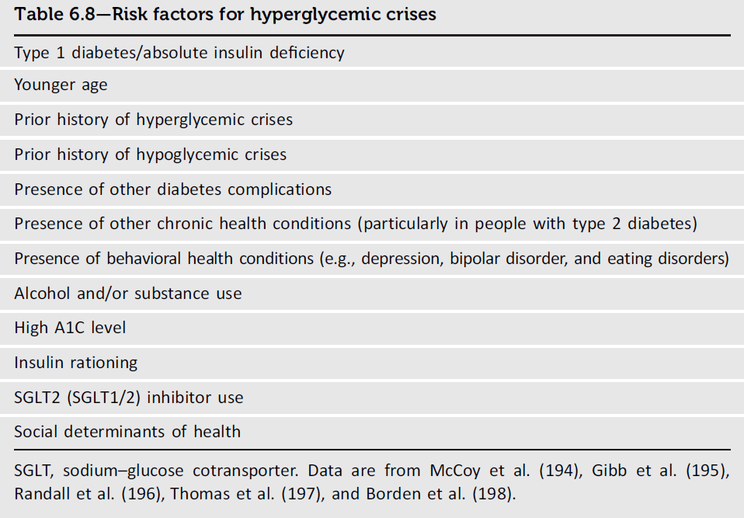
6. Glycemic Goals, Hypoglycemia, and Hyperglycemic Crises
Table 6.8
Glycemic Goals, Hypoglycemia, and Hyperglycemic Crises Standards of Care in Diabetes - 2026. Diabetes Care 2026;49(Suppl. 1):S132-S149

Slide 132
Section 7. Diabetes Technology
(https://doi.org/10.2337/dc26-S007)

Slide 133
General Device Principles
7. Diabetes Technology
7.1 Diabetes devices should be offered to people with diabetes. A
7.2 The type(s) and selection of devices should be individualized based on a person’s specific needs, circumstances, preferences, and skill level. In the setting of an individual whose diabetes is partially or wholly managed by someone else (e.g., a young child or a person with cognitive impairment or dexterity, psychosocial issues, and/or physical limitations), the caregiver’s skills and preferences are integral to the decision-making process. E
7.3a When prescribing a continuous glucose monitoring (CGM) device, ensure that people with diabetes and caregivers are offered initial and ongoing training and education as indicated by individual circumstances. Education should include utilization of data, including uploading or sharing data to monitor and adjust therapy. C
7.3b When prescribing an automated insulin delivery (AID) system, people with diabetes and their caregivers must receive education on how to use and troubleshoot the system. This education should occur at regular intervals as needed. Education should include utilization of the integrated system and its data, including uploading or sharing data to monitor and adjust therapy. C

Slide 134
General Device Principles (continued)
7. Diabetes Technology
7.4 Health care professionals working with people with diabetes should be aware of available technologies and seek additional support when needed. E
7.5 People with diabetes using CGM, continuous subcutaneous insulin infusion (CSII), and/or AID for diabetes management should have continued access to devices across third-party payors, regardless of age or A1C levels. E
7.6 Children and adolescents should be supported at school in the use of diabetes technology, such as CGM systems, CSII, connected insulin pens, and AID systems. E
7.7 For adults with diabetes using diabetes technology, reasonable accommodations in educational and work settings should include having sufficient time to manage their devices and respond to high and low glucose levels. E

Slide 135
General Device Principles (continued)
7. Diabetes Technology
7.8 Consider early initiation, including at diagnosis, of CGM, CSII, and AID depending on a person’s or caregiver’s needs and preferences. C
7.8a There should be no requirement of C-peptide level, B the presence of islet autoantibodies, B or duration of insulin treatment C before initiation of CSII or AID.
7.9 Standardized reports for all CGM, CSII, AID, and connected insulin devices with a minimum of a single-page report, such as the ambulatory glucose profile and weekly summary, should be available and utilized. Options for daily and weekly reports and raw data should be available. E

Slide 136
Blood Glucose Monitoring
7. Diabetes Technology
7.10 People with diabetes should be provided with blood glucose monitoring (BGM) devices as indicated by their circumstances, preferences, and treatment. People using CGM devices must also have access to BGM at all times. A
7.11 People who are taking insulin and using BGM should be encouraged to check their blood glucose levels when appropriate based on their insulin therapy. This may include checking when fasting, prior to meals and snacks, after meals, at bedtime, in the middle of the night, prior to, during, and after exercise, when hypoglycemia is suspected, after treating low blood glucose levels until achieving normoglycemia, when hyperglycemia is suspected, and prior to and while performing critical tasks such as driving. B
7.12 Health care professionals should be aware of the differences in accuracy among blood glucose meters. Only meters approved by the U.S. Food and Drug Administration (FDA) (or comparable regulatory agencies for other geographical locations) with proven accuracy should be used, with unexpired test strips purchased from a pharmacy or licensed distributor and properly stored. E

Slide 137
Blood Glucose Monitoring (continued)
7. Diabetes Technology
7.13 Although BGM in people on noninsulin therapies has not consistently shown clinically significant reductions in A1C levels, it may be helpful when modifying meal plans, physical activity plans, and/or medications (particularly medications that can cause hypoglycemia) in conjunction with a treatment adjustment program. E
7.14 Consider potential interference of medications and substances on glucose levels measured by blood glucose meters. B

Slide 138

7. Diabetes Technology
Table 7.1
Diabetes Technology: Standards of Care in Diabetes - 2026. Diabetes Care 2026;49(Suppl. 1):S150-S165

Slide 139
Continuous Glucose Monitoring Devices
7. Diabetes Technology
7.15 Use of CGM is recommended at diabetes onset and anytime thereafter for children, adolescents, and adults with diabetes who are on insulin therapy, A on noninsulin therapies that can cause hypoglycemia, C and on any diabetes treatment where CGM helps in management. C The specific CGM device and method for use should be made based on the individual’s circumstances, preferences, and needs. E
7.16 In people with diabetes on insulin therapy, CGM devices should be used as close to daily as possible for maximal benefit. A People with diabetes should have uninterrupted access to their supplies to minimize gaps in CGM. A
7.17 During pregnancy for individuals with type 1 diabetes, CGM can help achieve glycemic goals (e.g., time in range and time above range) A and A1C goal B and may be beneficial for other types of diabetes in pregnancy. E See section 15, “Management of Diabetes in Pregnancy,” for more detail regarding use of technology in pregnancy.

Slide 140
Continuous Glucose Monitoring Devices (continued)
7. Diabetes Technology
7.18 In circumstances when consistent use of CGM is not feasible, consider periodic use of personal or professional CGM to adjust medication and/or lifestyle. C
7.19 Skin reactions, either due to irritation or allergy, should be assessed and addressed to aid in successful use of devices. E
7.20 People who wear CGM devices should be educated on potential interfering substances and other factors that may affect accuracy. C

Slide 141

7. Diabetes Technology
Table 7.2
Diabetes Technology: Standards of Care in Diabetes - 2026. Diabetes Care 2026;49(Suppl. 1):S150-S165

Slide 142

7. Diabetes Technology
Table 7.3
Diabetes Technology: Standards of Care in Diabetes - 2026. Diabetes Care 2026;49(Suppl. 1):S150-S165

Slide 143

7. Diabetes Technology
Table 7.4
Diabetes Technology: Standards of Care in Diabetes - 2026. Diabetes Care 2026;49(Suppl. 1):S150-S165

Slide 144
Insulin Delivery (syringes and pens)
7. Diabetes Technology
7.21 For people with insulin-requiring diabetes on MDI, insulin pens are preferred in most cases. Still, insulin syringes may be used for insulin delivery considering individual and caregiver preference, insulin type, availability in vials, dosing therapy, cost, and self management capabilities. C
7.22 Insulin pens or insulin injection aids are recommended for people with dexterity issues or vision impairment or when decided by shared decision making to facilitate the accurate dosing and administration of insulin. C
7.23 Offer connected insulin pens for people with diabetes taking multiple daily insulin injections when appropriate. B
7.24 FDA-approved insulin dose calculators/decision support systems may be helpful for calculating insulin doses. B

Slide 145
Insulin Delivery (Pumps and Automated Delivery Systems)
7. Diabetes Technology
7.25a AID systems are the preferred insulin delivery method over multiple daily injections (MDI), CSII, and sensor- augmented pump in people with type 1 diabetes, A adults with type 2 diabetes, A children and adolescents with type 2 diabetes, E and other forms of insulin-deficient diabetes. B–E Choice of an AID system should be made based on the individual’s circumstances, preferences, and needs. E
7.25b Consider AID systems for select people with type 2 diabetes treated with basal insulin not achieving individualized glycemic goals. B Choice of an AID system should be made based on the individual’s circumstances, preferences, and needs. E
7.26 Individuals with diabetes who have been using CSII and/or AID should have continued access across third party payors. E

Slide 146
Insulin Delivery (Open-Source Automated Insulin Dosing)
7. Diabetes Technology
7.27 Support and provide diabetes management advice to people with diabetes who choose to use an opensource AID system. B

Slide 147
Digital Health Technology
7. Diabetes Technology
7.28 Consider combining technology (CGM, insulin pump, and/or diabetes apps) with online or virtual licensed coaching to improve glycemic outcomes in individuals with diabetes or prediabetes. B

Slide 148
Inpatient Care
7. Diabetes Technology
7.29 In people with diabetes wearing personal CGM, the use of CGM should be continued when clinically appropriate during hospitalization, with confirmatory point-of-care glucose measurements for insulin dosing and hypoglycemia assessment and treatment under an institutional protocol. B
7.30 Continue use of insulin pump or AID in people with diabetes who are hospitalized when clinically appropriate. This is contingent upon availability of necessary supplies, resources, training, ongoing competency assessments, and implementation of institutional diabetes technology protocols. C

Slide 149
Section 8. Obesity and Weight Management for the Prevention and Treatment of Diabetes
(https://doi.org/10.2337/dc26-S008)

Slide 150
Assessment and Monitoring of the Individual with Overweight or Obesity
8. Obesity and Weight Management for the Prevention and Treatment of Diabetes
8.1 Use person-centered, nonjudgmental language that fosters collaboration between individuals and health care professionals, including person-first language (e.g., “person with obesity” rather than “obese person” and “person with diabetes” rather than “diabetic person”). E
8.2a Screen for overweight and obesity using BMI annually. To confirm excess adiposity, additional assessments of body fat using anthropometric assessments (e.g., waist-to-hip ratio) or direct measurements (e.g., dual-energy X-ray absorptiometry, bioelectrical impedance analysis) could be considered where available/feasible. E
8.2b Monitor obesity-related anthropometric measurements at least annually to inform treatment considerations. During active weight management treatment, increase monitoring to at least every 3 months. E
8.3 Accommodations should be made to provide privacy during anthropometric measurements. E

Slide 151
Assessment and Monitoring of the Individual with Overweight or Obesity (continued)
8. Obesity and Weight Management for the Prevention and Treatment of Diabetes
8.4 In people with type 2 diabetes and overweight or obesity, weight management should represent a primary goal of treatment along with glycemic management. A
8.5 Provide weight management treatment, aiming for any magnitude of weight loss. Weight loss of 5–7% of baseline weight improves glycemia and other intermediate cardiovascular risk factors. A Sustained loss of >10% of body weight usually confers greater benefits, including disease-modifying effects and possible remission of type 2 diabetes A and may improve long-term cardiovascular outcomes and mortality. B
8.6 Individualize initial treatment approaches for obesity (i.e., lifestyle and nutritional therapy, pharmacologic therapy, or metabolic surgery) A based on the person’s medical history, life circumstances, and preferences. C Consider combining treatment approaches if appropriate. C

Slide 152
Nutrition, Physical Activity, and Behavioral Therapy Interventions
8. Obesity and Weight Management for the Prevention and Treatment of Diabetes
8.7 Nutrition, physical activity, and behavioral therapy are recommended for people with type 2 diabetes and overweight or obesity to achieve both weight and health outcome goals. B
8.8a Interventions including high frequency of counseling (≥16 sessions in 6 months) with focus on nutrition changes, physical activity, and behavioral strategies to achieve a 500–750 kcal/day energy deficit (irrespective of macronutrient composition) should be recommended for weight loss when available. A
8.8b If access to such interventions is limited, consider alternative structured programs delivering nutrition changes, physical activity, and behavioral counseling (e.g., remote, telehealth, mobile app). E
8.9 Nutrition recommendations should be individualized to the person’s preferences and nutritional needs. Use nutritional plans that create an energy deficit, while still following general nutritional guidance, to achieve weight loss. A

Slide 153
Nutrition, Physical Activity, and Behavioral Therapy Interventions (continued)
8. Obesity and Weight Management for the Prevention and Treatment of Diabetes
8.10 When developing a plan of care, consider systemic, structural, cultural, and socioeconomic factors that may impact nutrition patterns and food choices, such as food insecurity and hunger, access to healthful food options, and other social determinants of health. C
8.11 For those who achieve weight loss goals, continue to monitor progress, provide ongoing support, and recommend continuing interventions to maintain weight goals long term. E Effective long-term (≥1 year) weight maintenance programs provide monthly contact and support, include frequent self-monitoring of body weight (weekly or more frequently) and other self-monitoring strategies (e.g., food diaries or wearables), and encourage regular physical activity (200–300min/week). A
8.12 Short-term nutrition intervention using structured, very-low-calorie-meals (800–1,000 kcal/day) should be prescribed only to carefully selected individuals by trained practitioners in medical settings with close monitoring. Long-term, comprehensive weight maintenance strategies and counseling should be integrated to maintain weight loss. B

Slide 154
Nutrition, Physical Activity, and Behavioral Therapy (continued)
8. Obesity and Weight Management for the Prevention and Treatment of Diabetes
8.13 Nutritional supplements are not recommended, as they have not been shown to be effective for weight loss. A
8.14 Counsel and regularly monitor individuals pursuing intentional weight loss to ensure adequate nutritional intake, with particular attention to preventing protein insufficiency and micronutrient deficiencies. E

Slide 155
Pharmacotherapy
8. Obesity and Weight Management for the Prevention and Treatment of Diabetes
8.15 Whenever clinically appropriate, engage other care team members to minimize use of weight-promoting medications for treatment of other conditions among adults with diabetes and obesity. E
8.16 When choosing glucose-lowering medications for people with type 2 diabetes and overweight or obesity, prioritize medications with beneficial effect on weight. B
8.17 Obesity pharmacotherapy should be considered for people with diabetes and overweight or obesity along with lifestyle changes. Potential benefits and risks must be considered. A
8.18 In people with diabetes and overweight or obesity, the preferred pharmacotherapy should be a glucagonlike peptide 1 receptor agonist or dual glucose-dependent insulinotropic polypeptide and glucagon-like peptide 1 receptor agonist with greater weight loss efficacy (i.e., semaglutide or tirzepatide), especially considering their added weight-independent benefits. A

Slide 156
Pharmacotherapy (continued)
8. Obesity and Weight Management for the Prevention and Treatment of Diabetes
8.19 Obesity pharmacotherapy indicated for chronic therapy should be continued beyond reaching weight loss goals to maintain the health benefits, as discontinuation often results in recurrence of weight gain and worsening or reemergence of cardiometabolic risk factors. B
8.20 Individualize the dose and the dose titration approach of obesity pharmacotherapy to balance effectiveness, health benefits, and tolerability; the optimal treatment dose may not be the maximum approved dose. B
8.21 In people with diabetes not reaching weight treatment goals, modify or intensify treatment with additional approaches, including structured lifestyle management programs, metabolic surgery, A and additional or alternative pharmacologic agents. B

Slide 157
Metabolic Surgery
8. Obesity and Weight Management for the Prevention and Treatment of Diabetes
8.22 Consider metabolic surgery as a weight and glycemic management approach in people with type 2 diabetes with BMI ≥30.0 kg/m² (or ≥27.5 kg/m² in Asian American individuals) who are otherwise good surgical candidates. A
8.23 Metabolic surgery should be performed in high-volume centers with interprofessional teams knowledgeable about and experienced in managing obesity, diabetes, and gastrointestinal surgery. E
8.24 People being considered for metabolic surgery should be evaluated for comorbid psychological conditions and social and situational circumstances that have the potential to interfere with surgery outcomes. B
8.25 People who undergo metabolic surgery should receive long-term medical and behavioral support and routine micronutrient, nutritional, and metabolic status monitoring. B

Slide 158
Metabolic Surgery (continued)
8. Obesity and Weight Management for the Prevention and Treatment of Diabetes
8.26 If post-metabolic surgery hypoglycemia is suspected, clinical evaluation should exclude other potential disorders contributing to hypoglycemia, and management should include education, medical nutrition therapy with a registered dietitian nutritionist experienced in post-metabolic surgery hypoglycemia, and medication treatment, as needed. A In individuals with post-metabolic surgery hypoglycemia, use continuous glucose monitoring to improve safety. C
8.27 In people who undergo metabolic surgery, routinely screen for psychosocial and behavioral health changes and refer to a qualified behavioral health professional as needed. C
8.28 Monitor individuals who have undergone metabolic surgery for insufficient weight loss or weight recurrence at least every 6–12 months. E In those who have insufficient weight loss or experience weight recurrence, assess for potential predisposing factors and, if appropriate, consider additional weight loss interventions (e.g., obesity pharmacotherapy). C

Slide 159
Treatment of Obesity in Type 1 Diabetes
8. Obesity and Weight Management for the Prevention and Treatment of Diabetes
8.29 Apply obesity management strategies used in the general adult population, including GLP-1 RA-based therapy B and metabolic surgery, C to adults with type 1 diabetes who have obesity (BMI ≥30.0 kg/m², or ≥27.5 kg/m² in Asian American individuals). Shared decision-making should inform individualized care.

Slide 160

8. Obesity and Weight Management for the Prevention and Treatment of Diabetes
Table 8.1
Obesity and Weight Management for the Prevention and Treatment of Diabetes: Standards of Care in Diabetes - 2026. Diabetes Care 2026;49(Suppl. 1):S166-S182

Slide 161

8. Obesity and Weight Management for the Prevention and Treatment of Diabetes
Table 8.1 (continued)
Obesity and Weight Management for the Prevention and Treatment of Diabetes: Standards of Care in Diabetes - 2026. Diabetes Care 2026;49(Suppl. 1):S166-S182

Slide 162

8. Obesity and Weight Management for the Prevention and Treatment of Diabetes
Table 8.2
Obesity and Weight Management for the Prevention and Treatment of Diabetes: Standards of Care in Diabetes - 2026. Diabetes Care 2026;49(Suppl. 1):S166-S182

Slide 163
Section 9. Pharmacologic Approaches to Glycemic Treatment
(https://doi.org/10.2337/dc26-S009)

Slide 164
Pharmacologic Therapy for Adults with Type 1 Diabetes
9. Pharmacologic Approaches to Glycemic Treatment
9.1 Treat most adults with type 1 diabetes with continuous subcutaneous insulin infusion or multiple daily doses of prandial (injected or inhaled) and basal insulin. A
9.2 For most adults with type 1 diabetes, insulin analogs (or inhaled insulin) are preferred over injectable human insulins to minimize hypoglycemia risk. A
9.3 To improve glycemic outcomes and quality of life and to minimize hypoglycemia risk, most adults with type 1 diabetes should receive education on how to match mealtime insulin doses to carbohydrate intake and fat and protein intake depending on the person’s or caregiver’s needs or preferences. They should also be taught how to modify the insulin dose (correction dose) based on concurrent glycemia, glycemic trends (if available), sick-day management, and anticipated physical activity. B
9.4 Insulin treatment plans and insulin-taking behaviors should be reevaluated at regular intervals (e.g., every 3–6 months) and adjusted to incorporate specific factors that affect choice of treatment and ensure achievement of individualized glycemic goals. E

Slide 165

9. Pharmacologic Approaches to Glycemic Treatment
Figure 9.1
Pharmacologic Approaches to Glycemic Treatment: Standards of Care in Diabetes - 2026. Diabetes Care 2026;49(Suppl. 1):S183-215

Slide 166

9. Pharmacologic Approaches to Glycemic Treatment
Figure 9.2
Pharmacologic Approaches to Glycemic Treatment: Standards of Care in Diabetes - 2026. Diabetes Care 2026;49(Suppl. 1):S183-215

Slide 167

9. Pharmacologic Approaches to Glycemic Treatment
Figure 9.2 (continued)
Pharmacologic Approaches to Glycemic Treatment: Standards of Care in Diabetes - 2026. Diabetes Care 2026;49(Suppl. 1):S183-215

Slide 168

9. Pharmacologic Approaches to Glycemic Treatment
Figure 9.3
Pharmacologic Approaches to Glycemic Treatment: Standards of Care in Diabetes - 2026. Diabetes Care 2026;49(Suppl. 1):S183-215

Slide 169

9. Pharmacologic Approaches to Glycemic Treatment
Table 9.1
Pharmacologic Approaches to Glycemic Treatment: Standards of Care in Diabetes - 2026. Diabetes Care 2026;49(Suppl. 1):S183-215

Slide 170

9. Pharmacologic Approaches to Glycemic Treatment
Table 9.1 (continued)
Pharmacologic Approaches to Glycemic Treatment: Standards of Care in Diabetes - 2026. Diabetes Care 2026;49(Suppl. 1):S183-215

Slide 171

9. Pharmacologic Approaches to Glycemic Treatment
Table 9.1 (continued)
Pharmacologic Approaches to Glycemic Treatment: Standards of Care in Diabetes - 2026. Diabetes Care 2026;49(Suppl. 1):S183-215

Slide 172
Pharmacologic Therapy for Adults with Type 2 Diabetes
9. Pharmacologic Approaches to Glycemic Treatment
9.5 A person-centered shared decision-making approach should guide the choice of glucose-lowering medications for adults with type 2 diabetes. Use medications that provide sufficient effectiveness to achieve and maintain intended treatment goals with consideration of the effects on cardiovascular, kidney, weight, and other relevant comorbidities; hypoglycemia risk; cost and access; risk for adverse reactions and tolerability; and individual preferences (Fig. 9.4 and Table 9.2). E
9.6 Consider combination therapy in adults with type 2 diabetes for initial treatment to shorten time to attainment of individualized glycemic goals. A
9.7 In adults with type 2 diabetes and established or high risk of atherosclerotic cardiovascular disease, the treatment plan should include medications with demonstrated benefits to reduce cardiovascular events (e.g., glucagon-like peptide 1 receptor agonist [GLP-1 RA] and/or sodium–glucose cotransporter 2 [SGLT2] inhibitor) for glycemic management and comprehensive cardiovascular risk reduction (irrespective of A1C) (Fig. 9.4 and Table 9.2). A

Slide 173
Pharmacologic Therapy for Adults with Type 2 Diabetes (continued)
9. Pharmacologic Approaches to Glycemic Treatment
9.8 In adults with type 2 diabetes who have heart failure (HF) (with either reduced or preserved ejection fraction), an SGLT2 inhibitor is recommended for both glycemic management and prevention of HF hospitalizations (irrespective of A1C) (Fig. 9.4). A
9.9a In adults with type 2 diabetes, obesity, and symptomatic heart failure with preserved ejection fraction (HFpEF), the glucose-lowering treatment plan should include a dual glucose-dependent insulinotropic polypeptide (GIP) and GLP-1 RA with demonstrated benefits for HF-related symptoms and reduction in HF events (irrespective of A1C). A
9.9b In adults with type 2 diabetes, obesity, and symptomatic HFpEF, the glucose-lowering treatment plan should include a GLP-1 RA with demonstrated benefits for HF-related symptoms A and/or reduction in HF events (irrespective of A1C). B
9.10 In adults with type 2 diabetes who have chronic kidney disease (CKD) (with confirmed estimated glomerular filtration rate [eGFR] 20–60 mL/min/1.73 m² and/or albuminuria), an SGLT2 inhibitor or GLP-1 RA with demonstrated benefit in this population should be used for both glycemic management and for slowing progression of CKD and reduction in cardiovascular events (irrespective of A1C) (Fig. 9.4). The glycemic benefits of SGLT2 inhibitors are reduced at eGFR <45 mL/min/1.73 m². A

Slide 174
Pharmacologic Therapy for Adults with Type 2 Diabetes (continued)
9. Pharmacologic Approaches to Glycemic Treatment
9.11 In adults with type 2 diabetes and advanced CKD (eGFR <30 mL/min/1.73 m²), a GLP-1 RA is preferred for glycemic management due to lower risk of hypoglycemia and for cardiovascular event reduction. B Individuals on dialysis can be safely initiated or continued on GLP-1–based therapy (that is not dependent on kidney clearance) to reduce cardiovascular risk and mortality. C
9.12 In adults with type 2 diabetes, metabolic dysfunction–associated steatotic liver disease (MASLD), and overweight or obesity, consider using a GLP-1 RA with demonstrated benefits in metabolic dysfunction–associated steatohepatitis (MASH) A or a dual GIP and GLP-1 RA with potential benefits in MASH B for glycemic management and as an adjunctive therapy to interventions for weight loss.
9.13a In adults with type 2 diabetes and biopsy-proven MASH or those at high risk for liver fibrosis (based on noninvasive tests), a GLP-1 RA is preferred for glycemic management due to beneficial effects on MASH. A Pioglitazone or a dual GIP and GLP-1 RA B can be considered for glycemic management due to potential beneficial effects on MASH.
9.13b Combination therapy with pioglitazone plus a GLP-1 RA can be considered for the treatment of hyperglycemia in adults with type 2 diabetes with biopsy-proven MASH or those at high risk of liver fibrosis (identified with noninvasive tests) due to potential beneficial effects on MASH. B

Slide 175
Pharmacologic Therapy for Adults with Type 2 Diabetes (continued)
9. Pharmacologic Approaches to Glycemic Treatment
9.14 Medication plan and medication-taking behavior should be reevaluated at regular intervals (e.g., every 3–6 months) and adjusted as needed to incorporate specific factors that affect choice of treatment and ensure achievement of individualized glycemic goals (Fig. 4.1 and Table 9.2). E
9.15 Treatment modification (including intensification or deintensification) for adults not meeting individualized treatment goals should not be delayed. A
9.16 Choice of glucose-lowering therapy modification should take into consideration individualized glycemic and weight goals, presence of comorbidities (cardiovascular, kidney, liver, and other metabolic comorbidities), and the risk of hypoglycemia. A
9.17 When initiating a new glucose-lowering medication, reassess the need for and/or dose of medications with higher hypoglycemia risk (i.e., sulfonylureas, meglitinides, and insulin) to minimize the risk of hypoglycemia and treatment burden. A

Slide 176
Pharmacologic Therapy for Adults with Type 2 Diabetes (continued)
9. Pharmacologic Approaches to Glycemic Treatment
9.18 Concurrent use of dipeptidyl peptidase 4 (DPP-4) inhibitors with a GLP-1 RA or a dual GIP and GLP-1 RA is not recommended due to lack of additional glucose lowering beyond that of a GLP-1–based therapy. B
9.19 In adults with type 2 diabetes who have not achieved their individualized weight goals, additional weight management interventions (e.g., intensification of lifestyle modifications, structured weight management programs, pharmacologic agents, or metabolic surgery, as appropriate) are recommended. A
9.20 In adults with type 2 diabetes, initiation of insulin should be considered regardless of background glucose-lowering therapy or disease duration if symptoms of hyperglycemia are present or when A1C or blood glucose levels are very high (i.e., A1C >10% [>86 mmol/mol] or blood glucose ≥300 mg/dL [≥16.7 mmol/L]). E
9.21 In adults with type 2 diabetes without severe hyperglycemia or hyperglycemic crisis, GLP-1–based therapy is preferred to insulin for initial or add-on glucose-lowering therapy (Fig. 9.4). B

Slide 177
Pharmacologic Therapy for Adults with Type 2 Diabetes (continued)
9. Pharmacologic Approaches to Glycemic Treatment
9.22 If insulin is used, combination therapy with a GLP-1 RA, including a dual GIP and GLP-1 RA, is recommended for greater glycemic effectiveness as well as beneficial effects on weight and hypoglycemia risk for adults with type 2 diabetes. Insulin dosing should be reassessed upon addition or dose escalation of a GLP-1 RA or dual GIP and GLP-1 RA. A
9.23 In adults with type 2 diabetes who are initiating insulin therapy, continue glucose-lowering agents (unless contraindicated or not tolerated) for ongoing glycemic and metabolic benefits (i.e., weight, cardiometabolic, or kidney benefits). A

Slide 178

9. Pharmacologic Approaches to Glycemic Treatment
Figure 9.4
Pharmacologic Approaches to Glycemic Treatment: Standards of Care in Diabetes - 2026. Diabetes Care 2026;49(Suppl. 1):S183-215

Slide 179

9. Pharmacologic Approaches to Glycemic Treatment
Figure 9.4 (continued)
Pharmacologic Approaches to Glycemic Treatment: Standards of Care in Diabetes - 2026. Diabetes Care 2026;49(Suppl. 1):S183-215

Slide 180

9. Pharmacologic Approaches to Glycemic Treatment
Figure 9.4 (continued)
Pharmacologic Approaches to Glycemic Treatment: Standards of Care in Diabetes - 2026. Diabetes Care 2026;49(Suppl. 1):S183-215

Slide 181

9. Pharmacologic Approaches to Glycemic Treatment
Table 9.2
Pharmacologic Approaches to Glycemic Treatment: Standards of Care in Diabetes - 2026. Diabetes Care 2026;49(Suppl. 1):S183-215

Slide 182

9. Pharmacologic Approaches to Glycemic Treatment
Table 9.2 (continued)
Pharmacologic Approaches to Glycemic Treatment: Standards of Care in Diabetes - 2026. Diabetes Care 2026;49(Suppl. 1):S183-215

Slide 183

9. Pharmacologic Approaches to Glycemic Treatment
Table 9.2 (continued)
Pharmacologic Approaches to Glycemic Treatment: Standards of Care in Diabetes - 2026. Diabetes Care 2026;49(Suppl. 1):S183-215

Slide 184

9. Pharmacologic Approaches to Glycemic Treatment
Table 9.2 (continued)
Pharmacologic Approaches to Glycemic Treatment: Standards of Care in Diabetes - 2026. Diabetes Care 2026;49(Suppl. 1):S183-215

Slide 185

9. Pharmacologic Approaches to Glycemic Treatment
Figure 9.5
Pharmacologic Approaches to Glycemic Treatment: Standards of Care in Diabetes - 2026. Diabetes Care 2026;49(Suppl. 1):S183-215

Slide 186

9. Pharmacologic Approaches to Glycemic Treatment
Figure 9.5 (continued)
Pharmacologic Approaches to Glycemic Treatment: Standards of Care in Diabetes - 2026. Diabetes Care 2026;49(Suppl. 1):S183-215

Slide 187

9. Pharmacologic Approaches to Glycemic Treatment
Figure 9.5 (continued)
Pharmacologic Approaches to Glycemic Treatment: Standards of Care in Diabetes - 2026. Diabetes Care 2026;49(Suppl. 1):S183-215

Slide 188

9. Pharmacologic Approaches to Glycemic Treatment
Table 9.3
Pharmacologic Approaches to Glycemic Treatment: Standards of Care in Diabetes - 2026. Diabetes Care 2026;49(Suppl. 1):S183-215

Slide 189

9. Pharmacologic Approaches to Glycemic Treatment
Table 9.3 (continued)
Pharmacologic Approaches to Glycemic Treatment: Standards of Care in Diabetes - 2026. Diabetes Care 2026;49(Suppl. 1):S183-215

Slide 190

9. Pharmacologic Approaches to Glycemic Treatment
Table 9.4
Pharmacologic Approaches to Glycemic Treatment: Standards of Care in Diabetes - 2026. Diabetes Care 2026;49(Suppl. 1):S183-215

Slide 191

9. Pharmacologic Approaches to Glycemic Treatment
Table 9.4 (continued)
Pharmacologic Approaches to Glycemic Treatment: Standards of Care in Diabetes - 2026. Diabetes Care 2026;49(Suppl. 1):S183-215

Slide 192
Additional Recommendations For All Individuals with Diabetes
9. Pharmacologic Approaches to Glycemic Treatment
9.24 Include healthy behaviors, diabetes self-management education and support, avoidance of therapeutic inertia, and social determinants of health as essential components of the glucose-lowering management of diabetes. A
9.25 Use of continuous glucose monitoring (CGM) is recommended at diabetes onset and anytime thereafter for adults with diabetes who are on insulin therapy, A on noninsulin therapies that can cause hypoglycemia, B and on any diabetes treatment where CGM aids in management. B The choice of CGM device and method for use should be made based on the individual’s circumstances, preferences, and needs. B
9.26 Monitor for signs of overbasalization during insulin therapy, such as significant bedtime-to-morning or postprandial-to-preprandial glucose differential, occurrences of hypoglycemia (aware or unaware), and high glycemic variability. When overbasalization is suspected, a thorough reevaluation should occur promptly to further tailor therapy to the individual’s needs. E
9.27 Automated insulin delivery systems should be offered to all adults with type 1 and 2 diabetes on insulin depending on the person’s or caregiver’s needs and preferences. A

Slide 193
Additional Recommendations For All Individuals with Diabetes
9. Pharmacologic Approaches to Glycemic Treatment
9.28 Glucagon should be prescribed for all individuals taking insulin or at high risk for hypoglycemia. A Family, caregivers, school personnel, and others providing support to these individuals should know its location and be educated on how to administer it. Glucagon preparations that do not require reconstitution are preferred. B
9.29 Routinely assess all people with diabetes for financial obstacles that could impede their diabetes management. Clinicians, members of the diabetes care team, and social services professionals should work collaboratively, as appropriate and feasible, to support these individuals by implementing strategies to reduce costs, thereby improving their access to evidence-based care. E
9.30 In adults with diabetes and cost-related barriers, consider use of lower-cost medications for glycemic management (i.e., metformin, sulfonylureas, thiazolidinediones, and human insulin) within the context of their risks for hypoglycemia, weight gain, cardiovascular and kidney events, and other adverse effects. E

Slide 194
Special Circumstances and Populations
9. Pharmacologic Approaches to Glycemic Treatment
9.31a Use of compounded products that are not approved by the U.S. Food and Drug Administration (FDA) is not recommended due to uncertainty about their content and resulting concerns about safety, quality, and effectiveness. C
9.31b If a glucose-lowering medication is unavailable (e.g., in shortage), it is recommended to switch to a different FDA-approved medication with similar efficacy, as clinically appropriate. E
9.31c Upon resolution of the unavailability (e.g., shortage), reassess the appropriateness of resuming the original FDA-approved medication. E

Slide 195
Special Circumstances and Populations (continued)
9. Pharmacologic Approaches to Glycemic Treatment
9.32a Individuals of childbearing potential with diabetes should be counseled on contraception options A and the impact of some glucose-lowering medications on contraception efficacy. C
9.32b A person-centered shared decision-making approach to preconception planning is essential for all individuals of childbearing potential with diabetes. A Preconception planning should address attainment of glycemic goals, A the time frame for discontinuing noninsulin glucose-lowering medications, E and optimal glycemic management in preparation for pregnancy. A
9.33 Individuals who develop hyperglycemia during treatment with immunotherapy (including anti-PD-1 or anti-PD-L1 therapy, e.g., nivolumab, pembrolizumab, or avelumab) should be assessed for the immediate need for initiation of insulin therapy due to the potential risk of diabetic ketoacidosis while additional testing is completed to determine if the hyperglycemia is related to immunotherapy-associated diabetes. Close monitoring, education, and dose adjustment are needed if insulin is started. C

Slide 196
Special Circumstances and Populations (continued)
9. Pharmacologic Approaches to Glycemic Treatment
9.34 Consider metformin as the first-line treatment of hyperglycemia due to mTOR inhibitors. E
9.35a Consider metformin as the firstline treatment of hyperglycemia due to phosphoinositide 3-kinase (PI3K) inhibitors that affect the α isoform (e.g., alpelisib and inavolisib). E
9.35b Use of insulin should be reserved for severe hyperglycemia and hyperglycemic crises due to its potential impact on the efficacy of PI3K inhibitors. E
9.36 Adjust or initiate additional glucose-lowering therapies to maintain individualized glycemic goals based on the specific glucocorticoid treatment plan, with frequent reassessment of glucose levels and glucocorticoid treatment plans. C

Slide 197
Special Circumstances and Populations (continued)
9. Pharmacologic Approaches to Glycemic Treatment
9.37 In adults with posttransplantation diabetes mellitus (PTDM) or preexisting type 2 diabetes, insulin is preferred for the management of hyperglycemia in the postoperative setting. A A DPP-4 inhibitor can be considered for mild hyperglycemia. E
9.38a In adults with PTDM or preexisting type 2 diabetes, noninsulin pharmacotherapy can be used for long-term glycemic management, C and medication selection may differ depending on the transplanted organ(s). E
9.38b In adults with PTDM or preexisting type 2 diabetes, a GLP-1 RA can be considered for long-term glycemic management due to additional cardiometabolic benefits (e.g., cardiovascular, kidney, weight, and liver benefits). C
9.38c If long-term individualized glycemic goals cannot be achieved or maintained with noninsulin pharmacotherapy in adults with PTDM or preexisting type 2 diabetes, consider adding insulin. C
9.39 Educate individuals with diabetes who are at risk for developing diabetic ketoacidosis and who are treated with SGLT inhibition on the risks and signs of ketoacidosis and methods of risk mitigation management, provide them with appropriate tools for ketone measurement (i.e., serum β-hydroxybutyrate), and discourage a ketogenic eating pattern. E

Slide 198
Section 10. Cardiovascular Disease and Risk Management
(https://doi.org/10.2337/dc26-S010)

Slide 199

10. Cardiovascular Disease and Risk Management
Figure 10.1
Cardiovascular Disease and Risk Management: Standards of Care in Diabetes - 2026 Diabetes Care 2026;49(Suppl. 1):S216-S245

Slide 200
Hypertension and Blood Pressure Management – Screening and Diagnosis
10. Cardiovascular Disease and Risk Management
10.1 Blood pressure should be measured at every routine clinical visit, or at least every 6 months. Individuals found to have elevated blood pressure without a diagnosis of hypertension (systolic blood pressure 120–129 mmHg and diastolic blood pressure <80 mmHg) should have blood pressure confirmed using multiple readings, including measurements on a separate day, to diagnose hypertension. A Hypertension is defined as a systolic blood pressure ≥130 mmHg or a diastolic blood pressure ≥80 mmHg based on an average of two or more measurements obtained on two or more occasions. A Individuals with blood pressure ≥180/110 mmHg and cardiovascular disease could be diagnosed with hypertension at a single visit. E
10.2 Counsel all people with hypertension and diabetes to monitor their blood pressure at home after appropriate education. A

Slide 201
Hypertension and Blood Pressure Management – Treatment Goals
10. Cardiovascular Disease and Risk Management
10.3 For people with diabetes and hypertension, blood pressure goals should be individualized through a shared decision-making process that addresses cardiovascular risk, potential adverse effects of antihypertensive medications, and individual preferences. B
10.4 If it can be safely attained, the on-treatment blood pressure goal is <130/80 mmHg; a systolic blood pressure goal <120 mmHg should be encouraged in individuals with high cardiovascular or kidney risk. A

Slide 202

10. Cardiovascular Disease and Risk Management
Figure 10.2
Cardiovascular Disease and Risk Management: Standards of Care in Diabetes - 2026 Diabetes Care 2026;49(Suppl. 1):S216-S245

Slide 203

10. Cardiovascular Disease and Risk Management
Figure 10.2 (continued)
Cardiovascular Disease and Risk Management: Standards of Care in Diabetes - 2026 Diabetes Care 2026;49(Suppl. 1):S216-S245

Slide 204

10. Cardiovascular Disease and Risk Management
Figure 10.2 (continued)
Cardiovascular Disease and Risk Management: Standards of Care in Diabetes - 2026 Diabetes Care 2026;49(Suppl. 1):S216-S245

Slide 205
Hypertension and Blood Pressure Management – Treatment Strategies (Lifestyle Intervention)
10. Cardiovascular Disease and Risk Management
10.5 For people with diabetes and blood pressure >120/80 mmHg, advise lifestyle behaviors including weight loss when indicated, a Dietary Approaches to Stop Hypertension (DASH)–style eating pattern including reducing sodium, limiting or avoiding alcohol consumption, increased physical activity, and smoking cessation. A

Slide 206
Hypertension and Blood Pressure Management – Treatment Strategies (Pharmacologic Interventions)
10. Cardiovascular Disease and Risk Management
10.6 In individuals with confirmed office-based blood pressure ≥130/80 mmHg, pharmacologic therapy should be initiated and titrated to achieve their individualized blood pressure goal. A
10.7 Individuals with confirmed office based blood pressure ≥150/90 mmHg should, in addition to lifestyle therapy, have prompt initiation and timely titration of two drugs or a single-pill combination of drugs for hypertension that have also been demonstrated to reduce cardiovascular events in people with diabetes. A
10.8 Treatment for hypertension should include drug classes demonstrated to reduce cardiovascular events in people with diabetes. A ACE inhibitors or angiotensin receptor blockers (ARBs) are recommended first-line therapy for hypertension in people with diabetes and albuminuria or coronary artery disease. A
10.9 Multiple-drug therapy is generally required to achieve blood pressure goals. However, avoid any combination of ACE inhibitors, ARBs (including ARBs and neprilysin inhibitors), and direct renin inhibitors. A

Slide 207
Hypertension and Blood Pressure Management – Treatment Strategies (Pharmacologic Interventions, continued)
10. Cardiovascular Disease and Risk Management
10.10 In nonpregnant people with diabetes and hypertension, either an ACE inhibitor or ARB is recommended for those with moderately increased albuminuria (UACR 30–299 mg/g creatinine) B and is strongly recommended for those with severely increased albuminuria (UACR ≥300 mg/g creatinine) and/or estimated glomerular filtration rate (eGFR) <60 mL/min/1.73 m² to maximally tolerated dose to prevent the progression of kidney disease and reduce cardiovascular events. A If one class is not tolerated, the other should be substituted. B
10.11 Monitor for drop in eGFR and for increase in serum potassium levels at initiation and periodically as clinically appropriate when ACE inhibitors, ARBs, and mineralocorticoid receptor antagonists (MRAs) are used. B Monitor for hypokalemia when diuretics are used at routine visits and 7–14 days after initiation or after a dose change and periodically as clinically appropriate. B
10.12 In sexually active individuals of childbearing potential who are not using reliable contraception, avoid ACE inhibitors, ARBs, MRAs, direct renin inhibitors, and neprilysin inhibitors, as they are contraindicated in pregnancy. A

Slide 208
Hypertension and Blood Pressure Management – Treatment Strategies (Resistant Hypertension)
10. Cardiovascular Disease and Risk Management
10.13 Individuals with hypertension who are not meeting blood pressure goals on three classes of antihypertensive medications (including a diuretic) should be considered for MRA therapy. A

Slide 209
Lipid Management (Lifestyle Intervention)
10. Cardiovascular Disease and Risk Management
10.14 Lifestyle modification focusing on weight loss (if indicated); application of a Mediterranean or DASH eating pattern; reduction of saturated fat and trans fat; increase of dietary n-3 fatty acids, viscous fiber, and plant stanol and sterol intake; and increased physical activity should be recommended to improve the lipid profile and reduce the risk of developing atherosclerotic cardiovascular disease (ASCVD) in people with diabetes. A
10.15 Intensify lifestyle therapy and optimize glycemic management for people with diabetes with elevated triglyceride levels (≥150 mg/dL [≥1.7 mmol/L]) and/or low HDL cholesterol (<40 mg/dL [<1.0 mmol/L] for men and <50 mg/dL [<1.3 mmol/L] for women). C

Slide 210
Lipid Management (Ongoing Therapy and Monitoring with Lipid Panel)
10. Cardiovascular Disease and Risk Management
10.16 In adults with prediabetes or diabetes not taking statins or other lipid-lowering therapy, it is reasonable to obtain a lipid profile at the time of diagnosis, at an initial medical evaluation, annually thereafter, or more frequently if indicated. E
10.17 Obtain a lipid profile at initiation of statins or other lipid-lowering therapy, 4–12 weeks after initiation or a change in dose, and annually thereafter, as it facilitates monitoring the response to therapy and informs medication-taking behavior. A

Slide 211
Statin Treatment (Primary Prevention)
10. Cardiovascular Disease and Risk Management
10.18 For people with diabetes aged 40–75 years without ASCVD, use moderate-intensity statin therapy in addition to lifestyle therapy. A
10.19 For people with diabetes aged 20–39 years with additional ASCVD risk factors, it may be reasonable to initiate statin therapy in addition to lifestyle therapy. C
10.20 For people with diabetes aged 40–75 years at higher cardiovascular risk, including those with one or more additional ASCVD risk factors, high-intensity statin therapy is recommended to reduce LDL cholesterol by ≥50% of baseline and to obtain an LDL cholesterol goal of <70 mg/dL (<1.8 mmol/L). A
10.21 For people with diabetes aged 40–75 years at higher cardiovascular risk, especially those with multiple additional ASCVD risk factors and an LDL cholesterol ≥70 mg/dL (≥1.8 mmol/L), it may be reasonable to add ezetimibe or a proprotein convertase subtilisin/kexin type 9 (PCSK9) inhibitor to maximum tolerated statin therapy. B

Slide 212
Statin Treatment (Primary Prevention, continued)
10. Cardiovascular Disease and Risk Management
10.22 In adults with diabetes aged >75 years already on statin therapy, it is reasonable to continue statin treatment. B
10.23 In adults with diabetes aged >75 years, it may be reasonable to initiate moderate-intensity statin therapy after discussion of potential benefits and risks. C
10.24 In people with diabetes intolerant to statin therapy, treatment with bempedoic acid is recommended to reduce cardiovascular event rates as an alternative cholesterol-lowering plan. A
10.25 In most circumstances, lipid-lowering agents should be stopped prior to conception and avoided in sexually active individuals of childbearing potential who are not using reliable contraception. B In some circumstances (e.g., familial hypercholesterolemia, familial hypertriglyceridemia, prior ASCVD event, or history of pancreatitis), lipid-lowering therapy may be continued when the benefits outweigh risks. E

Slide 213

10. Cardiovascular Disease and Risk Management
Figure 10.3
Cardiovascular Disease and Risk Management: Standards of Care in Diabetes - 2026 Diabetes Care 2026;49(Suppl. 1):S216-S245

Slide 214
Statin Treatment (Secondary Prevention)
10. Cardiovascular Disease and Risk Management
10.26 For people of all ages with diabetes and ASCVD, high-intensity statin therapy should be added to lifestyle therapy. A
10.27 For people with diabetes and ASCVD, treatment with high-intensity statin therapy is recommended to obtain an LDL cholesterol reduction of ≥50% from baseline and an LDL cholesterol goal of <55 mg/dL (<1.4 mmol/L). Addition of ezetimibe or a PCSK9 inhibitor with proven benefit in this population is recommended if this goal is not achieved on maximum tolerated statin therapy. B
10.28a For individuals who do not tolerate the intended statin intensity, the maximum tolerated statin dose should be used. E
10.28b For people with diabetes and ASCVD intolerant to statin therapy, PCSK9 monoclonal antibody therapy, A bempedoic acid therapy, A or PCSK9 inhibitor therapy with inclisiran siRNA E should be considered as an alternative cholesterol-lowering therapy.

Slide 215

10. Cardiovascular Disease and Risk Management
Figure 10.4
Cardiovascular Disease and Risk Management: Standards of Care in Diabetes - 2026 Diabetes Care 2026;49(Suppl. 1):S216-S245

Slide 216

10. Cardiovascular Disease and Risk Management
Table 10.1
Cardiovascular Disease and Risk Management: Standards of Care in Diabetes - 2026 Diabetes Care 2026;49(Suppl. 1):S216-S245

Slide 217
Treatment of Other Lipoprotein Fractions or Goals
10. Cardiovascular Disease and Risk Management
10.29 For individuals with fasting triglyceride levels ≥500 mg/dL (≥5.7 mmol/L), evaluate for secondary causes of hypertriglyceridemia and consider medical therapy to reduce the risk of pancreatitis. C
10.30 In adults with hypertriglyceridemia (fasting triglycerides >150 mg/dL [>1.7 mmol/L] or nonfasting triglycerides >175 mg/dL [>2.0 mmol/L]), clinicians should address and treat lifestyle factors (obesity and metabolic syndrome), secondary factors (diabetes, chronic liver or kidney disease and/or nephrotic syndrome, and hypothyroidism), and medications that raise triglycerides. C
10.31 In individuals with ASCVD or other cardiovascular risk factors on a statin with managed LDL cholesterol but elevated triglycerides (150–499 mg/dL [1.7–5.6 mmol/L]), the addition of icosapent ethyl can be considered to reduce cardiovascular risk. B

Slide 218
Other Combination Therapy
10. Cardiovascular Disease and Risk Management
10.33 In individuals receiving statin therapy, the addition of fibrate, niacin, or dietary supplements containing n-3 fatty acids is not recommended as they do not provide additional cardiovascular risk reduction. A

Slide 219
Antiplatelet Agents
10. Cardiovascular Disease and Risk Management
10.33 Use aspirin therapy (75–162mg/day) as a secondary prevention strategy in those with diabetes and a history of ASCVD. A
10.34a For individuals with ASCVD and documented aspirin allergy, clopidogrel (75 mg/day) should be used. B
10.34b The length of treatment with dual antiplatelet therapy using low-dose aspirin and a P2Y12 inhibitor in individuals with diabetes after an acute coronary syndrome, acute ischemic stroke, or transient ischemic attack should be determined by an interprofessional team approach that includes a cardiovascular or neurological specialist, respectively. E
10.35 Combination therapy with 81 mg aspirin daily plus 2.5 mg rivaroxaban twice daily should be considered for individuals with stable coronary and/or peripheral artery disease (PAD) and low bleeding risk to prevent major adverse limb and cardiovascular events. A
10.36 Aspirin therapy (75–162 mg/day) may be considered as a primary prevention strategy in those with diabetes who are at increased cardiovascular risk after a comprehensive discussion with the individual on the benefits versus the comparable increased risk of bleeding. A

Slide 220
Cardiovascular Disease – Screening
10. Cardiovascular Disease and Risk Management
10.37a In asymptomatic individuals, routine screening for coronary artery disease is not recommended, as it does not improve outcomes as long as ASCVD risk factors are treated. A
10.37b Consider investigations for coronary artery disease in the presence of any of the following: signs or symptoms of cardiac or associated vascular disease, including carotid bruits, transient ischemic attack, stroke, claudication, or PAD; or electrocardiographic abnormalities (e.g., pathological Q waves). E

Slide 221
Cardiovascular Disease – Screening (continued)
10. Cardiovascular Disease and Risk Management
10.38a Adults with diabetes are at increased risk for the development of asymptomatic cardiac structural or functional abnormalities (stage B heart failure) or symptomatic (stage C) heart failure. Consider screening adults with diabetes by measuring a natriuretic peptide (B-type natriuretic peptide [BNP] or N-terminal pro-BNP [NTproBNP]) to facilitate prevention of stage C heart failure. B
10.38b In asymptomatic individuals with diabetes and abnormal natriuretic peptide levels, echocardiography is recommended to identify stage B heart failure. A
10.39 In asymptomatic individuals with diabetes and age ≥65 years, microvascular disease in any location, or foot complications or any end-organ damage from diabetes, screening for PAD with ankle-brachial index testing is recommended if a PAD diagnosis would change management. B

Slide 222
Cardiovascular Disease – Treatment
10. Cardiovascular Disease and Risk Management
10.40a Among people with type 2 diabetes who have established ASCVD or chronic kidney disease (CKD), a sodium–glucose cotransporter 2 (SGLT2) inhibitor or glucagon-like peptide 1 receptor agonist (GLP-1 RA) with demonstrated cardiovascular disease benefit is recommended as part of the comprehensive cardiovascular risk reduction and/or glucose-lowering treatment plans. A
10.40b In people with type 2 diabetes and established ASCVD or multiple ASCVD risk factors, or CKD, an SGLT2 inhibitor with demonstrated cardiovascular benefit is recommended to reduce the risk of cardiovascular events. A
10.40c In people with type 2 diabetes and established ASCVD or multiple risk factors for ASCVD, or CKD, a GLP-1 RA with demonstrated cardiovascular benefit is recommended to reduce the risk of cardiovascular events. A
10.40d In people with type 2 diabetes and established ASCVD or multiple risk factors for ASCVD, combined therapy with an SGLT2 inhibitor with demonstrated cardiovascular benefit and a GLP-1 RA with demonstrated cardiovascular benefit may be considered for additive reduction of the risk of adverse cardiovascular and kidney events. B

Slide 223
Cardiovascular Disease – Treatment (continued)
10. Cardiovascular Disease and Risk Management
10.41a In people with type 2 diabetes and established heart failure with either preserved or reduced ejection fraction, an SGLT2 inhibitor (including SGLT1/2 inhibitor) with proven benefit in this population is recommended to reduce the risk of worsening heart failure and cardiovascular death. A
10.41b In people with type 2 diabetes and established heart failure with either preserved or reduced ejection fraction, an SGLT2 inhibitor with proven benefit in this population is recommended to improve quality of life. A
10.42 For individuals with type 2 diabetes and CKD with albuminuria treated with maximum tolerated doses of ACE inhibitor or ARB, recommend treatment with a nonsteroidal MRA with demonstrated benefit to improve cardiovascular outcomes and reduce the risk of CKD progression. A

Slide 224
Cardiovascular Disease – Treatment (continued)
10. Cardiovascular Disease and Risk Management
10.43 In individuals with diabetes aged ≥55 years with established ASCVD or multiple ASCVD risk factors, ACE inhibitor or ARB therapy is recommended to reduce the risk of cardiovascular events. A
10.44a In individuals with diabetes and asymptomatic (stage B) heart failure, an interprofessional approach to optimize guideline-directed medical therapy, which should include a cardiovascular disease specialist, is recommended to reduce the risk for progression to symptomatic (stage C) heart failure. A
10.44b In individuals with diabetes and asymptomatic (stage B) heart failure, ACE inhibitors or ARBs and β-blockers are recommended to reduce the risk for progression to symptomatic (stage C) heart failure. A

Slide 225
Cardiovascular Disease – Treatment (continued)
10. Cardiovascular Disease and Risk Management
10.44c In individuals with type 2 diabetes and asymptomatic (stage B) heart failure or with high risk of or established cardiovascular disease, treatment with an SGLT inhibitor with proven heart failure prevention benefit A or a GLP-1 RA with heart failure prevention benefit B is recommended to reduce the risk of hospitalization for heart failure.
10.44d In adults with type 2 diabetes, obesity, and symptomatic heart failure with preserved ejection fraction (HFpEF), the treatment plan should include a dual GIP/GLP-1 RA A or a GLP-1 RA B with demonstrated benefit for reduction in heart failure events.
10.44e In adults with type 2 diabetes, obesity, and symptomatic heart failure with preserved ejection fraction (HFpEF), the treatment plan should include a dual GIP/GLP-1 RA or a GLP-1 RA with demonstrated benefit for reduction in heart failure symptoms. A

Slide 226
Cardiovascular Disease – Treatment (continued)
10. Cardiovascular Disease and Risk Management
10.44f In individuals with type 2 diabetes and CKD, recommend treatment with a nonsteroidal MRA with demonstrated benefit to reduce the risk of hospitalization for heart failure. A
10.44g In individuals with diabetes, guideline-directed medical therapy for myocardial infarction and symptomatic stage C heart failure is recommended with ACE inhibitors or ARBs (including ARBs and neprilysin inhibitors), MRAs, β-blockers, and SGLT2 inhibitors. A
10.44h In individuals with diabetes and symptomatic stage C heart failure with ejection fraction >40%, a nonsteroidal MRA with proven benefit in reducing worsening heart failure events is recommended. A A nonsteroidal MRA should not be used with an MRA.

Slide 227
Cardiovascular Disease – Treatment (continued)
10. Cardiovascular Disease and Risk Management
10.45 In people with type 2 diabetes with stable heart failure, metformin may be continued for glucose lowering if eGFR remains >30 mL/min/1.73 m² but should be avoided in unstable or hospitalized individuals with heart failure. B
10.46 Educate individuals with diabetes who are at risk for developing diabetic ketoacidosis and who are treated with SGLT inhibition on the risks and signs of ketoacidosis and methods of risk mitigation management, provide them with appropriate tools for ketone measurement (i.e., serum β-hydroxybutyrate), and discourage a ketogenic eating pattern. E

Slide 228

10. Cardiovascular Disease and Risk Management
Figure 10.5
Cardiovascular Disease and Risk Management: Standards of Care in Diabetes - 2026 Diabetes Care 2026;49(Suppl. 1):S216-S245

Slide 229

10. Cardiovascular Disease and Risk Management
Figure 10.5 (continued)
Cardiovascular Disease and Risk Management: Standards of Care in Diabetes - 2026 Diabetes Care 2026;49(Suppl. 1):S216-S245

Slide 230

10. Cardiovascular Disease and Risk Management
Figure 10.6
Cardiovascular Disease and Risk Management: Standards of Care in Diabetes - 2026 Diabetes Care 2026;49(Suppl. 1):S216-S245

Slide 231

Fig 10.6 (continued)
10. Cardiovascular Disease and Risk Management
Figure 10.6 (continued)
Cardiovascular Disease and Risk Management: Standards of Care in Diabetes - 2026 Diabetes Care 2026;49(Suppl. 1):S216-S245

Slide 232
Section 11. Chronic Kidney Disease and Risk Management
(https://doi.org/10.2337/dc26-S011)

Slide 233
Chronic Kidney Disease - Assessment
11. Chronic Kidney Disease and Risk Management
11.1a Assess kidney function with random urine albumin-to-creatinine ratio (UACR) and estimated glomerular filtration rate (eGFR) at least annually in people with type 1 diabetes with duration of ≥5 years and in all people with type 2 diabetes regardless of treatment. B
11.1b In people with chronic kidney disease (CKD), monitor urinary albumin (e.g., spot UACR) and eGFR 1–4 times per year depending on the stage of F1 kidney disease (Fig. 11.1). B

Slide 234
Chronic Kidney Disease – Surveillance
11. Chronic Kidney Disease and Risk Management
11.2 Aim to reduce urinary albumin by ≥30% in people with CKD and albuminuria ≥300 mg/g to slow CKD progression. B

Slide 235
Chronic Kidney Disease – Nutrition
11. Chronic Kidney Disease and Risk Management
11.3 For people with CKD stage G3 or higher, protein intake should be 0.8 g/kg body weight per day, as for the general population. A For individuals on dialysis, protein intake of 1.0–1.2 g/kg/day should be considered, since protein energy wasting is a major problem for some individuals on dialysis. B

Slide 236
Chronic Kidney Disease – Glycemic Goals
11. Chronic Kidney Disease and Risk Management
11.4 Optimize glucose management to reduce the risk or slow the progression of CKD (Fig. 9.4). A

Slide 237
Chronic Kidney Disease – Blood Pressure and Use of ACE Inhibitors and Angiotensin Receptor Blockers
11. Chronic Kidney Disease and Risk Management
11.5 If it can be safely attained, the on treatment blood pressure goal for people with CKD is <130/80 mmHg; a systolic blood pressure goal <120 mmHg and/or reduction in blood pressure variability should be encouraged. A
11.6a In nonpregnant people with diabetes and hypertension, either an ACE inhibitor or an angiotensin receptor blocker (ARB) is recommended for those with moderately increased albuminuria (UACR 30–299 mg/g creatinine) B and is strongly recommended for those with severely increased albuminuria (UACR ≥300 mg/g creatinine) and/or eGFR <60 mL/min/1.73 m² to maximally tolerated dose to prevent the progression of kidney disease and reduce cardiovascular events. A If one class is not tolerated, the other should be substituted. B
11.6b Monitor for drop in eGFR and increase in serum potassium levels at initiation and periodically as clinically appropriate when ACE inhibitors, ARBs, and mineralocorticoid receptor antagonists (MRAs) are used. B Monitor for hypokalemia when diuretics are used at routine visits and 7–14 days after initiation or after a dose change and periodically as clinically appropriate. B

Slide 238
Chronic Kidney Disease – Blood Pressure and Use of ACE Inhibitors and Angiotensin Receptor Blockers (continued)
11. Chronic Kidney Disease and Risk Management
11.6c An ACE inhibitor or an ARB is not recommended for the primary prevention of CKD in people with diabetes who have normal blood pressure, normal UACR (<30 mg/g creatinine), and normal eGFR. A
11.6d Continue renin-angiotensin system blockade for mild to moderate increases in serum creatinine (≤30%) in individuals who have no signs of extracellular fluid volume depletion. A

Slide 239
Chronic Kidney Disease – Glucose Lowering Medications
11. Chronic Kidney Disease and Risk Management
11.7a For people with type 2 diabetes and CKD, use of a sodium–glucose cotransporter 2 (SGLT2) inhibitor with demonstrated benefit to reduce CKD progression and cardiovascular events is recommended. SGLT2 inhibitors should be initiated in individuals with eGFR ≥20 mL/min/1.73 m² but can safely continue until kidney failure. A
11.7b To reduce kidney disease progression and cardiovascular risk in people with type 2 diabetes and CKD, a glucagon-like peptide 1 agonist with demonstrated benefit in this population is recommended. A

Slide 240
Chronic Kidney Disease – Mineralocorticoid Receptor Antagonists
11. Chronic Kidney Disease and Risk Management
11.8 To reduce CKD progression and cardiovascular events in people with CKD and albuminuria, a nonsteroidal MRA that has been shown to be effective in clinical trials is recommended (if eGFR is ≥25 mL/min/1.73 m²). Potassium levels should be monitored 1 month after initiation. A

Slide 241
Chronic Kidney Disease – Combination therapy
11. Chronic Kidney Disease and Risk Management
11.9 Simultaneous initiation of an SGLT2 inhibitor and a nonsteroidal MRA (finerenone) can be considered in adults with type 2 diabetes and UACR ≥100 mg/g with eGFR 30-90 mL/min/1.73m² on RAS inhibitor due to evidence of safety and beneficial effects on albuminuria. B

Slide 242
Chronic Kidney Disease – Kidney-Protective Medications in Pregnancy
11. Chronic Kidney Disease and Risk Management
11.10 Kidney-protective medications that are potentially harmful in pregnancy should be avoided in sexually active individuals of childbearing potential who are not using reliable contraception and, if used, should be switched prior to conception to kidney-protective medications considered safer during pregnancy. B

Slide 243
Chronic Kidney Disease – Severe Chronic Kidney Disease and Kidney Failure
11. Chronic Kidney Disease and Risk Management
11.11a Individuals with eGFR <20 mL/min/1.73 m² and not on dialysis can be safely continued on SGLT2 inhibitors to reduce the risk of CKD progression B and for cardiovascular benefits. C
11.11b Individuals on dialysis can be safely initiated or continued on GLP-1–based therapy that is not dependent on kidney clearance to reduce cardiovascular risk and mortality. C

Slide 244
Chronic Kidney Disease – Referral
11. Chronic Kidney Disease and Risk Management
11.12a Individuals should be referred for evaluation by a nephrologist if they have rapidly increasing urinary albumin levels and/or rapidly decreasing eGFR and/or if the eGFR is <30 mL/min/1.73 m². A
11.12b Refer to a nephrologist for uncertainty about the etiology of kidney disease or difficult management issues. B

Slide 245

11. Chronic Kidney Disease and Risk Management
Figure 11.1
Chronic Kidney Disease and Risk Management: Standards of Care in Diabetes – 2026 Diabetes Care 2026;49(Suppl. 1):S246-S260

Slide 246

11. Chronic Kidney Disease and Risk Management
Figure 11.2
Chronic Kidney Disease and Risk Management: Standards of Care in Diabetes – 2026 Diabetes Care 2026;49(Suppl. 1):S246-S260

Slide 247

11. Chronic Kidney Disease and Risk Management
Figure 11.2 (continued)
Chronic Kidney Disease and Risk Management: Standards of Care in Diabetes – 2026 Diabetes Care 2026;49(Suppl. 1):S246-S260

Slide 248

11. Chronic Kidney Disease and Risk Management
Table 11.1
Chronic Kidney Disease and Risk Management: Standards of Care in Diabetes – 2026 Diabetes Care 2026;49(Suppl. 1):S246-S260

Slide 249

11. Chronic Kidney Disease and Risk Management
Table 11.2
Chronic Kidney Disease and Risk Management: Standards of Care in Diabetes – 2026 Diabetes Care 2026;49(Suppl. 1):S246-S260

Slide 250

11. Chronic Kidney Disease and Risk Management
Table 11.3
Chronic Kidney Disease and Risk Management: Standards of Care in Diabetes – 2026 Diabetes Care 2026;49(Suppl. 1):S246-S260

Slide 251
Section 12. Retinopathy, Neuropathy, and Foot Care
(https://doi.org/10.2337/dc26-S012)

Slide 252
Diabetic Retinopathy
12. Retinopathy, Neuropathy, and Foot Care
12.1 Implement strategies to help people with diabetes reach glycemic goals to reduce the risk or slow the progression of diabetic retinopathy. A
12.2 Implement strategies to help people with diabetes reach blood pressure and lipid goals to reduce the risk or slow the progression of diabetic retinopathy. A

Slide 253
Diabetic Retinopathy - Screening
12. Retinopathy, Neuropathy, and Foot Care
12.3 Adults with type 1 diabetes should have an initial dilated and comprehensive eye examination by an ophthalmologist or optometrist 5 years after the onset of diabetes. B
12.4 People with type 2 diabetes should have an initial dilated and comprehensive eye examination by an ophthalmologist or optometrist at the time of the diabetes diagnosis. B
12.5 If there is no evidence of retinopathy from one or more annual eye exams and glycemic indicators are within the goal range, then screening every 1–2 years may be considered. If any level of diabetic retinopathy is present, subsequent dilated retinal examinations should be repeated at least annually by an ophthalmologist or optometrist. If retinopathy is progressing or sight threatening, then examinations by an ophthalmologist will be required more frequently. B

Slide 254
Diabetic Retinopathy – Screening (continued)
12. Retinopathy, Neuropathy, and Foot Care
12.6 Programs that use retinal photography with remote reading or the use of U.S. Food and Drug Administration– approved artificial intelligence algorithms to improve access to diabetic retinopathy screening are appropriate screening strategies for diabetic retinopathy. Such programs need to provide pathways for timely referral for a comprehensive eye examination when indicated. B
12.7 Counsel individuals of childbearing potential with preexisting type 1 or type 2 diabetes who are planning pregnancy or who are pregnant on the risk of development and/or progression of diabetic retinopathy. B
12.8 Individuals with preexisting type 1 or type 2 diabetes should receive an eye exam before pregnancy as well as in the first trimester and may need to be monitored every trimester and for 1 year postpartum as indicated by the degree of retinopathy. B

Slide 255
Diabetic Retinopathy – Treatment
12. Retinopathy, Neuropathy, and Foot Care
12.9 Promptly refer individuals with any level of diabetic macular edema, moderate or worse nonproliferative diabetic retinopathy (a precursor of proliferative diabetic retinopathy [PDR]), or any PDR to an ophthalmologist who is knowledgeable and experienced in the management of diabetic retinopathy. A
12.10 Panretinal laser photocoagulation therapy is indicated to reduce the risk of vision loss in individuals with high-risk PDR and, in some cases, severe nonproliferative diabetic retinopathy. A
12.11 Intravitreous injections of anti-vascular endothelial growth factor (anti-VEGF) are a reasonable alternative to traditional panretinal laser photocoagulation for some individuals with PDR and also reduce the risk of vision loss in these individuals. A

Slide 256
Diabetic Retinopathy – Treatment (continued)
12. Retinopathy, Neuropathy, and Foot Care
12.12 Intravitreous injections of anti-VEGF are indicated as first-line treatment for most eyes with diabetic macular edema that involves the foveal center and impairs visual acuity. A
12.13 Macular focal/grid photocoagulation and intravitreal injections of corticosteroid are reasonable treatments in eyes with persistent diabetic macular edema despite previous anti-VEGF therapy or eyes that are not candidates for this first-line approach. A
12.14 The presence of retinopathy is not a contraindication to aspirin therapy for cardioprotection, as aspirin does not increase the risk of retinal hemorrhage. A

Slide 257
Visual Rehabilitation
12. Retinopathy, Neuropathy, and Foot Care
12.15 People who experience diabetes-related vision loss should be counseled on the availability and scope of vision rehabilitation care and provided, or referred for, a comprehensive evaluation of their visual impairment by a practitioner experienced in vision rehabilitation. E
12.16 People with diabetes-related vision loss should receive educational materials and resources for eye care support in addition to self-management education (e.g., glycemic management and hypoglycemia awareness). E

Slide 258
Neuropathy – Screening
12. Retinopathy, Neuropathy, and Foot Care
12.17 All people with diabetes should be assessed for diabetic peripheral neuropathy starting at diagnosis of type 2 diabetes and 5 years after the diagnosis of type 1 diabetes and at least annually thereafter. B
12.18 Assessment for distal symmetric polyneuropathy should include a careful history and assessment of either temperature or pinprick sensation (small-fiber function) and vibration sensation using a 128-Hz tuning fork (large-fiber function). All people with diabetes should have annual 10-g monofilament testing to identify feet at risk for ulceration and amputation. B
12.19 Symptoms and signs of autonomic neuropathy should be assessed in people with diabetes starting at diagnosis of type 2 diabetes and 5 years after the diagnosis of type 1 diabetes, and at least annually thereafter, and with evidence of other microvascular complications, particularly kidney disease and diabetic peripheral neuropathy. Screening can include asking about orthostatic dizziness, syncope, early satiety, erectile dysfunction, changes in sweating patterns, or dry cracked skin in the extremities. Signs of autonomic neuropathy include orthostatic hypotension, a resting tachycardia, or evidence of peripheral dryness or cracking of skin. E

Slide 259
Neuropathy – Treatment
12. Retinopathy, Neuropathy, and Foot Care
12.20 Optimize glucose management to prevent or delay the development of neuropathy in people with type 1 diabetes A and to slow the progression of neuropathy in people with type 2 diabetes. C Optimize weight, blood pressure, and serum lipid management to reduce the risk or slow the progression of diabetic neuropathy. B
12.21 Assess and treat pain related to diabetic peripheral neuropathy B and symptoms of autonomic neuropathy to improve quality of life. E
12.22 Gabapentinoids, serotonin - norepinephrine reuptake inhibitors, tricyclic antidepressants, and sodium channel blockers are recommended as initial pharmacologic treatments for neuropathic pain in diabetes. A Combinations of these medications can provide additional relief of neuropathic pain. A Opioids, including tramadol and tapentadol, should not be used for neuropathic pain treatment in diabetes given the potential for adverse events except in rare circumstances. B

Slide 260
Foot Care
12. Retinopathy, Neuropathy, and Foot Care
12.23 Perform a comprehensive foot evaluation at least annually to identify risk factors for ulcers and amputations. A
12.24 The examination should include inspection of the skin, assessment of foot deformities, neurological assessment (10-g monofilament testing or Ipswich touch test with at least one additional assessment: pinprick, temperature, or vibration), and vascular assessment, including pulses in the legs and feet. B
12.25 Individuals with evidence of sensory loss or prior ulceration or amputation should have their feet inspected at every visit. A
12.26 Obtain a prior history of ulceration, amputation, Charcot foot, angioplasty or vascular surgery, cigarette smoking, retinopathy, and renal disease and assess current symptoms of neuropathy (e.g., pain, burning, numbness) and vascular disease (e.g., leg fatigue, claudication). B

Slide 261
Foot Care (continued)
12. Retinopathy, Neuropathy, and Foot Care
12.27 Initial screening for peripheral artery disease (PAD) should include assessment of lower-extremity pulses, capillary refill time, rubor on dependency, pallor on elevation, and venous filling time. Individuals with a history of leg fatigue, claudication, and rest pain relieved with dependency or decreased or absent pedal pulses should be referred for ankle-brachial index with toe pressures and for further vascular assessment as appropriate. B
12.28 An interprofessional approach facilitated by a podiatrist in conjunction with other appropriate team members is recommended for individuals with foot ulcers and high-risk feet (e.g., those on dialysis, those with Charcot foot, those with a history of prior ulcers or amputation, and those with PAD). B
12.29 Refer individuals who smoke and have a history of prior lower-extremity complications, loss of protective sensation, structural abnormalities, or PAD to foot care specialists for ongoing preventive care and lifelong surveillance. B These individuals should also be provided with information on the importance of smoking cessation and referred for counseling on smoking cessation. A

Slide 262
Foot Care (continued)
12. Retinopathy, Neuropathy, and Foot Care
12.30 Provide general preventive foot self-care education to all people with diabetes, including those with loss of protective sensation, on appropriate ways to examine their feet (palpation or visual inspection with an unbreakable mirror) for daily surveillance of early foot problems. B
12.31 The use of specialized therapeutic footwear is recommended for people with diabetes at high risk for ulceration, including those with loss of protective sensation, foot deformities, ulcers, callous formation, poor peripheral circulation, or history of amputation. B
12.32 For chronic diabetic foot ulcers that have failed to heal with optimal standard care alone, adjunctive treatment with randomized controlled trial–proven advanced agents should be considered (e.g., negative-pressure wound therapy, several skin substitutes, or topical oxygen therapy). A

Slide 263
Factors that are associated with the at-risk foot include the following:
12. Retinopathy, Neuropathy, and Foot Care
Chronic hyperglycemia
Peripheral neuropathy/LOPS
PAD
Foot deformities (bunions, hammertoes, Charcot joint, etc.)
Preulcerative corns or calluses
Prior ulceration
Prior amputation
Smoking
Retinopathy
Nephropathy (particularly individuals on dialysis or posttransplant)
Social determinants of health such as socioeconomic status, and access-to-care factors

Slide 264

12. Retinopathy, Neuropathy, and Foot Care
Table 12.1
Retinopathy, Neuropathy, and Foot Care: Standards of Care in Diabetes - 2026 Diabetes Care 2026;49(Suppl. 1):S261-S276

Slide 265
Section 13. Older Adults
(https://doi.org/10.2337/dc26-S013)

Slide 266
Overall recommendations
13. Older Adults
13.1 Assess the medical, psychological, functional (self-management abilities), and social domains in older adults with diabetes using a comprehensive approach to determine goals and therapeutic approaches for diabetes management. B
13.2 Screen at least annually for geriatric syndromes (e.g., cognitive impairment, depression, urinary incontinence, falls, persistent pain, and frailty), hypoglycemia, and polypharmacy in older adults with diabetes, as they may affect diabetes management and diminish quality of life. B

Slide 267

13. Older Adults
Figure 13.1
Older Adults: Standards of Care in Diabetes - 2026 Diabetes Care 2026;49(Suppl. 1):S277-S296

Slide 268

13. Older Adults
Table 13.1
Older Adults: Standards of Care in Diabetes - 2026 Diabetes Care 2026;49(Suppl. 1):S277-S296

Slide 269

13. Older Adults
Table 13.1 (continued)
Older Adults: Standards of Care in Diabetes - 2026 Diabetes Care 2026;49(Suppl. 1):S277-S296

Slide 270

13. Older Adults
Table 13.1 (continued)
Older Adults: Standards of Care in Diabetes - 2026 Diabetes Care 2026;49(Suppl. 1):S277-S296

Slide 271
Neurocognitive Function
13. Older Adults
13.3 Screening for early detection of mild cognitive impairment or dementia should be performed for adults 65 years of age or older at the initial visit, annually, and as appropriate. B

Slide 272
Hypoglycemia
13. Older Adults
13.4 Ascertain and address episodes of hypoglycemia at routine visits because older adults with diabetes have a greater risk of hypoglycemia, especially when treated with hypoglycemic agents (e.g., sulfonylureas, meglitinides, and insulin). B
13.5 Recommend continuous glucose monitoring (CGM) for older adults with type 1 diabetes A and type 2 diabetes on insulin therapy B to improve glycemic outcomes, reduce hypoglycemia, and reduce treatment burden.
13.6 Consider the use of automated insulin delivery systems B and other advanced insulin delivery devices such as connected pens E to reduce risk of hypoglycemia for older adults, based on individual ability and support system.

Slide 273
Treatment Goals
13. Older Adults
13.7a Older adults with diabetes with few and stable coexisting chronic illnesses, and intact cognitive and functional status, should have lower glycemic goals (such as A1C <7.0–7.5% [<53–58 mmol/mol]) and/or time in range [TIR] 70–180 mg/dL [3.9–10.0 mmol/L] of ≥70% and time below range ≤70 mg/dL [3.9 mmol/L] of ≤4%) if CGM is used. C
13.7b Older adults with diabetes and intermediate or complex health are clinically heterogeneous with variable life expectancy. Selection of glycemic goals should be individualized and should prioritize avoidance of hypoglycemia, with less stringent goals (such as A1C <8.0% [<64 mmol/mol] and/or TIR 70–180 mg/dL [3.9–10.0 mmol/L] of ≥50% and time below range <70 mg/dL [≤3.9 mmol/L] of <1%) for those with significant cognitive and/or functional limitations, frailty, severe comorbidities, and a less favorable risk-to-benefit ratio of diabetes medications. C
13.7c Older adults with very complex or poor health receive minimal benefit from stringent glycemic goals. Clinicians should focus on avoiding hypoglycemia and symptomatic hyperglycemia. C

Slide 274
Treatment Goals (continued)
13. Older Adults
13.8 Screening for diabetes complications should be individualized in older adults with diabetes. Prioritize screening for complications that would lead to impairment of functional status or quality of life. C
13.9 The on-treatment blood pressure goal for most older adults with diabetes is <130/80 mmHg when it can be achieved safely, A and more a relaxed blood pressure goal (e.g., <140/90 mmHg) may be used for people with poor health, limited life expectancy, or high risk for adverse effects of hypertensive therapy. E
13.10 Treatment of other cardiovascular risk factors should be individualized in older adults with diabetes, considering the time frame of benefit. Lipid-lowering therapy and antiplatelet agents may benefit those with life expectancies at least equal to the time frame of primary prevention or secondary intervention trials. A

Slide 275

13. Older Adults
Table 13.2
Older Adults: Standards of Care in Diabetes - 2026 Diabetes Care 2026;49(Suppl. 1):S277-S296

Slide 276

13. Older Adults
Table 13.2 (continued)
Older Adults: Standards of Care in Diabetes - 2026 Diabetes Care 2026;49(Suppl. 1):S277-S296

Slide 277
Lifestyle Management
13. Older Adults
13.11a Recommend healthful eating with adequate protein intake (at least 0.8 g/kg body weight/day) for older adults with diabetes to maintain and potentially higher, individualized amounts to regain lean body mass and function. B
13.11b Recommend regular physical activity, including aerobic activity, weight-bearing exercise, and resistance training as tolerated in those who can safely engage in such activities, particularly to maintain lean body mass, especially in those pursuing weight loss. B
13.12 For older adults with type 2 diabetes, overweight or obesity, and the capacity to exercise safely, an intensive lifestyle intervention focused on dietary changes, physical activity, and weight loss (e.g., 5–7%) should be considered for its benefits on quality of life, mobility and physical functioning, and cardiometabolic risk. A

Slide 278
Pharmacologic Therapy
13. Older Adults
13.13 Select medications with low risk of hypoglycemia in older adults with type 2 diabetes, specifically for those with hypoglycemia risk factors. B
13.14a Deintensify hypoglycemia-causing medications (e.g., insulin, sulfonylureas, or meglitinides) or switch to a medication class with low hypoglycemia risk for individuals who are at high risk for hypoglycemia, using individualized glycemic goals. B
13.14b In older adults with diabetes, deintensify diabetes medications for individuals for whom the harms and/or burdens of treatment may be greater than the benefits, within individualized glycemic goals. E

Slide 279
Pharmacologic Therapy (continued)
13. Older Adults
13.14c Simplify complex treatment plans (especially insulin) to reduce the risk of hypoglycemia and polypharmacy and to decrease treatment burden. B
13.14d In older adults with type 2 diabetes and established or high risk of atherosclerotic cardiovascular disease, heart failure, and/or chronic kidney disease, the treatment plan should include agents that reduce cardiovascular and kidney disease risk, irrespective of glycemia. A
13.15 Consider costs of care and coverage when developing treatment plans to reduce risk of cost-related barriers to taking medication and performing self-management behaviors. B

Slide 280

13. Older Adults
Figure 13.2
Older Adults: Standards of Care in Diabetes - 2026 Diabetes Care 2026;49(Suppl. 1):S277-S296

Slide 281

13. Older Adults
Figure 13.3
Older Adults: Standards of Care in Diabetes - 2026 Diabetes Care 2026;49(Suppl. 1):S277-S296

Slide 282

13. Older Adults
Table 13.3
Older Adults: Standards of Care in Diabetes - 2026 Diabetes Care 2026;49(Suppl. 1):S277-S296

Slide 283

13. Older Adults
Table 13.3 (continued)
Older Adults: Standards of Care in Diabetes - 2026 Diabetes Care 2026;49(Suppl. 1):S277-S296

Slide 284

13. Older Adults
Table 13.3 (continued)
Older Adults: Standards of Care in Diabetes - 2026 Diabetes Care 2026;49(Suppl. 1):S277-S296

Slide 285
Treatment in Post-Acute and Long-Term Care Settings
13. Older Adults
13.16 Recommend diabetes education/training (including that for CGM devices, insulin pumps, and advanced insulin delivery systems) for the staff of post-acute and long-term care settings to improve the management of older adults with diabetes. E
13.17 People with diabetes residing in post-acute and long-term care settings need careful assessment of mobility, mentation, medications, and management preferences to establish individualized glycemic goals and to make appropriate choices of glucose-lowering agents and devices (including CGM devices, insulin pumps, and advanced insulin delivery systems) based on their clinical and functional status. E

Slide 286
13. Older Adults
For hypoglycemia, the following alert strategy could be considered:
1. Call a health care professional immediately in cases of low blood glucose levels (<70 mg/dL [<3.9 mmol/L]). However, treatment of hypoglycemia should not be delayed.
2. Call as soon as possible when
a) glucose values are 70–100 mg/dL (3.9–5.6 mmol/L) (treatment plan may need to be adjusted),
b) two or more blood glucose values >250 mg/dL (>13.9 mmol/L) are observed within a 24-h period accompanied by a significant change in clinical status,
c) glucose values are consistently >250 mg/dL (>13.9 mmol/L) within a 24-h period,
d) glucose values are consistently >300 mg/dL (>16.7 mmol/L) over 2 consecutive days,
e) any reading is too high for the glucose monitoring device, or
f) the individual is sick, with symptomatic hyperglycemia, vomiting, fever, lethargy, or poor oral intake

Slide 287
End-of-Life Care
13. Older Adults
13.18 When palliative care is needed in older adults with diabetes, health care professionals should discuss goals and intensity of care with people with diabetes and their care partners. Strict glucose, blood pressure, and lipid management are not necessary; consider deintensification or simplification of medication plans and prioritize symptom management. E
13.19 Prioritize the overall comfort, prevention of distressing symptoms, and preservation of quality of life and dignity as primary goals for diabetes management at the end of life. C

Slide 288
13. Older Adults
Different categories have been proposed for diabetes management in those at the end of life (77):
1. A stable individual: Continue with the person’s previous medication plan, with a focus on 1) the prevention of hypoglycemia and 2) the management of hyperglycemia using blood glucose monitoring, keeping levels below the renal threshold of glucose, and hyperglycemia-mediated dehydration. There is no role for A1C monitoring.
2. An individual with organ failure: Preventing hypoglycemia is of greatest significance. Dehydration must be prevented and treated. In people with type 1 diabetes, insulin administration may be reduced as the oral intake of food decreases but should not be stopped. For those with type 2 diabetes, agents that may cause hypoglycemia should be reduced in dose. The main goal is to avoid hypoglycemia, allowing for glucose values in the upper level of the desired goal range.
3. A dying individual: For people with type 2 diabetes, the discontinuation of all medications may be a reasonable approach, as these individuals are unlikely to have any oral intake. In people with type 1 diabetes, there is no consensus, but a small amount of basal insulin may maintain glucose levels and prevent acute hyperglycemic complications and symptom burden.

Slide 289
Section 14. Children and Adolescents
(https://doi.org/10.2337/dc26-S014)

Slide 290
Diabetes Self-Management Education and Support (Type 1)
14. Children and Adolescents
14.1 Children and adolescents with diabetes, and their parents or caregivers (for individuals aged <18 years), should receive comprehensive, culturally sensitive, and developmentally appropriate individualized diabetes self management education and support according to reference standards at diagnosis and routinely thereafter. B

Slide 291
Nutrition Therapy
14. Children and Adolescents
14.2 Provide individualized medical nutrition therapy for children and adolescents with prediabetes or diabetes, emphasizing key nutrition principles (i.e., more nonstarchy vegetables, whole fruits, legumes, whole grains, nuts and seeds, and low-fat dairy products and less sugar-sweetened beverages, sweets, meat, refined grains, and processed or ultraprocessed foods), B as an essential component of the overall treatment plan.
14.3 Monitor carbohydrate intake, whether by carbohydrate counting or experience-based estimation, as a key component to optimizing glycemic and weight management for children and adolescents with diabetes. B
14.4 Educate children and adolescents and their caregivers on the potential need to adjust insulin with high-fat and high-protein meals. Meal composition affects postprandial glucose excursions. A
14.5 In children and adolescents with diabetes, provide comprehensive nutrition education at diagnosis, and at least annually and ideally more frequently, by an experienced registered dietitian nutritionist to assess the eating pattern in relation to weight status, age-appropriate growth, risk for disordered eating behaviors, and cardiovascular disease risk factors. E

Slide 292
Physical Activity and Exercise
14. Children and Adolescents
14.6 Physical activity is recommended for all children and adolescents with diabetes with the goal of 60 min of moderate- to vigorous-intensity aerobic activity daily, with vigorous muscle strengthening and bone-strengthening activities at least 3 days per week. B
14.7 Children and adolescents with diabetes using insulin therapy and their parents should monitor glucose levels before, during, and after physical activity and receive education about personalized glycemic goals according to the type and intensity of the planned physical activity. C
14.8 Children and adolescents with diabetes and their parents or caregivers should be educated on strategies to prevent hypoglycemia during, after, and overnight following physical activity or exercise. Treatment for hypoglycemia should be accessible before, during, and after engaging in activity. C

Slide 293

14. Children and Adolescents
Figure 14.1
Children and Adolescents: Standards of Care in Diabetes - 2026 Diabetes Care 2026;49(Suppl. 1):S297-S320

Slide 294
14. Children and Adolescents
Figure 14.1 (continued)
Children and Adolescents: Standards of Care in Diabetes - 2026 Diabetes Care 2026;49(Suppl. 1):S297-S320

Slide 295
Psychosocial Care
14. Children and Adolescents
14.9 At diagnosis and during routine follow-up care, screen children and adolescents with type 1 diabetes, B type 2 diabetes, B and other forms of diabetes E for psychosocial concerns (e.g., diabetes distress, depressive symptoms, anxiety, disordered eating behaviors), family factors, and behavioral health concerns that could affect diabetes management with age appropriate standardized and validated tools. Refer to a qualified behavioral health professional, preferably experienced in childhood diabetes, when indicated.
14.10 Behavioral health professionals should be considered integral members of the pediatric diabetes interprofessional team. E
14.11 Encourage developmentally appropriate family involvement in diabetes management tasks for children and adolescents with type 1 diabetes, type 2 diabetes, B and other forms of diabetes, E recognizing that premature or unsupportive transfer of diabetes care responsibility to children and adolescents can contribute to diabetes distress, lower engagement in diabetes self-management behaviors, and deterioration in glycemia.

Slide 296
Psychosocial Care (continued)
14. Children and Adolescents
14.12 Health care professionals should screen for food insecurity, housing stability, health literacy, financial barriers, and social or community support and apply that information to treatment decisions. E
14.13 Health care professionals should consider asking school-aged children and adolescents with type 1 diabetes, B type 2 diabetes, E and other forms of diabetes, E along with their parents or caregivers, about social adjustment (peer relationships) and school performance to determine whether further intervention is needed.
14.14 Offer adolescents with diabetes time by themselves with their health care professional(s) at a developmentally appropriate age. E
14.15 During adolescence, generally during the stage of pubertal growth and development, incorporate reproductive health and preconception counseling into routine diabetes clinic visits for all individuals of childbearing potential because of the risk of adverse pregnancy outcomes in this population. A

Slide 297
Glycemic Monitoring, Insulin Delivery, and Goals
14. Children and Adolescents
14.16 Continuous glucose monitoring (CGM) should be offered for diabetes management at diagnosis or as soon as possible in children and adolescents with diabetes who are capable of using the device safely (either by themselves or with caregivers). A The choice of device should be made based on the individual’s and family’s circumstances, desires, and needs.
14.17 Offer automated insulin delivery (AID) systems for diabetes management to children and adolescents with type 1 diabetes who are capable of using the device safely (either by themselves or with caregivers). Choice of device should be made based on the individual’s and family’s circumstances, desires, and needs. A
14.18 Offer open-loop insulin pump therapy for type 1 diabetes management to children and adolescents on multiple daily injections who are capable of using the device safely (either by themselves or with caregivers) if unable to use AID systems. Choice of device should be made based on the individual’s and family’s circumstances, desires, and needs. A

Slide 298
Glycemic Monitoring, Insulin Delivery, and Goals (continued)
14. Children and Adolescents
14.19 Students with diabetes must be supported at school in the use of diabetes technology, including CGM, insulin pumps, connected insulin pens, and AID systems, as prescribed by their diabetes care team. C
14.20 A1C goals must be individualized and reassessed over time. An A1C of <7% (<53 mmol/mol) is appropriate for most children and adolescents with diabetes. B
14.21 Less stringent A1C goals (such as <7% [<53 mmol/mol] or <7.5% [<58 mmol/mol]) may be appropriate for children and adolescents with diabetes who cannot articulate symptoms of hypoglycemia; have hypoglycemia unawareness; cannot access advanced insulin delivery technology and/or CGM; cannot check blood glucose regularly; or have nonglycemic factors that increase A1C. B
14.22 Even less stringent A1C goals may be appropriate for children and adolescents with diabetes and a history of severe hypoglycemia or limited life expectancy or where the harms of treatment are greater than the benefits. B

Slide 299
Glycemic Monitoring, Insulin Delivery, and Goals (continued)
14. Children and Adolescents
14.23 Health care professionals may reasonably suggest more stringent A1C goals (such as <6.5% [<48 mmol/mol]) for selected children and adolescents with diabetes if they can be achieved without significant hypoglycemia, excessive weight gain, negative impacts on well-being or mental health, or undue burden of care or in those who have nonglycemic factors that decrease A1C (e.g., lower erythrocyte life span). Lower goals may also be appropriate during the honeymoon phase. B
14.24 For children and adolescents with diabetes, CGM metrics derived from CGM use over the most recent 14 days (or longer) are recommended to be used in conjunction with or without A1C whenever possible. B

Slide 300
Screening and Diagnosis (Type 2)
14. Children and Adolescents
14.25 Consider risk-based screening for prediabetes and/or type 2 diabetes after the onset of puberty or after 10 years of age, whichever occurs earlier, in children with overweight (BMI ≥85th to <95th percentile) or obesity (BMI ≥ 95th percentile) and who have one or more additional risk factor for diabetes (see Table 2.5 for evidence grading of other risk factors).
14.26 If screening is normal, repeat screening at a minimum of 2-year intervals E or more frequently if BMI is increasing. C
14.27 Fasting plasma glucose, 2-h plasma glucose during a 75-g oral glucose tolerance test, elevated random glucose with symptoms of hyperglycemia, and/or A1C can be used to test for prediabetes or type 2 diabetes in children and adolescents. B
14.28 Children and adolescents with overweight or obesity with hyperglycemia in whom the diagnosis of type 2 diabetes is being considered should have a panel of pancreatic autoantibodies tested to exclude the possibility of autoimmune type 1 diabetes. B

Slide 301
Management – Lifestyle (Type 2)
14. Children and Adolescents
14.29 Provide children and adolescents with overweight or obesity and type 2 diabetes and their families with developmentally and culturally appropriate comprehensive lifestyle programs integrated with diabetes management to achieve at least a 7–10% decrease in excess weight. B
14.30 Given the necessity of long term weight management for children and adolescents with diabetes, lifestyle intervention should be based on a chronic care model and offered in the context of diabetes care. E

Slide 302
Management – Glycemic Goals (Type 2)
14. Children and Adolescents
14.31 For children and adolescents with type 2 diabetes, glycemic status should be assessed at least every 3 months or as frequently as clinically indicated. E
14.32 Consider setting an A1C goal of <6.5% (<48 mmol/mol) for most children and adolescents with type 2 diabetes who have a low risk of hypoglycemia. For those at higher risk of hypoglycemia, A1C goals should be individualized as clinically appropriate. C

Slide 303
Pharmacologic Management (Type 2)
14. Children and Adolescents
14.33 Initiate pharmacologic therapy with consideration of multiple add-on therapies early on, in addition to behavioral counseling for healthful nutrition and physical activity changes, at diagnosis of type 2 diabetes. A
14.34 In individuals with incidentally diagnosed type 2 diabetes (A1C <8.5% [<69 mmol/mol] and asymptomatic), metformin is the initial pharmacologic treatment of choice unless contraindicated by kidney function. A
14.35 Children and adolescents with marked hyperglycemia (A1C ≥8.5% [≥ 69 mmol/mol]) without acidosis at diagnosis should be treated initially with long-acting insulin while metformin is initiated and titrated. B
14.36 Initiate subcutaneous or intravenous insulin treatment in individuals with ketoacidosis to rapidly correct the hyperglycemia and the metabolic derangement. Once acidosis is resolved, metformin should be initiated while subcutaneous insulin therapy is continued. A
14.37 In individuals presenting with severe hyperglycemia (blood glucose ≥ 600 mg/dL [≥ 33.3 mmol/L]), consider assessment and treatment as needed for hyperglycemic hyperosmolar state. A

Slide 304
Pharmacologic Management (Type 2, continued)
14. Children and Adolescents
14.38 If individualized glycemic goals are not achieved or maintained with metformin (with or without long-acting insulin), glucagon-like peptide 1 receptor agonist (GLP-1 RA) and/or sodium–glucose cotransporter 2 inhibitor(SGLT2i) should be considered in children and adolescents with type 2 diabetes of approved ages. A
14.39 For children and adolescents with type 2 diabetes not meeting individualized glycemic goals, consider maximizing noninsulin therapies (metformin, GLP-1 RA, and SGLT2i) before initiating and/or intensifying the insulin therapy plan. E
14.40 In individuals with type 2 diabetes initially treated with insulin and metformin and/or other glucose lowering medications who are meeting glucose goals based on blood glucose monitoring or CGM, reducing or discontinuing insulin should be considered. B

Slide 305
Metabolic Surgery (Type 2)
14. Children and Adolescents
14.41 Consider metabolic surgery for the treatment of adolescents with type 2 diabetes who have class 2 obesity or higher (BMI 35 to <40 kg/m² or 120 to <140% of the 95th percentile for age and sex, whichever is lower) and who have elevated A1C and/or serious comorbidities despite lifestyle and pharmacologic intervention. A
14.42 Metabolic surgery for adolescents with type 2 diabetes should be performed only by an experienced surgeon working as part of a well organized and engaged interprofessional team, including a surgeon, endocrinologist, registered dietitian nutritionist, behavioral health specialist, and nurse. A

Slide 306
Prevention and Management of Diabetes Complications Among All Children and Adolescents With Diabetes
14. Children and Adolescents
Recommendations 14.43–14.79, regarding type 1 and type 2 diabetes complications, are presented in Table 14.1 to facilitate direct comparison.

Slide 307

Table 14.1
14. Children and Adolescents
Table 14.1
Children and Adolescents: Standards of Care in Diabetes - 2026 Diabetes Care 2026;49(Suppl. 1):S297-S320

Slide 308

Table 14.1, continued
14. Children and Adolescents
Table 14.1, continued
Children and Adolescents: Standards of Care in Diabetes - 2026 Diabetes Care 2026;49(Suppl. 1):S297-S320

Slide 309

Table 14.1, continued
14. Children and Adolescents
Table 14.1, continued
Children and Adolescents: Standards of Care in Diabetes - 2026 Diabetes Care 2026;49(Suppl. 1):S297-S320

Slide 310

Table 14.1, continued
14. Children and Adolescents
Table 14.1, continued
Children and Adolescents: Standards of Care in Diabetes - 2026 Diabetes Care 2026;49(Suppl. 1):S297-S320

Slide 311

Table 14.1, continued
14. Children and Adolescents
Table 14.1, continued
Children and Adolescents: Standards of Care in Diabetes - 2026 Diabetes Care 2026;49(Suppl. 1):S297-S320

Slide 312

Table 14.1, continued
14. Children and Adolescents
Table 14.1, continued
Children and Adolescents: Standards of Care in Diabetes - 2026 Diabetes Care 2026;49(Suppl. 1):S297-S320

Slide 313

Table 14.1, continued
14. Children and Adolescents
Table 14.1, continued
Children and Adolescents: Standards of Care in Diabetes - 2026 Diabetes Care 2026;49(Suppl. 1):S297-S320

Slide 314
Substance Use Among All Children and Adolescents With Diabetes – Tobacco, Electronic Cigarettes, Alcohol, and Cannabis
14. Children and Adolescents
14.80 Screen children and adolescents with diabetes for tobacco/nicotine vaping, substance use, and alcohol use at diagnosis and regularly thereafter, C discourage use and provide appropriate referrals to cessation programs as needed. A
14.81 Advise all children, adolescents, and young adults with diabetes not to use cannabis recreationally in any form. E

Slide 315
Transition from Pediatric to Adult Care
14. Children and Adolescents
14.82 Diabetes care teams should implement transition preparation programs beginning in early adolescence and, at the latest, at least 1 year before the anticipated transfer from pediatric to adult health care. E
14.83 Interprofessional adult and pediatric health care teams should provide support and resources for adolescents, young adults, and their families prior to and during the transfer process from pediatric to adult health care. C
14.84 Pediatric diabetes specialists should partner with adolescents with diabetes and their caregivers to engage in shared decision-making for the timing of transfer to an adult diabetes specialist. There is no age specific cutoff for young people with diabetes to transfer to an adult diabetes specialist. E

Slide 316
Section 15 Management of Diabetes in Pregnancy
(https://doi.org/10.2337/dc26-S015)

Slide 317
Preconception Counseling
15. Management of Diabetes in Pregnancy
15.1 Starting at puberty and continuing in all people with diabetes and childbearing potential, preconception counseling should be incorporated into routine diabetes care. A
15.2 Family planning should be discussed, and effective contraception (with consideration of long-acting, reversible contraception) should be prescribed and used until an individual’s treatment plan and A1C are optimized for pregnancy. A
15.3 Preconception counseling should address the importance of achieving glucose levels as close to normal as is safely possible without excessive hypoglycemia, ideally A1C <6.5% (<48mmol/mol), to reduce the risk of congenital anomalies, preeclampsia, macrosomia, preterm birth, and other complications. A
15.4 Individuals with a history of gestational diabetes mellitus (GDM) should seek preconception screening for diabetes and preconception care to identify and treat hyperglycemia and prevent congenital malformations and other adverse maternal and fetal outcomes. E

Slide 318
Preconception Care
15. Management of Diabetes in Pregnancy
15.5 Individuals with preexisting diabetes who are planning a pregnancy should ideally begin receiving interprofessional care prior to conception, which includes an endocrinology health care professional, maternal-fetal medicine specialist, registered dietitian nutritionist, and diabetes care and education specialist, when available. B
15.6 In addition to focused attention on achieving glycemic goals, A standard preconception care should be augmented with extra focus on nutrition, physical activity, diabetes self-care education, and screening for diabetes comorbidities and complications. B
15.7 Individuals with preexisting diabetes who are planning a pregnancy or who have become pregnant should be counseled on the risk of development and/or progression of diabetic retinopathy. Dilated eye examinations should occur ideally before pregnancy as well as in the first trimester, and then pregnant individuals should be monitored every trimester and for 1 year postpartum as indicated by the degree of retinopathy and as recommended by the eye care health care professional. B

Slide 319


15. Management of Diabetes in Pregnancy
Table 15.1
Management of Diabetes in Pregnancy: Standards of Care in Diabetes - 2026 Diabetes Care 2026;49(Suppl. 1):S321-S338

Slide 320
Glycemic Goals in Pregnancy
15. Management of Diabetes in Pregnancy
15.8 Fasting, preprandial, and postprandial blood glucose monitoring are recommended in individuals with diabetes in pregnancy to achieve optimal glucose levels. Glucose goals are fasting plasma glucose <95 mg/dL (<5.3 mmol/L) and either 1-h postprandial glucose <140 mg/dL (<7.8 mmol/L) or 2-h postprandial glucose <120 mg/dL (<6.7 mmol/L). B
15.9 Due to increased red blood cell turnover, A1C is slightly lower during pregnancy in people with and without diabetes. Ideally, the A1C goal in pregnancy is <6% (<42 mmol/mol) if this can be achieved without significant hypoglycemia, but the goal may be relaxed to <7% (<53 mmol/mol) if necessary to prevent hypoglycemia. B
15.10 Continuous glucose monitoring (CGM) can help to achieve glycemic goals (e.g., time in range, time above range) A and A1C goal B in type 1 diabetes and pregnancy and may be beneficial for other types of diabetes in pregnancy. E

Slide 321
Glycemic Goals in Pregnancy
15. Management of Diabetes in Pregnancy
15.11 Recommend CGM to pregnant individuals with type 1 diabetes. A In conjunction with aims to achieve traditional pre- and postprandial glycemic goals, CGM can reduce the risk for large-for-gestational-age infants and neonatal hypoglycemia in pregnancy complicated by type 1 diabetes. A
15.12 CGM metrics may be used in combination with blood glucose monitoring to achieve optimal pre- and postprandial glycemic goals. E
15.13 Commonly used estimated A1C and glucose management indicator calculations should not be used in pregnancy as estimates of A1C. C

Slide 322

15. Management of Diabetes in Pregnancy
Table 15.2
Management of Diabetes in Pregnancy: Standards of Care in Diabetes - 2026 Diabetes Care 2026;49(Suppl. 1):S321-S338

Slide 323
Management of Diabetes in Pregnancy
15. Management of Diabetes in Pregnancy
15.14 Nutrition counseling before and during pregnancy should promote an eating pattern including fruits, vegetables, legumes, whole grains, nuts, seeds, fish, and other lean protein, which will provide a balance of macronutrients and healthy n-3 fatty acids. C
15.15 Lifestyle behavior change is an essential component of management of GDM and may suffice as treatment for many individuals. Insulin should be added if needed to achieve glycemic goals. A
15.16 Telehealth visits used in combination with in-person visits for pregnant people with GDM can improve outcomes compared with standard in person care alone. A
15.17 Insulin should be used to manage type 1 diabetes in pregnancy A and is the preferred agent for the management of GDM A and type 2 diabetes in pregnancy. B
15.18 Either multiple daily injections or insulin pump technology can be used in pregnancy complicated by type 1 diabetes. C

Slide 324
Management of Diabetes in Pregnancy (continued)
15. Management of Diabetes in Pregnancy
15.19 Automated insulin delivery (AID) systems with pregnancy-specific glucose targets are recommended for pregnant individuals with type 1 diabetes. A
15.20 AID systems without pregnancy-specific glucose targets or a pregnancy-specific algorithm may be considered for select pregnant individuals with type 1 diabetes when used with assistive techniques and working with experienced health care teams. B
15.21 Metformin and glyburide, individually or in combination, should not be used as first-line agents for management of diabetes in pregnancy, as both cross the placenta to the fetus A and may not be sufficient to achieve glycemic goals. B Other oral and noninsulin injectable glucose-lowering medications lack long-term safety data and are not recommended. E
15.22 Metformin, when used to treat polycystic ovary syndrome and induce ovulation, should be discontinued by the end of the first trimester. A

Slide 325
Preeclampsia and Aspirin
15. Management of Diabetes in Pregnancy
15.23 Pregnant individuals with type 1 or type 2 diabetes should be prescribed low-dose aspirin 100–150 mg/day starting at 12–16weeks of gestation to lower the risk of preeclampsia. E A dosage of 162 mg/day may be acceptable; E currently, in the U.S., low-dose aspirin is available in 81-mg tablets.

Slide 326
Pregnancy and Non-Glucose Lowering Drug Considerations
15. Management of Diabetes in Pregnancy
15.24 In pregnant individuals with diabetes and chronic hypertension, a blood pressure threshold <140/90mmHg is recommended for initiation and titration of therapy for better pregnancy. A Therapy should be deintensified if blood pressure is <90/60 mmHg. E
15.25a Potentially harmful medications in pregnancy (e.g., ACE inhibitors, angiotensin receptor blockers, mineralocorticoid receptor antagonists) should be stopped prior to conception and avoided in sexually active individuals of childbearing potential who are not using reliable contraception. B
15.25b In most circumstances, lipid-lowering medications should be stopped prior to conception and avoided in sexually active individuals of childbearing potential with diabetes who are not using reliable contraception. B In some circumstances (familial hypercholesterolemia, severe hypertriglyceridemia, prior atherosclerotic cardiovascular disease event), lipid-lowering therapy may be continued when the benefits outweigh risks. E

Slide 327
Postpartum Care
15. Management of Diabetes in Pregnancy
15.26 Insulin requirements need to be evaluated and adjusted for individuals requiring insulin after delivery because insulin resistance decreases dramatically immediately postpartum. C
15.27 A contraceptive plan should be discussed and implemented with all people with diabetes of childbearing potential. A
15.28 Breastfeeding efforts are recommended for all individuals with diabetes. A Breastfeeding is recommended for individuals with a history of GDM for multiple benefits, A including a reduced risk for type 2 diabetes later in life. B
15.29 Postpartum care should include psychosocial assessment and support for self-care. E
15.30 Screen individuals with a recent history of GDM at 4–12 weeks postpartum, using the 75-g oral glucose tolerance test and clinically appropriate nonpregnancy diagnostic criteria. B
15.31 Individuals with a history of GDM should have lifelong screening for the development of type 2 diabetes or prediabetes every 1–3 years. B
15.32 Individuals with overweight or obesity and a history of GDM found to have prediabetes should receive intensive lifestyle interventions and/or metformin to prevent diabetes. A

Slide 328
Section 16. Diabetes Care in the Hospital
(https://doi.org/10.2337/dc26-S016)

Slide 329
Hospital Care Delivery Standards
16. Diabetes Care in the Hospital
16.1 Perform an A1C test on all people with diabetes or hyperglycemia (random blood glucose >140 mg/dL [>7.8 mmol/L]) at the time of admission to the hospital if no A1C test result is available from the prior 3 months. B
16.2 Institutions should implement protocols using validated written or computerized provider order entry sets for management of dysglycemia in the hospital that allow for a personalized approach. B

Slide 330
Diabetes Care Specialists in the Hospital
16. Diabetes Care in the Hospital
16.3 When caring for hospitalized people with diabetes (with an existing or new diagnosis) or stress hyperglycemia, consult with a specialized diabetes or glucose management team when available. B

Slide 331
Glycemic Goals in Hospitalized Adults
16. Diabetes Care in the Hospital
16.4a Insulin should be initiated or intensified for treatment of persistent hyperglycemia starting at a threshold of ≥180 mg/dL (≥10.0 mmol/L) (confirmed on two occasions within 24 h) for the majority of critically ill individuals (those in the intensive care unit [ICU]). A
16.4b Insulin and/or other glucose lowering therapies should be initiated or intensified for treatment of persistent hyperglycemia starting at a threshold of ≥180 mg/dL (≥10.0 mmol/L) (confirmed on two occasions within 24 h) for the majority of noncritically ill individuals (those not in the ICU). B
16.5a Once therapy is initiated, a glycemic goal of 140–180 mg/dL (7.8–10.0 mmol/L) is recommended for most critically ill individuals (those in the ICU) with hyperglycemia. A More stringent individualized glycemic goals may be appropriate for selected critically ill individuals if they can be achieved without significant hypoglycemia. B
16.5b For noncritically ill individuals (those not in the ICU), a glycemic goal of 100–180 mg/dL (5.6–10.0 mmol/L) is recommended if it can be achieved without significant hypoglycemia. B

Slide 332
Continuous Glucose Monitoring
16. Diabetes Care in the Hospital
16.6 In people with diabetes using a personal continuous glucose monitoring (CGM) device, the use of CGM should be continued during hospitalization if clinically appropriate, with confirmatory point-of-care (POC) blood glucose measurements for insulin dosing decisions and hypoglycemia assessment, if resources and training are available, and according to an institutional protocol. B

Slide 333
Insulin Pump use in the Hospital
16. Diabetes Care in the Hospital
16.7 Continue use of insulin pump including automated insulin delivery in people with diabetes who are hospitalized when clinically appropriate. This is contingent upon availability of necessary supplies, resources, training, ongoing competency assessments, and implementation of institutional diabetes technology protocols. C

Slide 334
Insulin Therapy
16. Diabetes Care in the Hospital
16.8a Continuous intravenous insulin infusion is recommended for achieving glycemic goals and avoiding hypoglycemia in critically ill individuals. A
16.8b Basal insulin or a basal plus correction insulin plan is the preferred treatment for noncritically ill hospitalized individuals with poor or no oral intake. A
16.9 An insulin plan with basal, prandial, and correction components is the preferred treatment for most noncritically ill hospitalized individuals with adequate nutritional intake. A
16.10 For most individuals, sole use of a correction or supplemental insulin without basal insulin (formerly referred to as a sliding scale) in the inpatient setting is discouraged. A

Slide 335
Noninsulin Therapies
16. Diabetes Care in the Hospital
16.11 It is recommended that use of a sodium–glucose cotransporter 2 inhibitor be initiated or continued during hospitalization if indicated for heart failure, providing there are no contraindications. A

Slide 336
Hypoglycemia
16. Diabetes Care in the Hospital
16.12 A hypoglycemia management protocol should be adopted by all health systems. A plan for identifying, treating, and preventing hypoglycemia should be established for each individual. Episodes of hypoglycemia in the hospital should be documented in the health record and tracked to inform quality improvements. C
16.13 Treatment plans should be reviewed and changed as necessary to prevent hypoglycemia and recurrent hypoglycemia when a blood glucose value of <70 mg/dL (<3.9 mmol/L) is documented. C

Slide 337
Perioperative Care
16. Diabetes Care in the Hospital
16.14 To improve postoperative outcomes after elective surgery, a preoperative A1C goal <8% (<64 mmol/mol) is recommended within 3 months, with individualized risk-to-benefit ratio assessment. C The 14-day glucose management indicator goal <8% and/or time in range >50% can also be used. E
16.15 Blood glucose before, during, and after surgery should be monitored and maintained between 100 and 180 mg/dL (5.6 and 10.0 mmol/L). Goals may differ depending on the surgery, risk for hypoglycemia, and glucose-lowering therapy. C

Slide 338
16. Diabetes Care in the Hospital
In individuals undergoing noncardiac general surgery, basal insulin plus premeal short- or rapid-acting insulin (basal-bolus) coverage has been associated with improved glycemic outcomes and lower rates of perioperative complications compared with the reactive, correction-only short- or rapid-acting insulin coverage alone with no basal insulin dosing (74,145). In addition to glycemic goals, the following points need attention:
1.Stricter perioperative glycemic goals are not advised because they may not improve outcomes and are associated with increased hypoglycemia (146). 2. Blood glucose should be monitored at least every 2–4 h while the individual takes nothing by mouth, and insulin should be administered as needed. Insulin is the only recommended glucose-lowering medication in the perioperative period.
3. CGM should not be used alone for glucose monitoring during surgery (147).
4. Metformin and other oral glucose lowering agents should be held on the day of surgery or procedure. See below for SGLT2 inhibitor and GLP-1 RA use in the perioperative period.
5. Individuals using an insulin pump may continue pump use during surgery if this is consistent with institutional policies and surgical procedures (148). This would require an interprofessional approach and adequate support systems in the hospital. If an insulin pump cannot be used during surgery, an alternative plan (insulin infusion or basal plus correctional insulin) should be initiated before surgery. Compared with usual dosing, a reduction of 25% of basal insulin dose given the evening before surgery is more likely to achieve perioperative blood glucose goals with a lower risk for hypoglycemia (149). Insulin dose reductions also include NPH insulin to one-half of the dose or long-acting basal insulin analogs to 75–80% of the dose or adjustment of insulin pump (if not in automated mode) basal rates based on the type of diabetes and clinical judgment. However, the decision needs to be individualized, as the dose reduction may not be appropriate for some people with type 1 diabetes.

Slide 339
Diabetic Ketoacidosis and Hyperglycemic Hyperosmolar State
16. Diabetes Care in the Hospital
16.16 Manage diabetic ketoacidosis (DKA) and hyperglycemic hyperosmolar state (HHS) by administering intravenous fluids, insulin, and electrolytes.(Fig. 16.1) and by closely monitoring during treatment, ensuring timely and bridged transition to maintenance subcutaneous insulin administration, and identifying and treating the precipitating cause. A
16.17 The discharge planning process should include education on the recognition, prevention, and management of DKA and/or HHS for all individuals affected by or at high risk for these events to prevent recurrence and readmission. B

Slide 340

16. Diabetes Care in the Hospital
Figure 16.1
Diabetes Care in the Hospital: Standards of Care in Diabetes - 2026 Diabetes Care 2026;49(Suppl. 1):S339-S355

Slide 341

16. Diabetes Care in the Hospital
Figure 16.1 (continued)
Diabetes Care in the Hospital: Standards of Care in Diabetes - 2026 Diabetes Care 2026;49(Suppl. 1):S339-S355

Slide 342

16. Diabetes Care in the Hospital
Table 16.1
Diabetes Care in the Hospital: Standards of Care in Diabetes - 2026 Diabetes Care 2026;49(Suppl. 1):S339-S355

Slide 343

16. Diabetes Care in the Hospital
Table 16.1
Diabetes Care in the Hospital: Standards of Care in Diabetes - 2026 Diabetes Care 2026;49(Suppl. 1):S339-S355

Slide 344
Transition from the Hospital to the Ambulatory Setting
16. Diabetes Care in the Hospital
16.18 structured discharge plan should be tailored to the individual with diabetes. B For those not being discharged to home, consider the capabilities of the facility for diabetes management. E

Slide 345
Section 17. Diabetes Advocacy
(https://doi.org/10.2337/dc26-S017)

Slide 346
Select Diabetes Advocacy Statements
17. Diabetes Advocacy
Diabetes Care in the School Setting
Diabetes and Driving
Diabetes Management in Detention Facilities
Care of Young Children with Diabetes in the Childcare and Community Setting
Insulin Access and Affordability
Diabetes and Employment

Slide 347
©American Diabetes Association, 2024. All Rights Reserved.

